Slide 1
THE POETRY OF WORLD WAR I

Slide 2
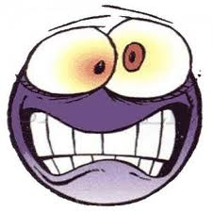
WHY DO SOME STUDENTS (AND SOME TEACHERS) GROAN WHEN THEY HEAR THE WORD “POETRY”?
Hidden meanings
Metaphor, simile, oh no!
Rhymes
Weird words

Slide 3
WHY USE POETRY…
OFFERS BRIEF READINGS
GIVES HISTORICAL ERA A HUMAN FACE
ENCOURAGES ACTIVE PARTICIPATION FROM STUDENTS
APPLIES WELL TO SMALL-GROUP WORK
PROVIDES SMOOTH INTRODUCTIONS TO CLASS
PROVIDES SOLID CONCLUSION (AKA CLOSURE)

Slide 4
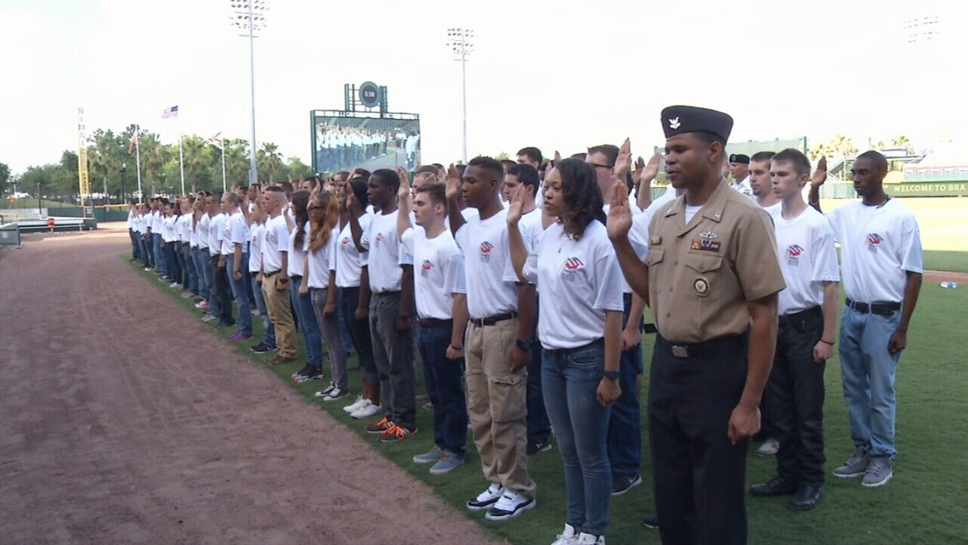
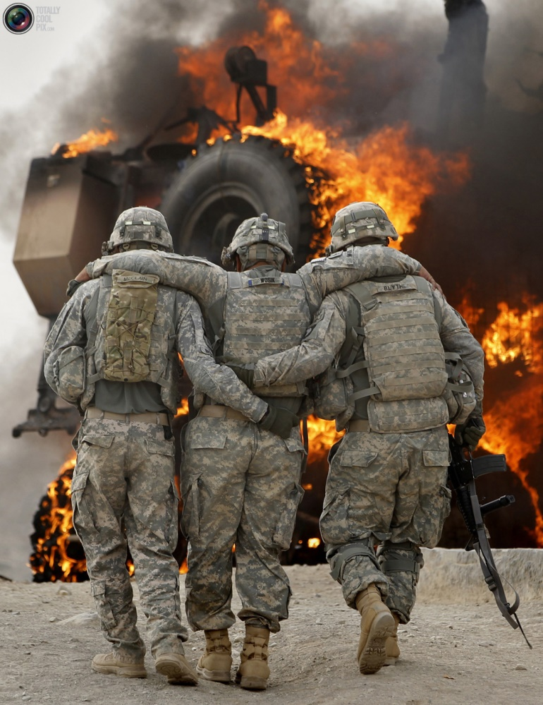
WHY DO YOUNG MEN (AND WOMEN) ENLIST IN THE SERVICE WHEN THEIR COUNTRY IS AT WAR?

Slide 5
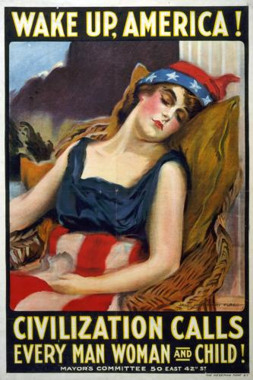

Slide 6
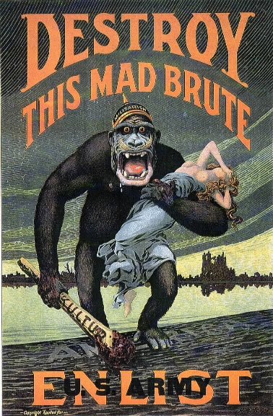
Notes:
German: Work for Victory, Just like we Fight for it!

Slide 7
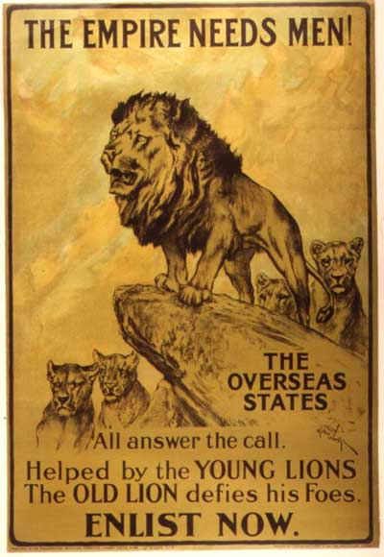

Slide 8
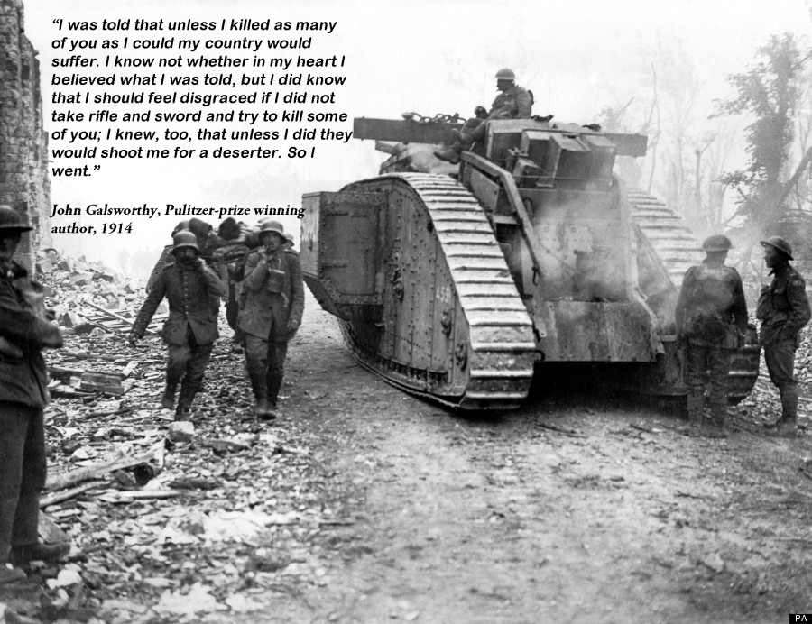

Slide 9
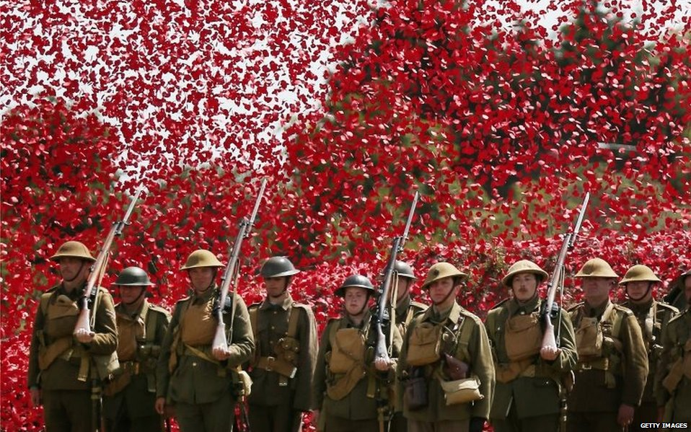

Slide 10
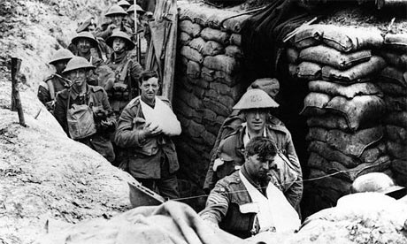
“The first world war was the first time war was seen and understood by writers, by a whole generation of them, who didn't see it remotely, through chivalrously tinted lenses but in the mud and the blood and the shrapnel.”

Slide 11
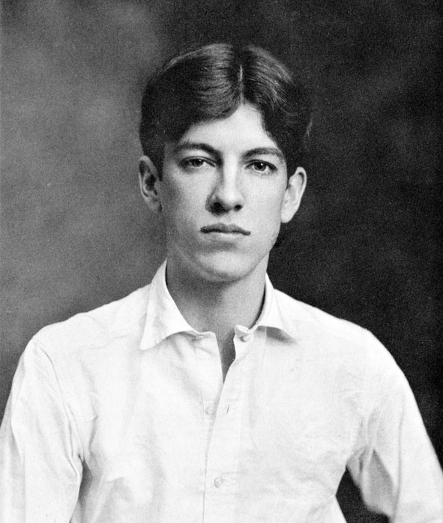
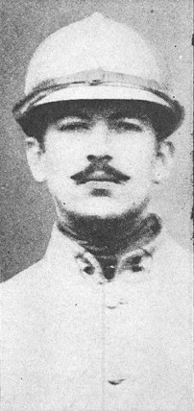
Alan Seeger

Slide 12
I have a Rendezvous with Death by Alan Seeger
I have a rendezvous with Death
At some disputed barricade.
When Spring comes back with rustling shade
And apple-blossoms fill the air—
I have a rendezvous with Death
When Spring brings back blue days and fair.

Slide 13
Rupert Brooke

Slide 14
The Soldier
If I should die, think only this of me: That there's some corner of a foreign field That is for ever England. There shall be In that rich earth a richer dust concealed; A dust whom England bore, shaped, made aware, Gave, once, her flowers to love, her ways to roam, A body of England's, breathing English air, Washed by the rivers, blest by suns of home.

Slide 16
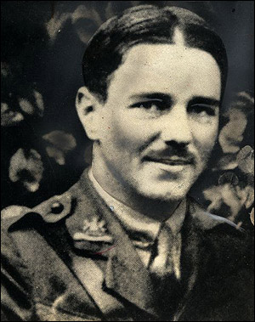
Wilfred Owen

Slide 17
Dulce Et Decorum Est
Bent double, like old beggars under sacks,
Knock-kneed, coughing like hags, we cursed through sludge,
Till on the haunting flares we turned our backs
And towards our distant rest began to trudge.
Men marched asleep. Many had lost their boots
But limped on, blood-shod. All went lame; all blind;
Drunk with fatigue; deaf even to the hoots
Of tired, outstripped Five-Nines¹ that dropped behind

Slide 18
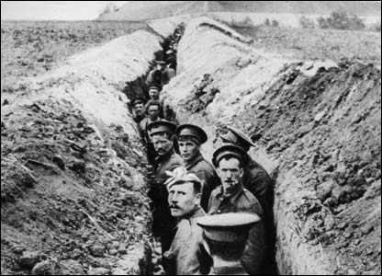

Slide 19
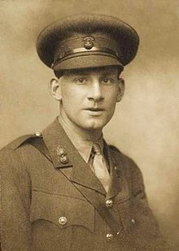
Siegfried Sassoon

Slide 20
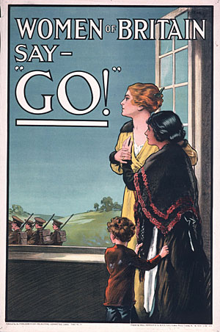
The Hero
“Jack fell as he’d have wished,” the Mother said,
And folded up the letter that she’d read.
“The Colonel writes so nicely.” Something broke
In the tired voice that quavered to a choke.
She half looked up. “We mothers are so proud
Of our dead soldiers.” Then her face was bowed.

Slide 21
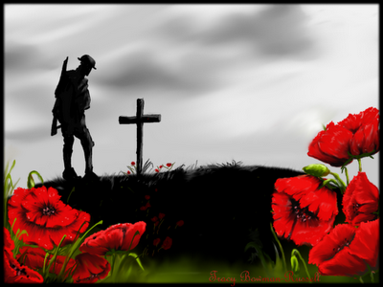

Slide 22
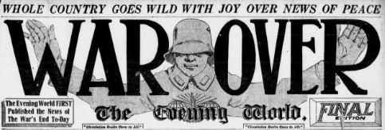
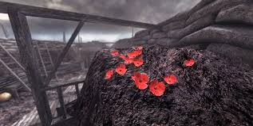

Slide 23
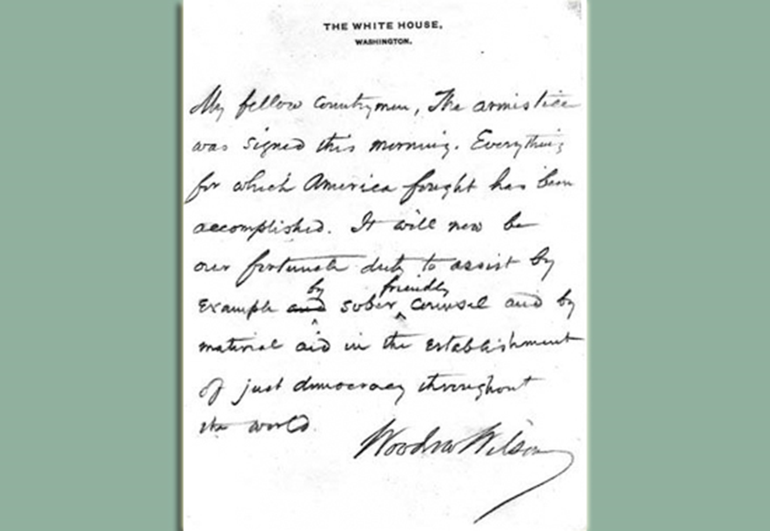

Slide 24
Common Core Standards
Analyze how a text uses structure to emphasize key points or to advance an explanation or analysis.
Analyze how Sassoon organizes “The Hero” to criticize the general public’s view of war. (Key terms you might include: point of view, dialogue, narrative)

Slide 25
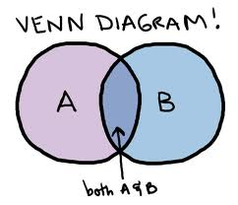
Compare the point of view of two or more authors for how they treat the same or similar topics, including which details they include and emphasize in their respective accounts.
Compare the point of view of Brooke’s “The Soldier” with Owen’s “Dulce et Decorum est.”
Or: Seeger’s “I Have a Rendezvous with Death” with Owen’s “Anthem for Doomed Youth.”

Slide 26
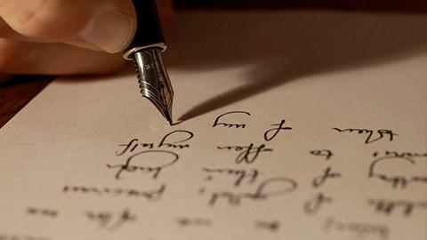
Produce clear and coherent writing in which the development, organization, and style are appropriate to task, purpose, and audience.
You are the father of a young man in 1917. Write a letter to your son encouraging or discouraging him from enlisting. Use one of the poems as part of your support

Slide 27
Photo Credits
The Poetry of WWI: lit.genius.com
Why enlist: armyties.com; totallycoolpix.com
Wake Up America: learnnc.org
Destroy Brute: commons.wikimedia.org; So wie: tw.center.net
Empire Needs Men: tumbler.com
Galbraith quote: Bettman/Corbis.Theguardian.com
Untitled: men marching with poppies, belfastTelegraph.co.uk
“The first world war…”: Bettman/Corbisthe guardian.com
Alan Seeger: commons.wikimedia.org; wikipedia.org
Rupert Brooke: oucs.ox.ac/il
Untitled: news.bbc.co.uk
Wilfred Owen: telegraph.co.uk
Untitled: news.bbc.co.uk
Siegfried Sassoon: dailymail.co.uk
The Hero: centenary.llgc.org.uk
Untitled: admire.bs
War Over: admire.bs

