Slide 1
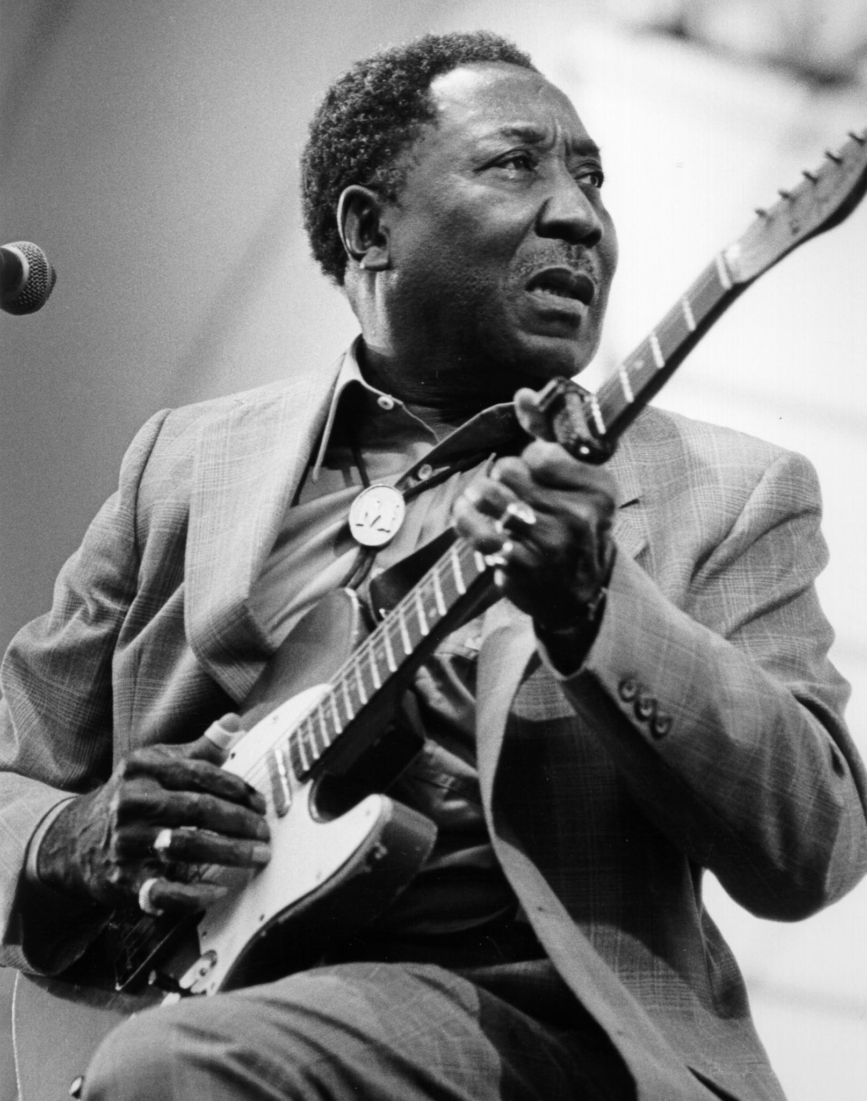
Jazz from A to Z Educator Workshop Everybody’s Got the Blues:
Migration of the Blues in Post-World War II United States and United Kingdom

Slide 2
Jazz from A to Z Educator Workshop
Goals and Outcomes
Goal-
Support humanities education through the inter-disciplinary study of history, literature, music, and art.
Outcome-
Teachers will compose lesson plans integrating Jazz from A to Z content, resources and strategies that elevate students’ cultural knowledge and historical thinking skills in American/World history classes by March 15, 2015.
http://jazzfromatoz.mesaartscenter.com/

Slide 3
Jazz from A to Z Educator Workshop Objectives
:
Explain the push and pull factors of the Second Great Migration.
Determine the scope of racial inequality in America after World War II.
Determine how racial equality remains an elusive ideal in the United States.
Develop an understanding of the historical roots and the basic elements of the blues.
Explain the relationship between the Second Great Migration and blues music.
Analyze the connection between the blues and American/British rock ‘n’ roll.

Slide 4
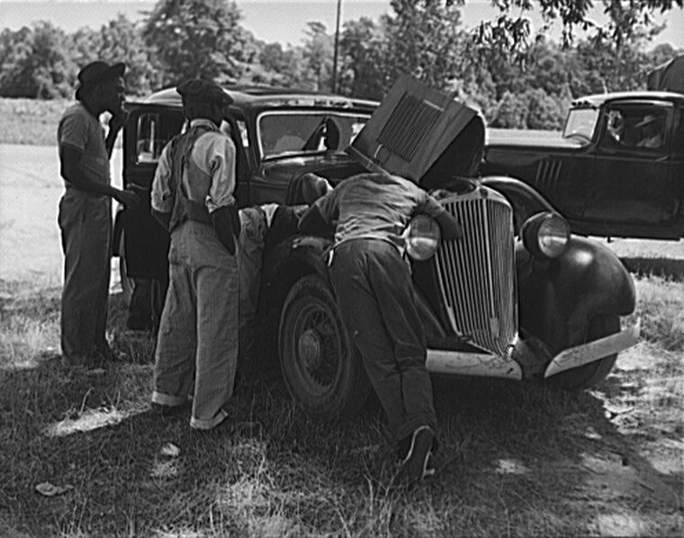
The Second Great Migration
Definition
Migration Statistics

Slide 5
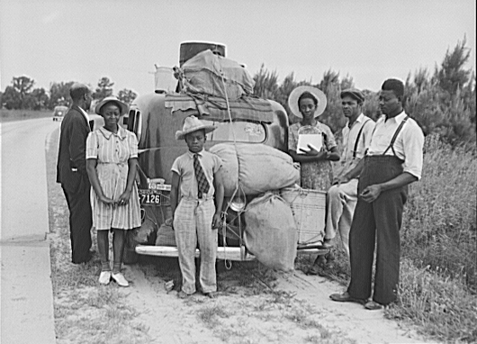
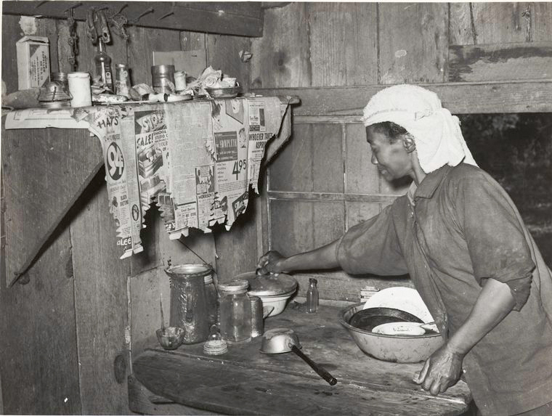
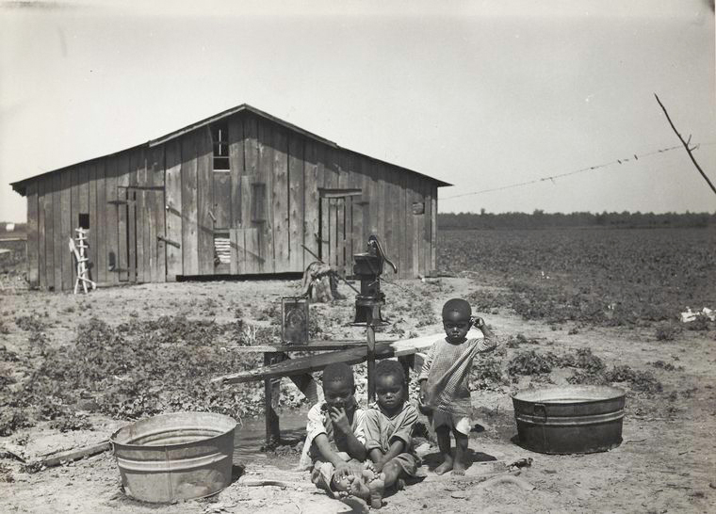
Out of the Rural South
Push Factors

Slide 6
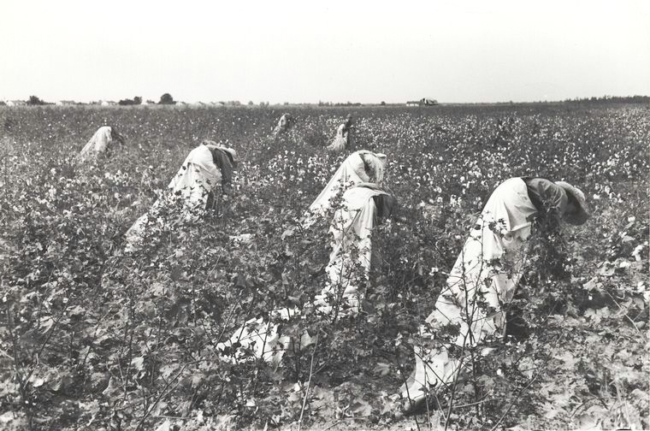
Collpase of Southern Agriculture
Increased World Production
Decline in Prices

Slide 7

Mechanized Farming
Reduced Demand for Labor
Tractors
Cotton Pickers

Slide 8
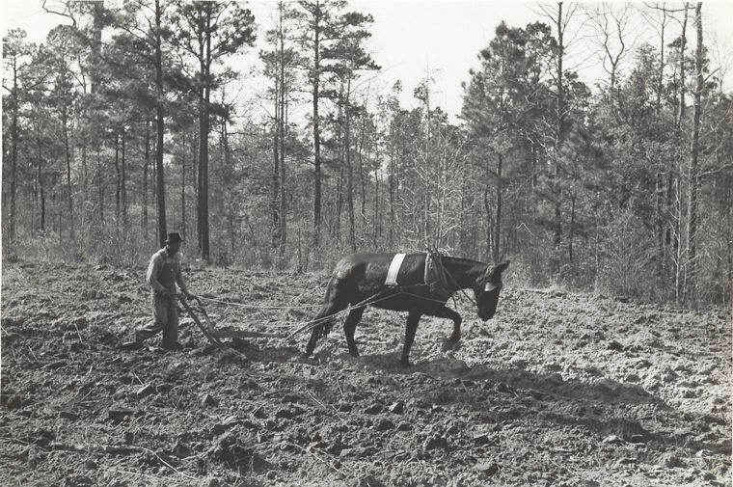
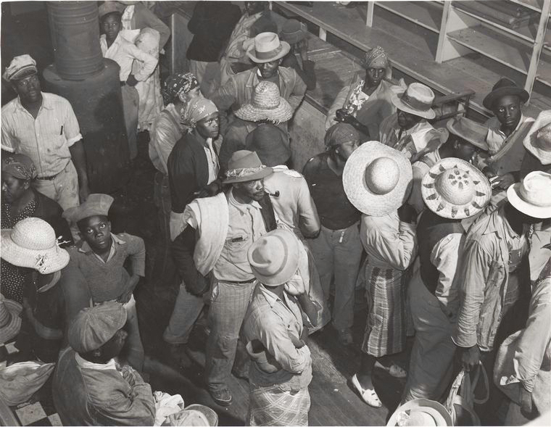
Sharecropping and the Tenant System
Credit
Company Stores

Slide 9
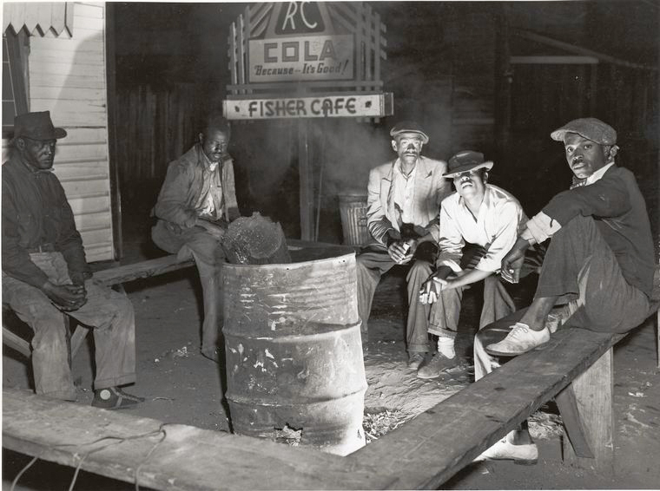
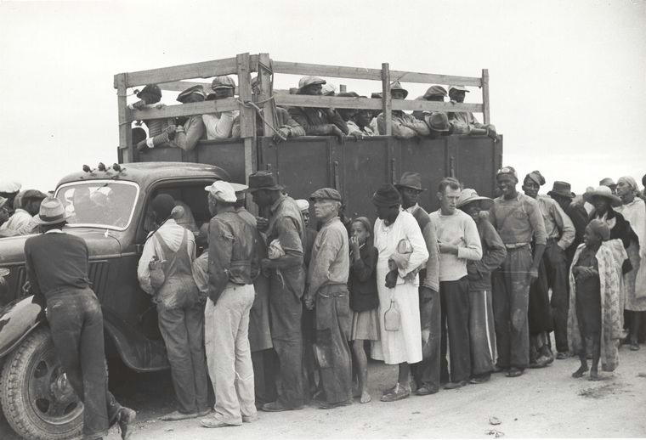
The “New” Deal

Slide 10

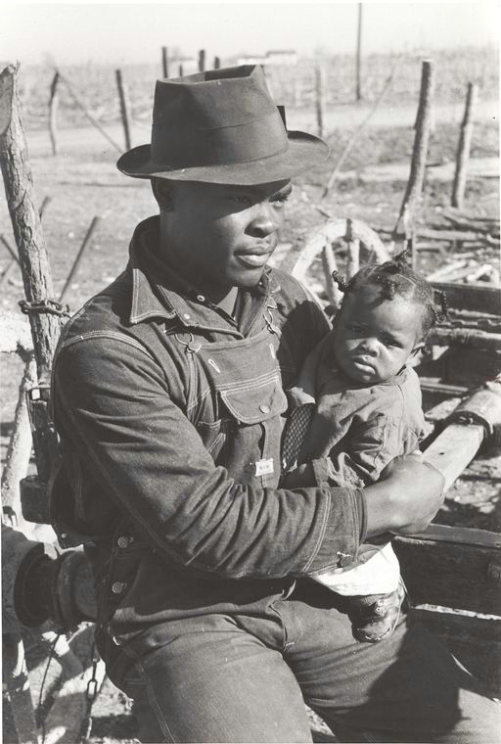
The Clarksdale List

Slide 11
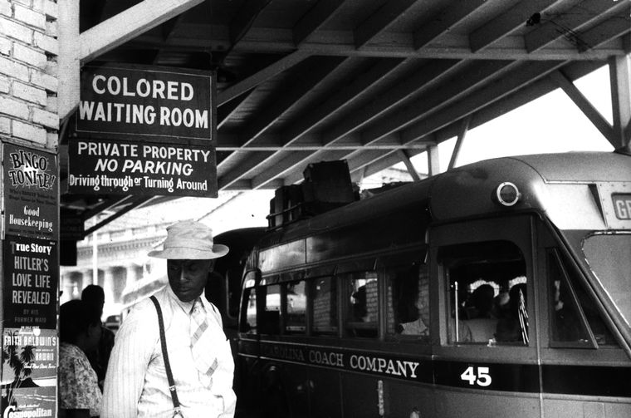
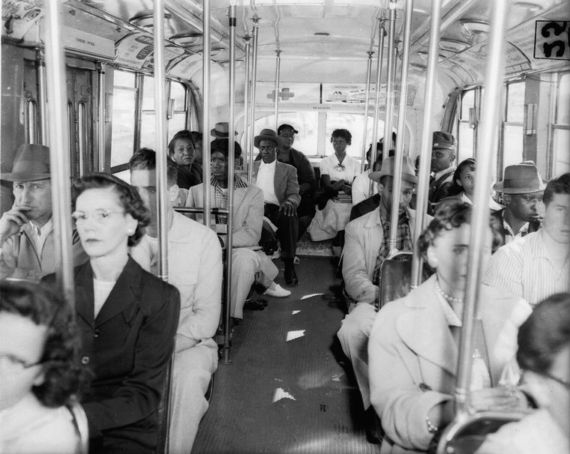
Fleeing Racism: Jim Crow

Slide 12
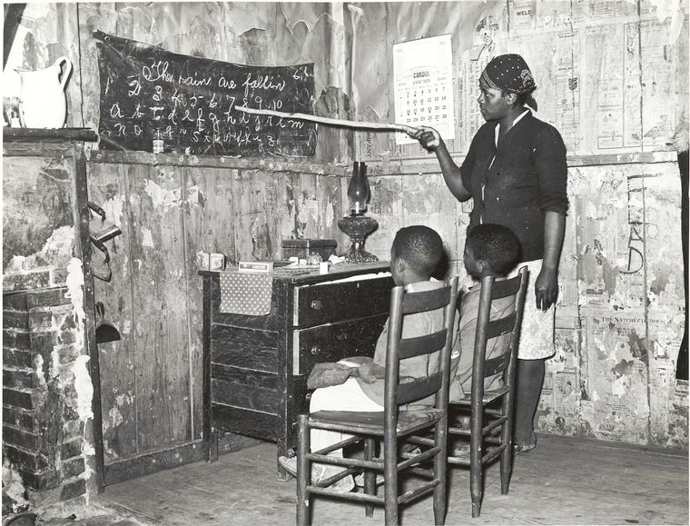
Fleeing Racism: Education

Slide 13
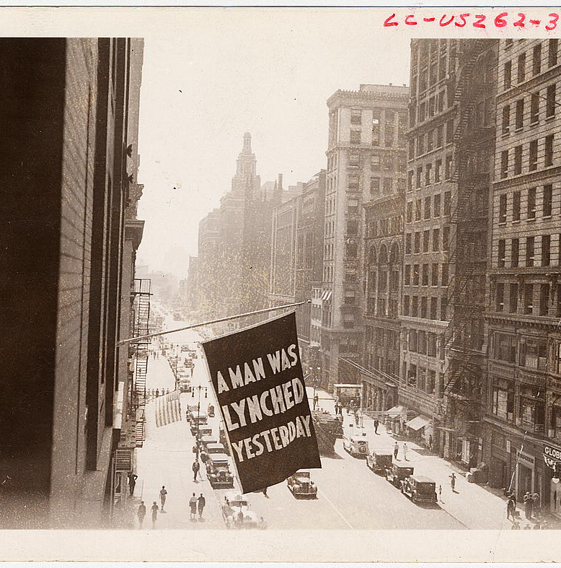
Fleeing Racism: Lynching
  African American Lynchings (1882-1962)
  Alabama- 299
  Arkansas- 226
  Florida – 257
  Georgia- 491
  Louisiana- 335
  Mississippi- 538
  North Carolina- 85
  South Carolina- 156
  Tennessee- 204
  Texas- 352

Slide 14
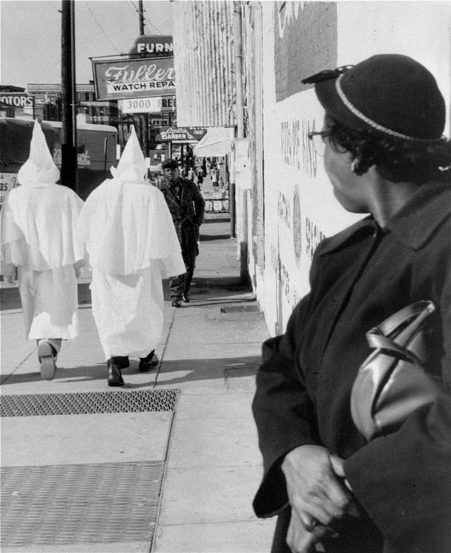
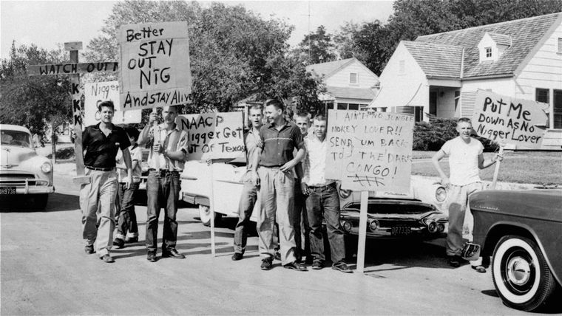
Domestic Terrorism

Slide 15

Pull Factors:
Effects of World War II

Slide 16

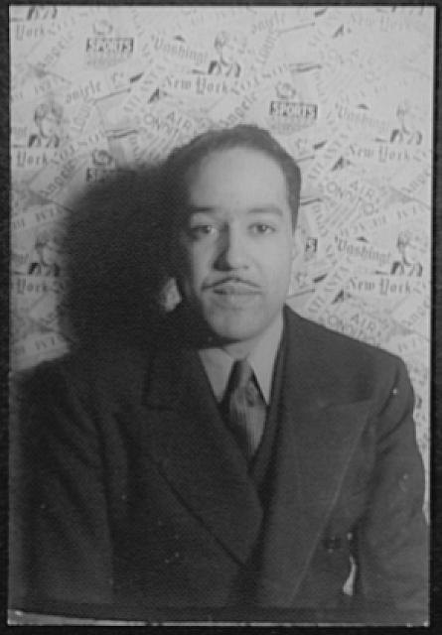
The Great Disconnect
“Mr.Prejudice”
by Horace Pippin (1943)
“Beaumont to Detroit”
By Langston Hughes (1943)

Slide 17
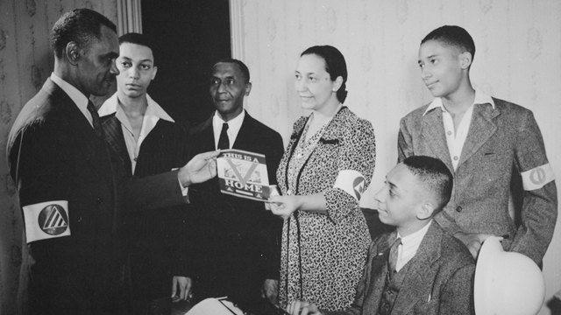
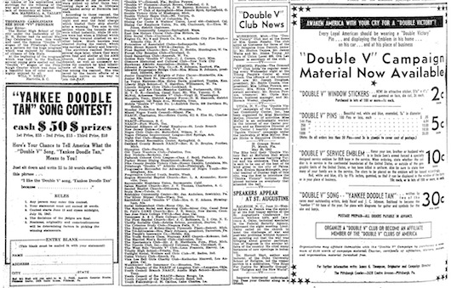
Double V Campaign

Slide 18

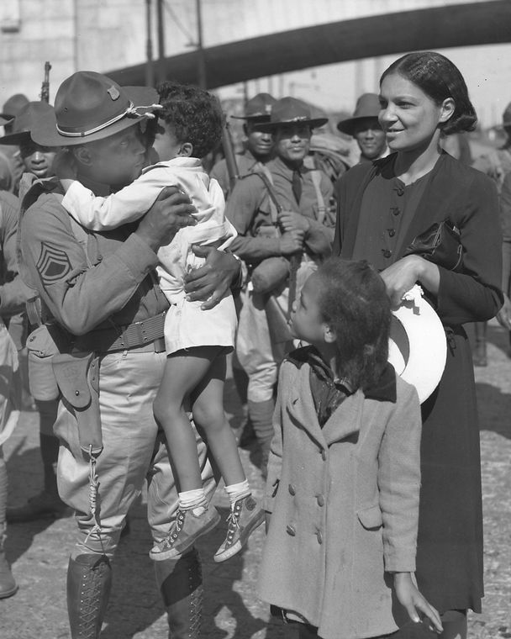
Mobilization: Armed Forces

Slide 19


Mobilization: The Economy

Slide 20
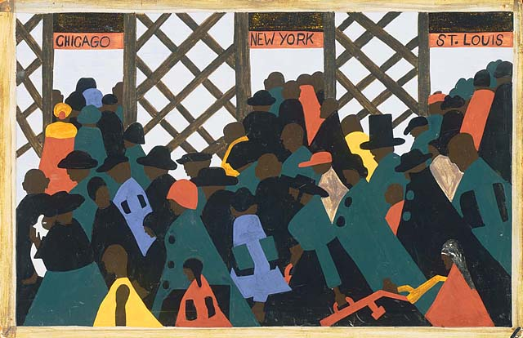
Mobilization
African American Migration

Slide 21
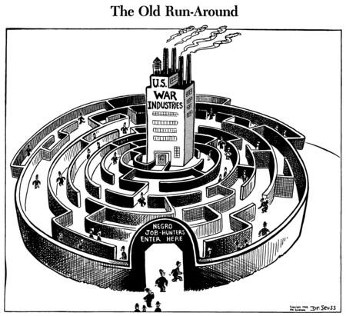
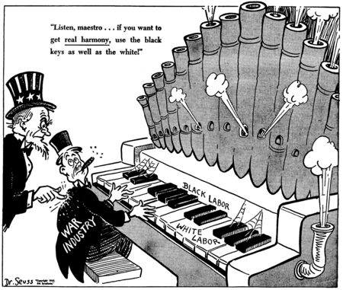
Fair Employment?

Slide 22
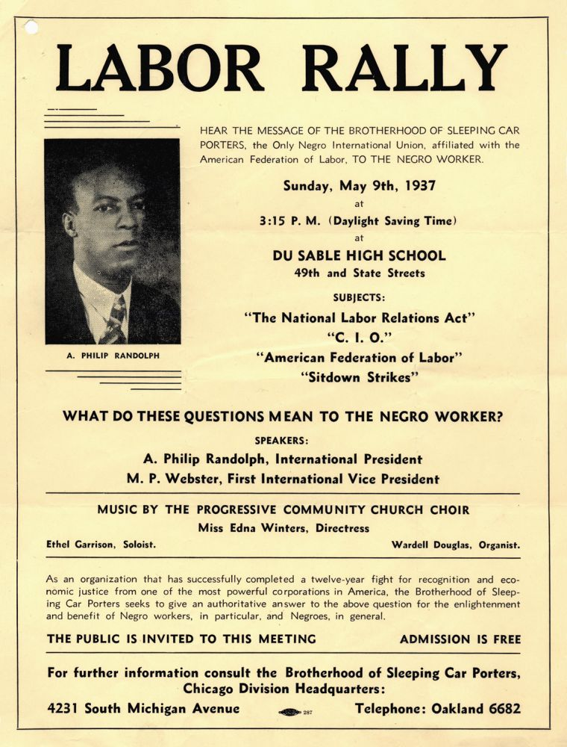
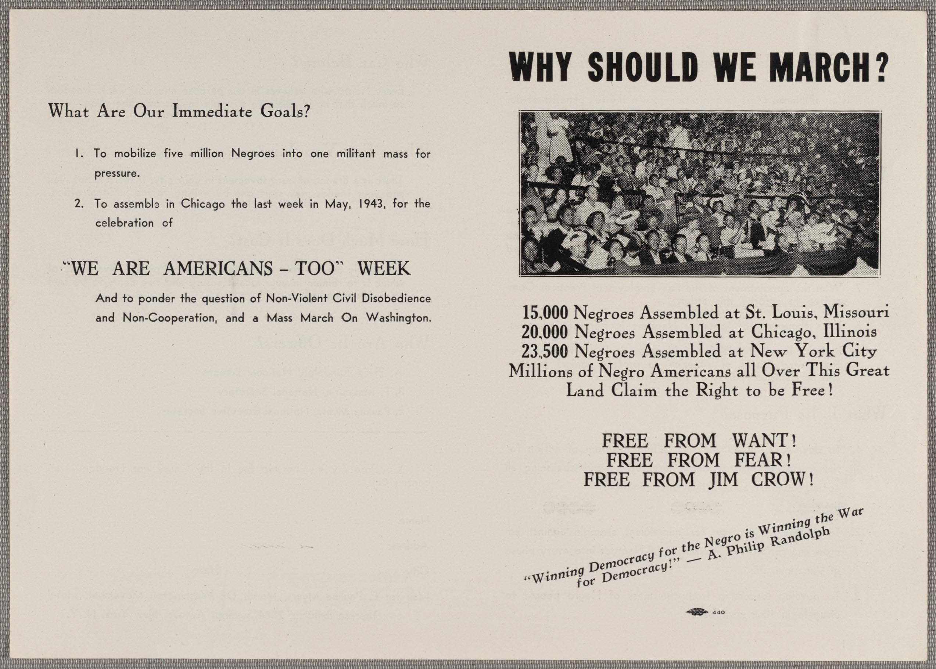
A. Philip Randolph

Slide 23

Post-War Prosperity
Indicators
Causes
  Government Spending
  Technological Progress
  Consumer Spending
  Foreign Trade

Slide 24
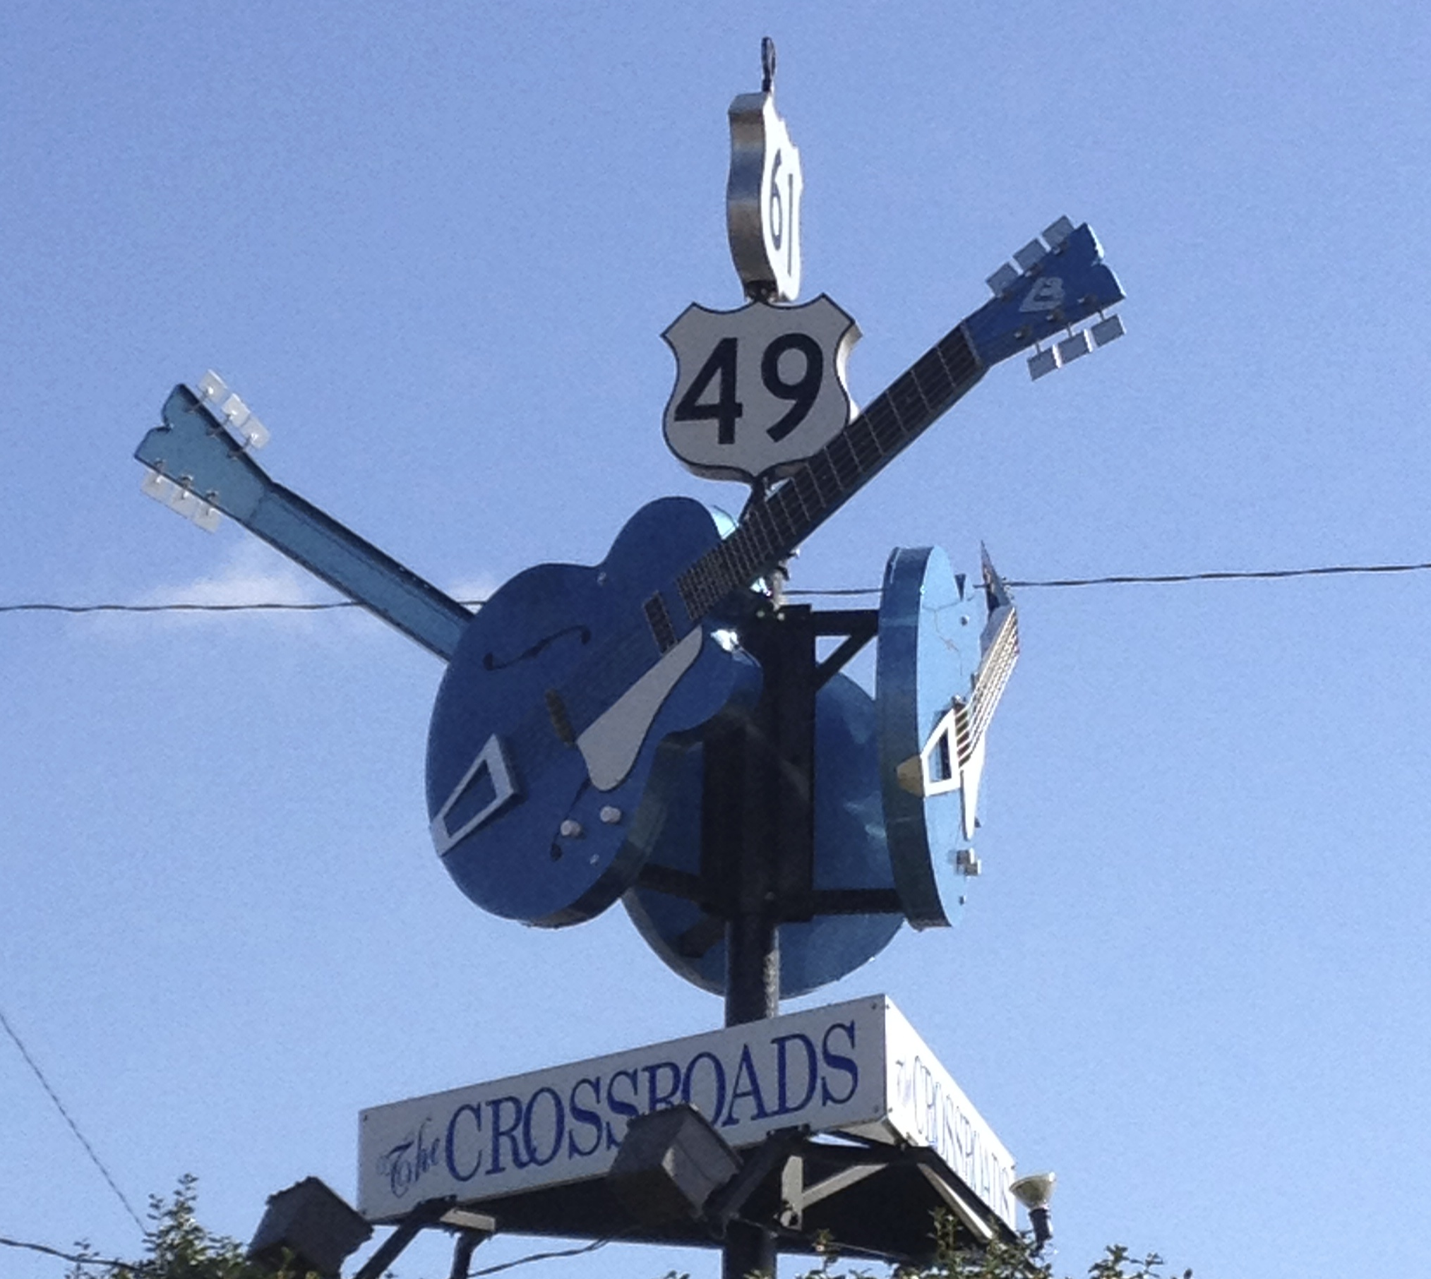

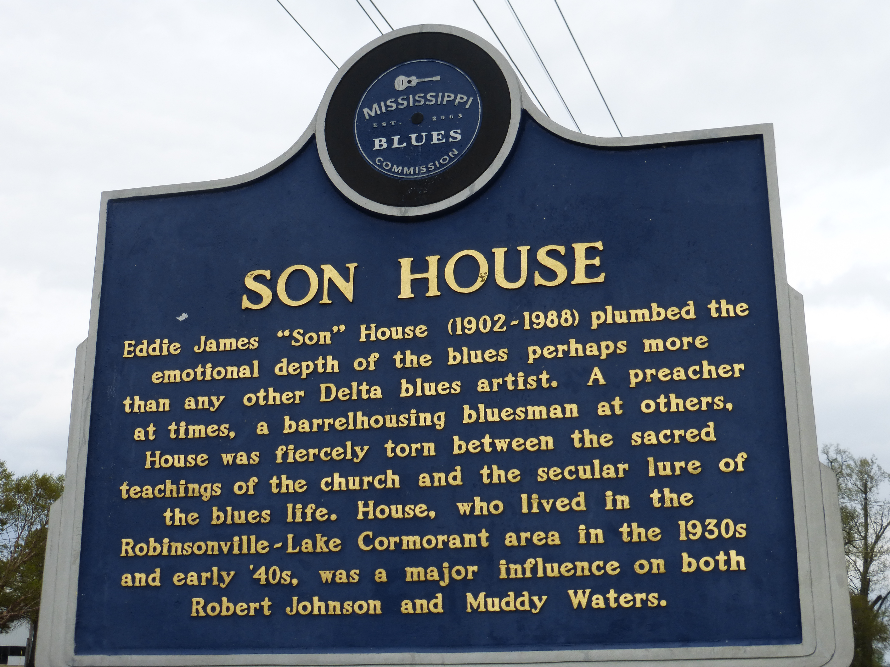
The Sound of the Delta (Rural Blues)

Slide 25
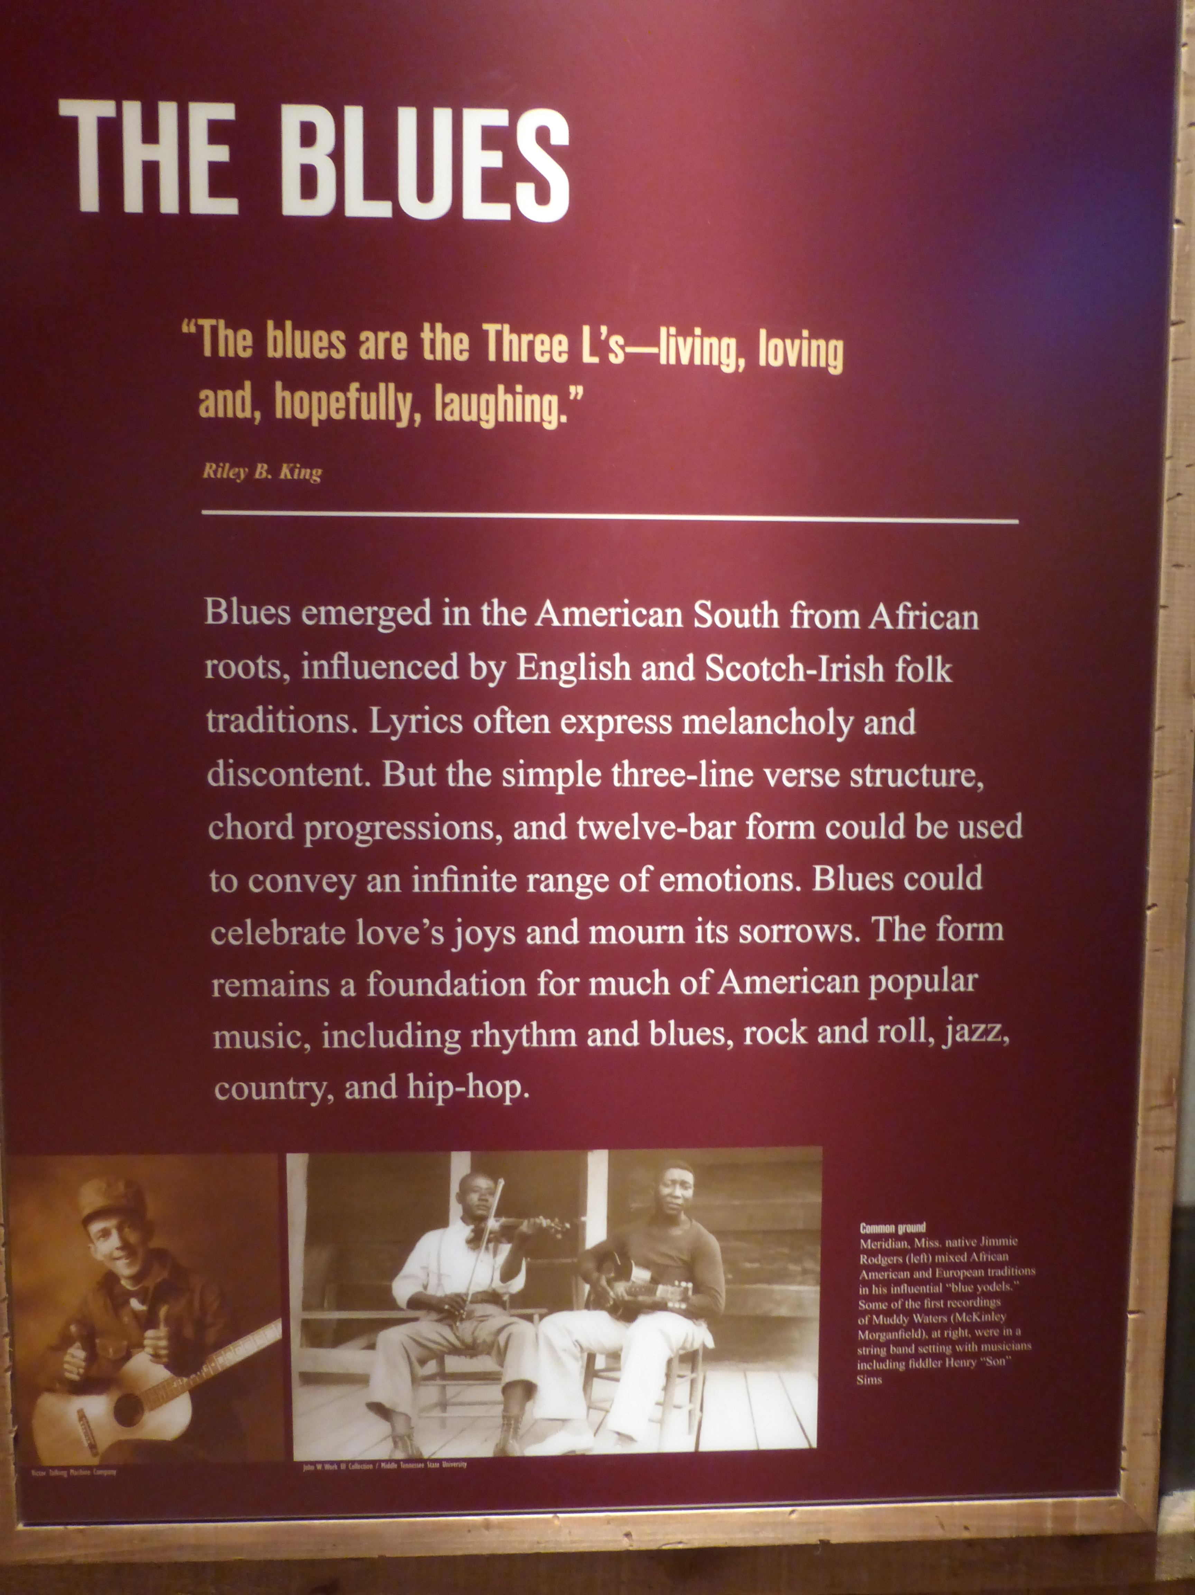
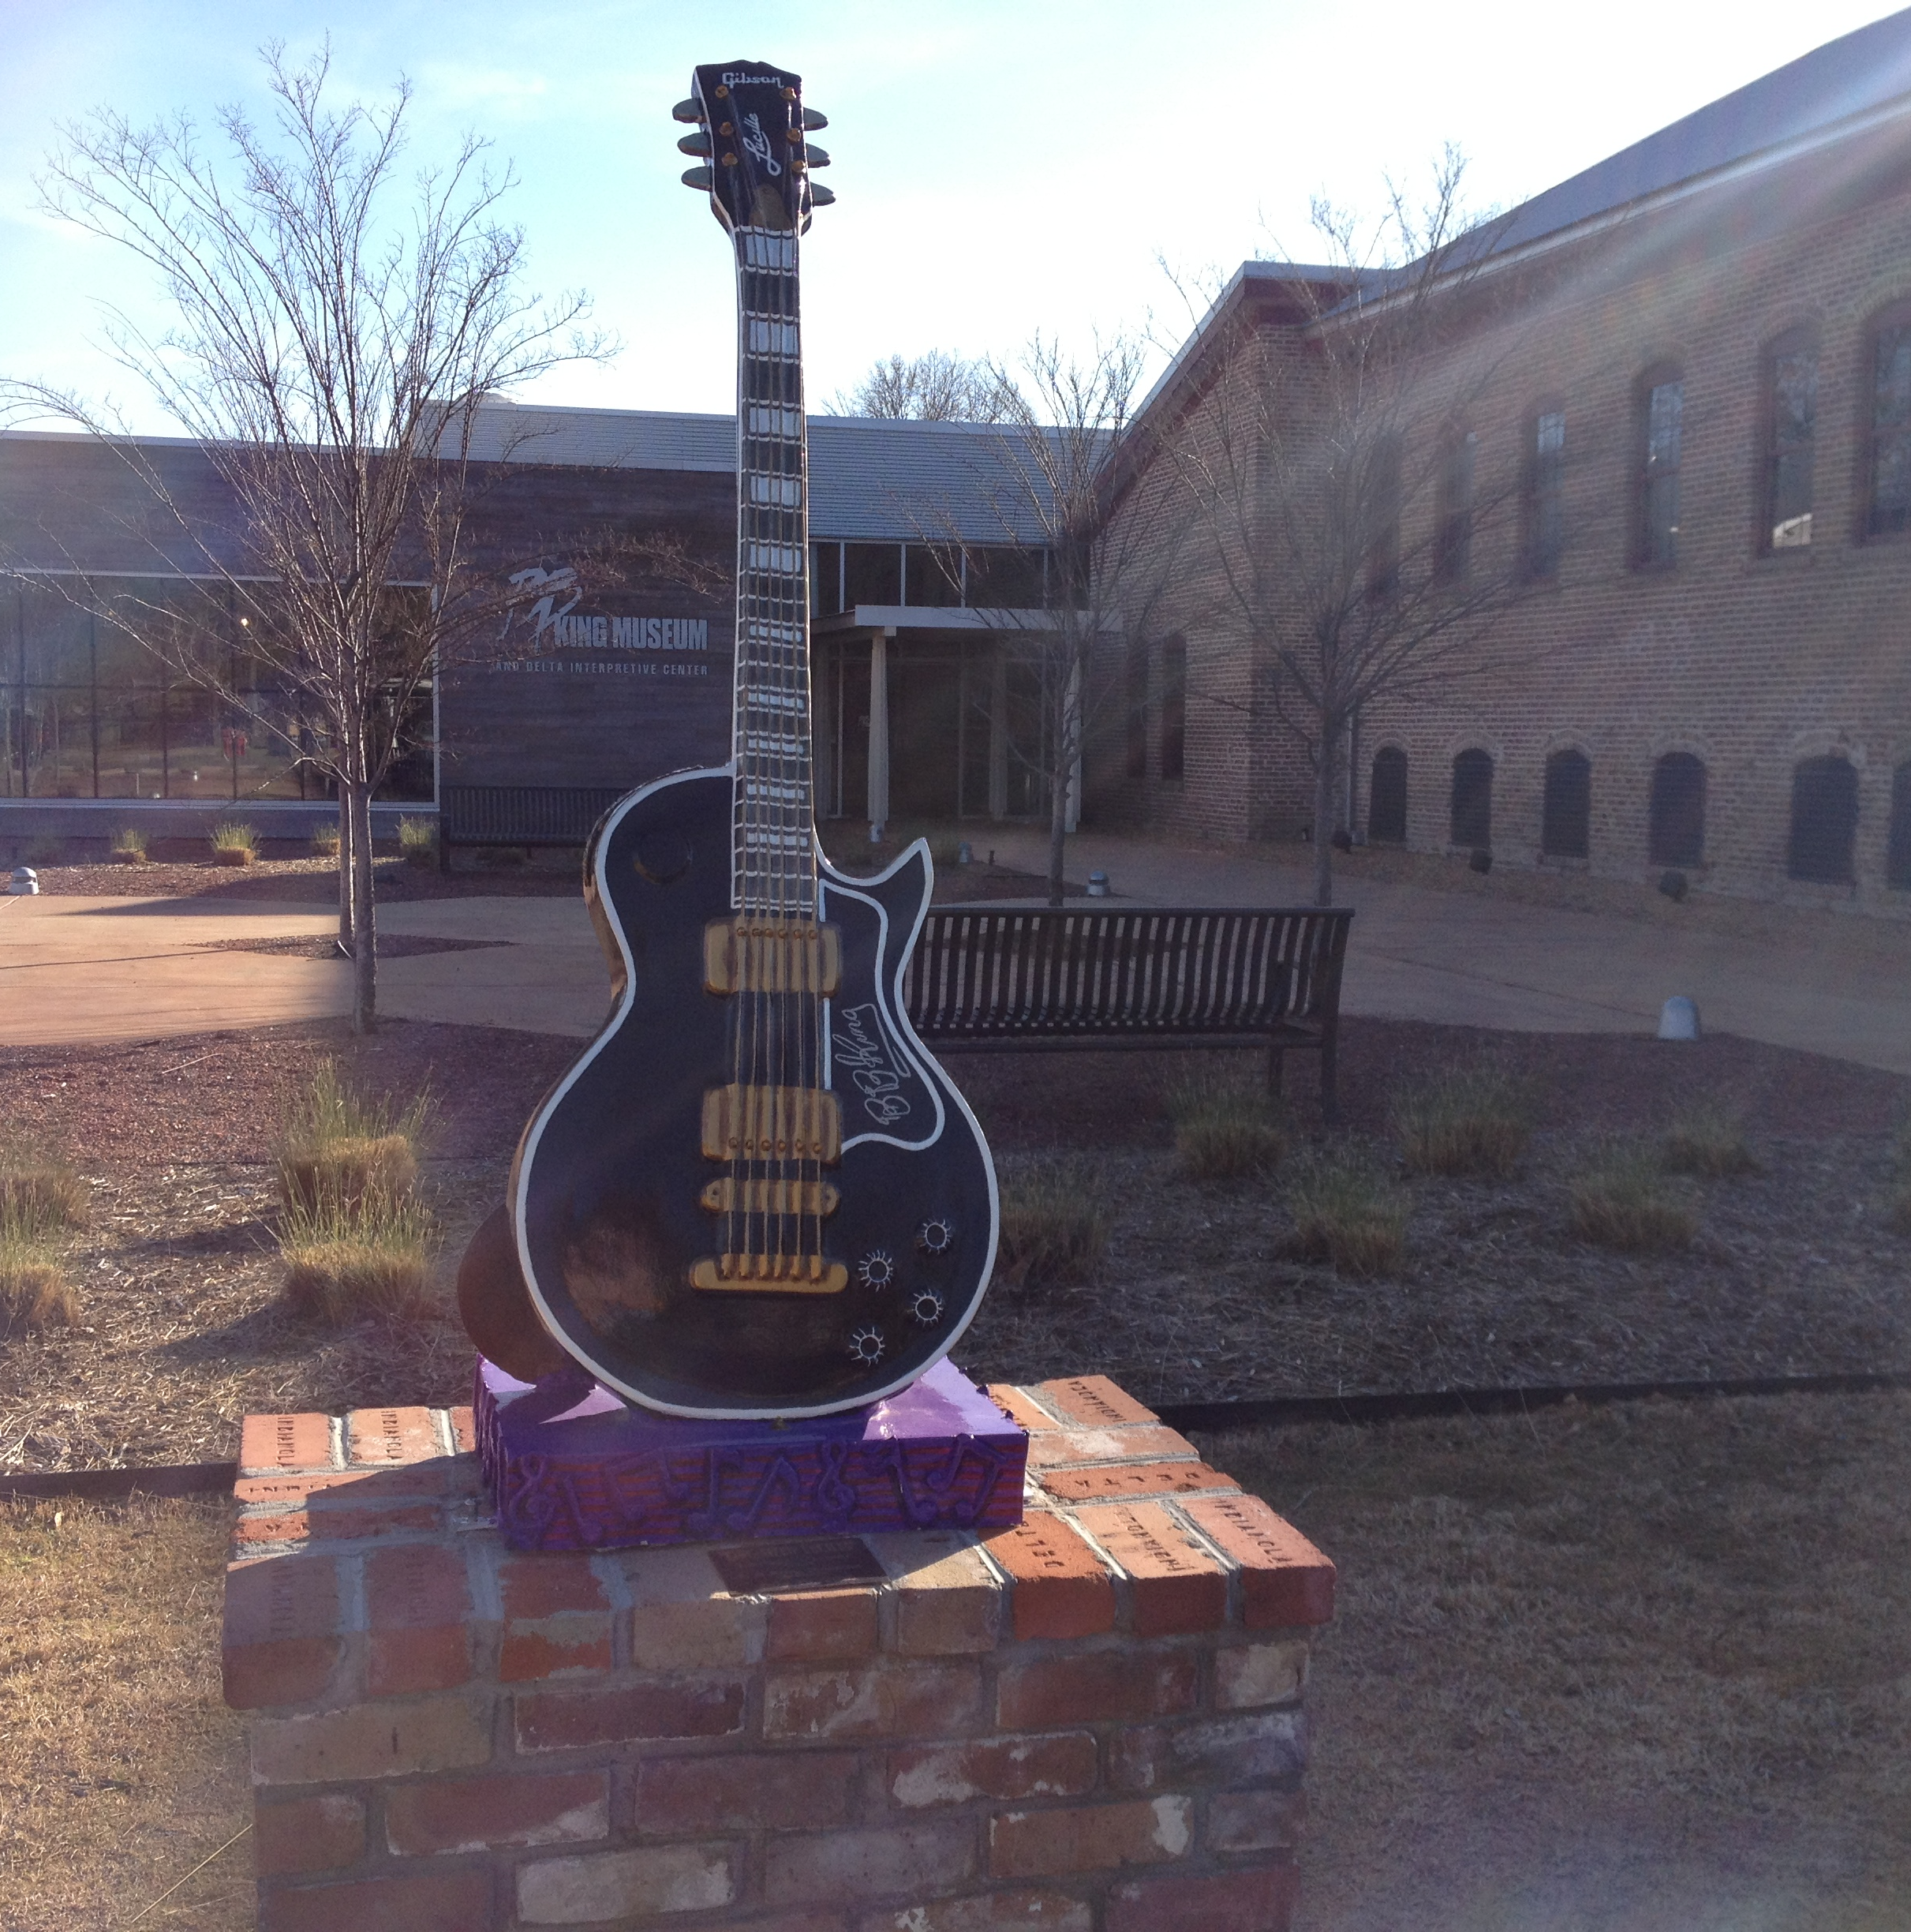
Musical Elements of the Blues

Slide 26
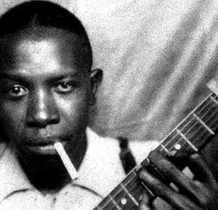
Robert Johnson
VITAL STATISTICS
Born: May 8, 1911 in Hazlehurst, Mississippi
Died: August 16, 1938 in Greenwood, Mississippi.
Nationality: U.S.
Genre: Blues
Performed as: Songwriter, Singer, Guitarist

Slide 27
Photo Credits
All photos credits for this PowerPoint can be accessed on the Jazz From A to Z content outline from the educator workshop “Everybody’s Got the Blues.”

