Slide 1
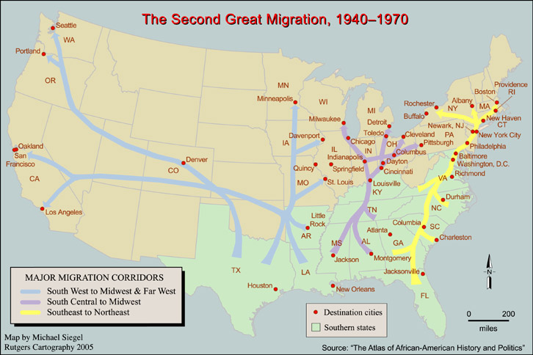
The Second Great Migration
Destinations

Slide 2
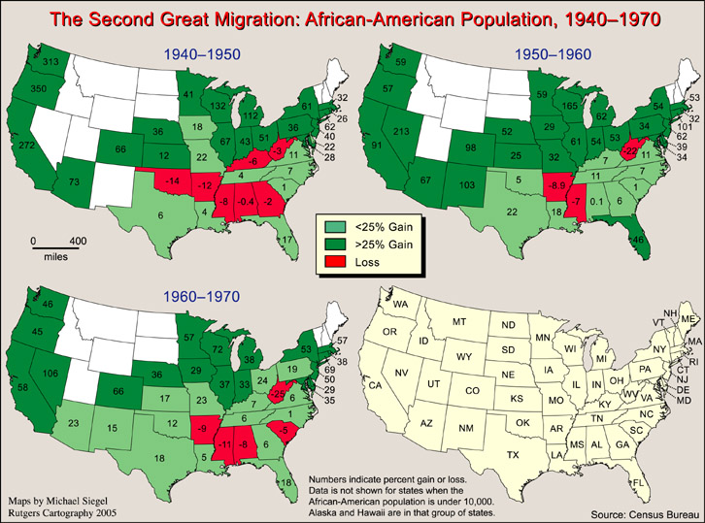
Into the North and West

Slide 3
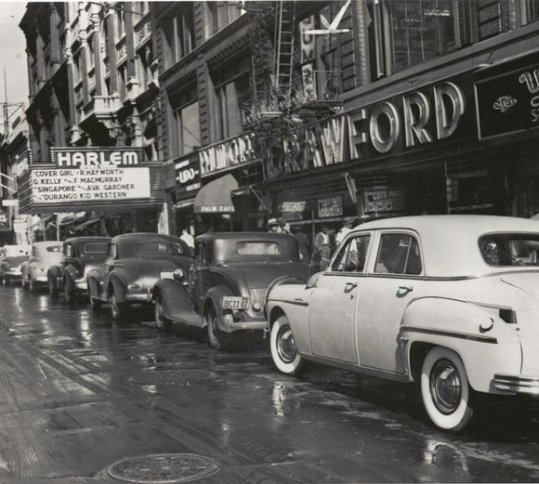
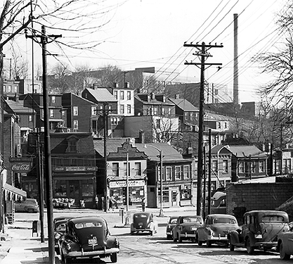
Cities
New York’s Harlem
Pittsburgh’s Hill District

Slide 4
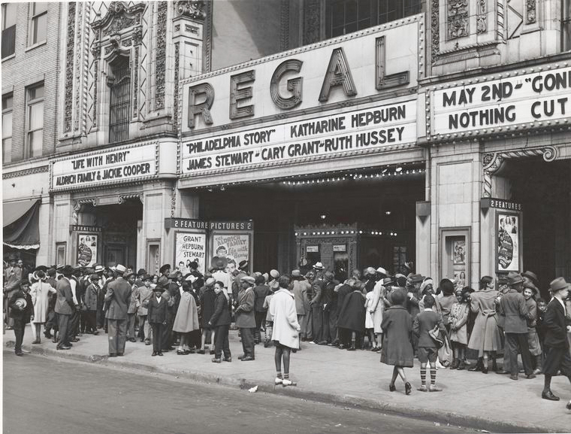
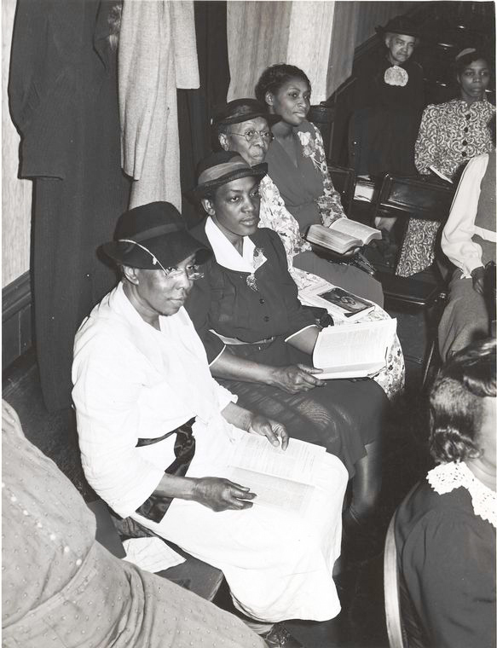
Adjustment to Urban Life
“Bright Lights, Big City”
“Storefront Church”

Slide 5
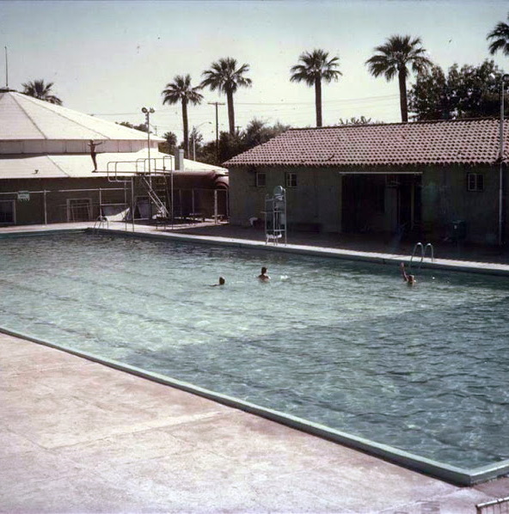
Issues Facing Migrants: Discrimination in Public Accommodations
“Mr. Jarvis reported that the Mexican and Negro problem was getting out of hand and some definite action should be taken in order to give the Caretaker the proper authority to handle the situation.”
Mesa Parks and Playground Board Meeting, July 9, 1940

Slide 6
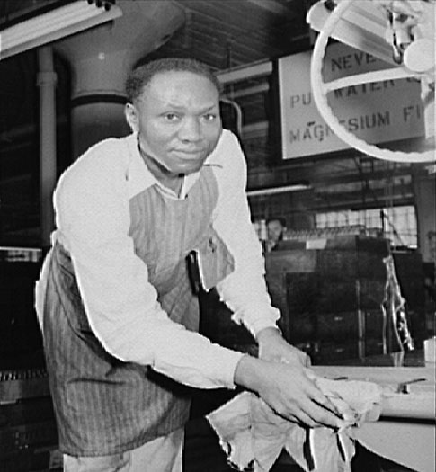
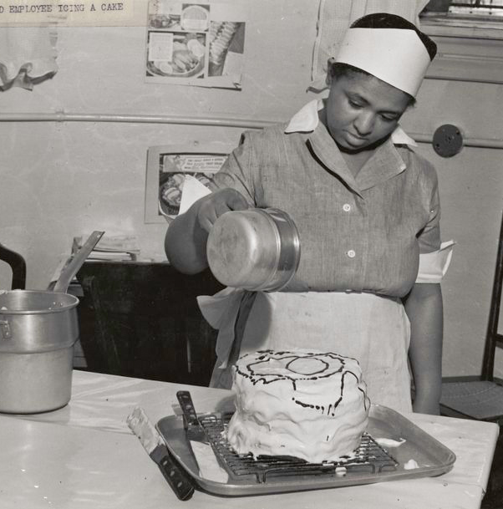
Issues Facing Migrants:
Employment Discrimination

Slide 7
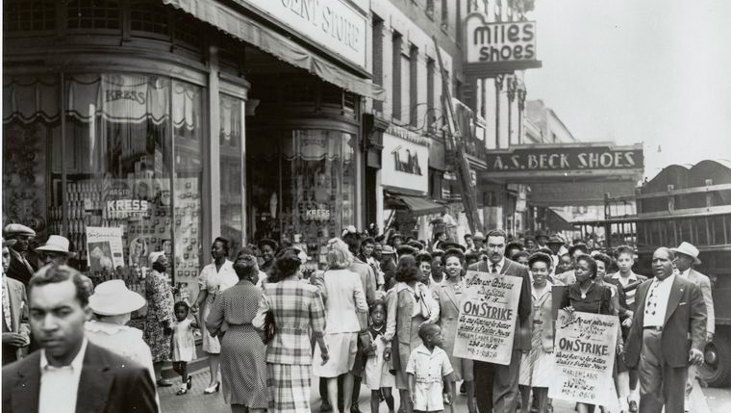
Fair Employment

Slide 8
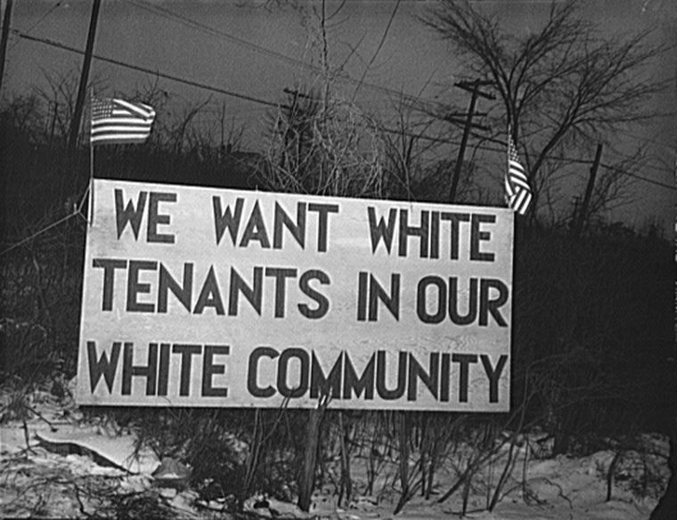
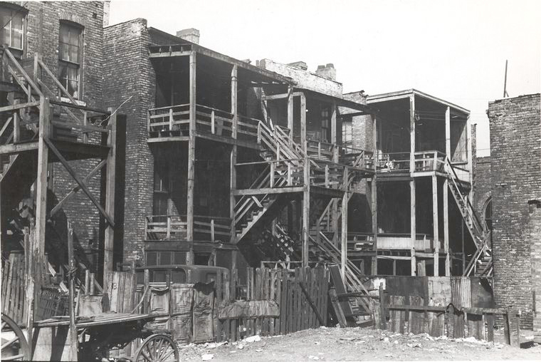
Issues Facing Migrants:
Housing Discrimination
Detroit
Chicago

Slide 9
Means of Housing Discrimination
Redlining
Housing/Restrictive Covenants
Public Housing Projects
Realtors’ Code of Ethics
Block Associations
Terrorism
“White Flight”

Slide 10
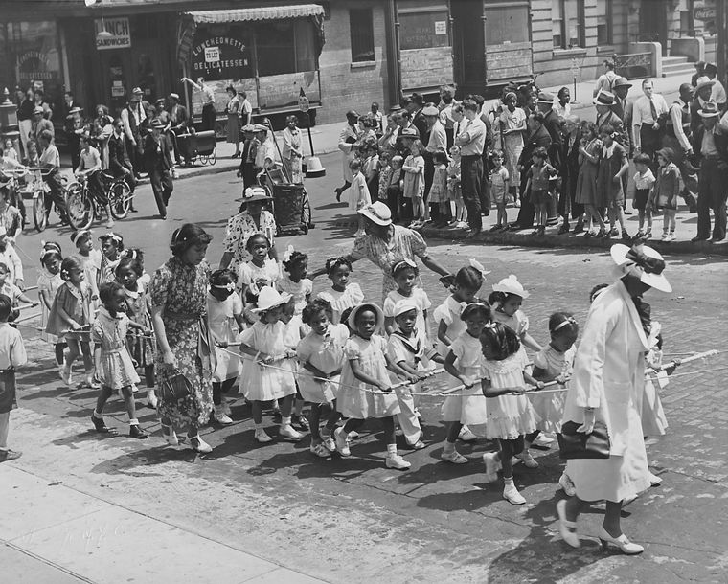
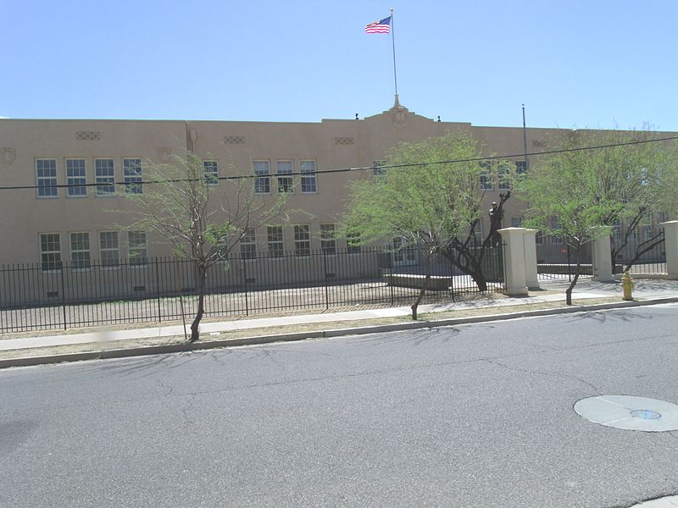
Issues Facing Migrants:
Segregated Schools
Harlem Children
George Washington Carver High School- Phoenix

Slide 11
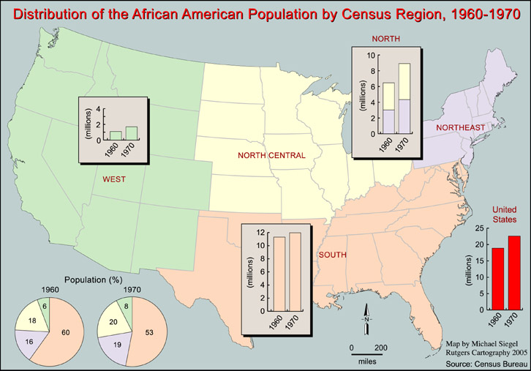
Impact of the Migration

Slide 12
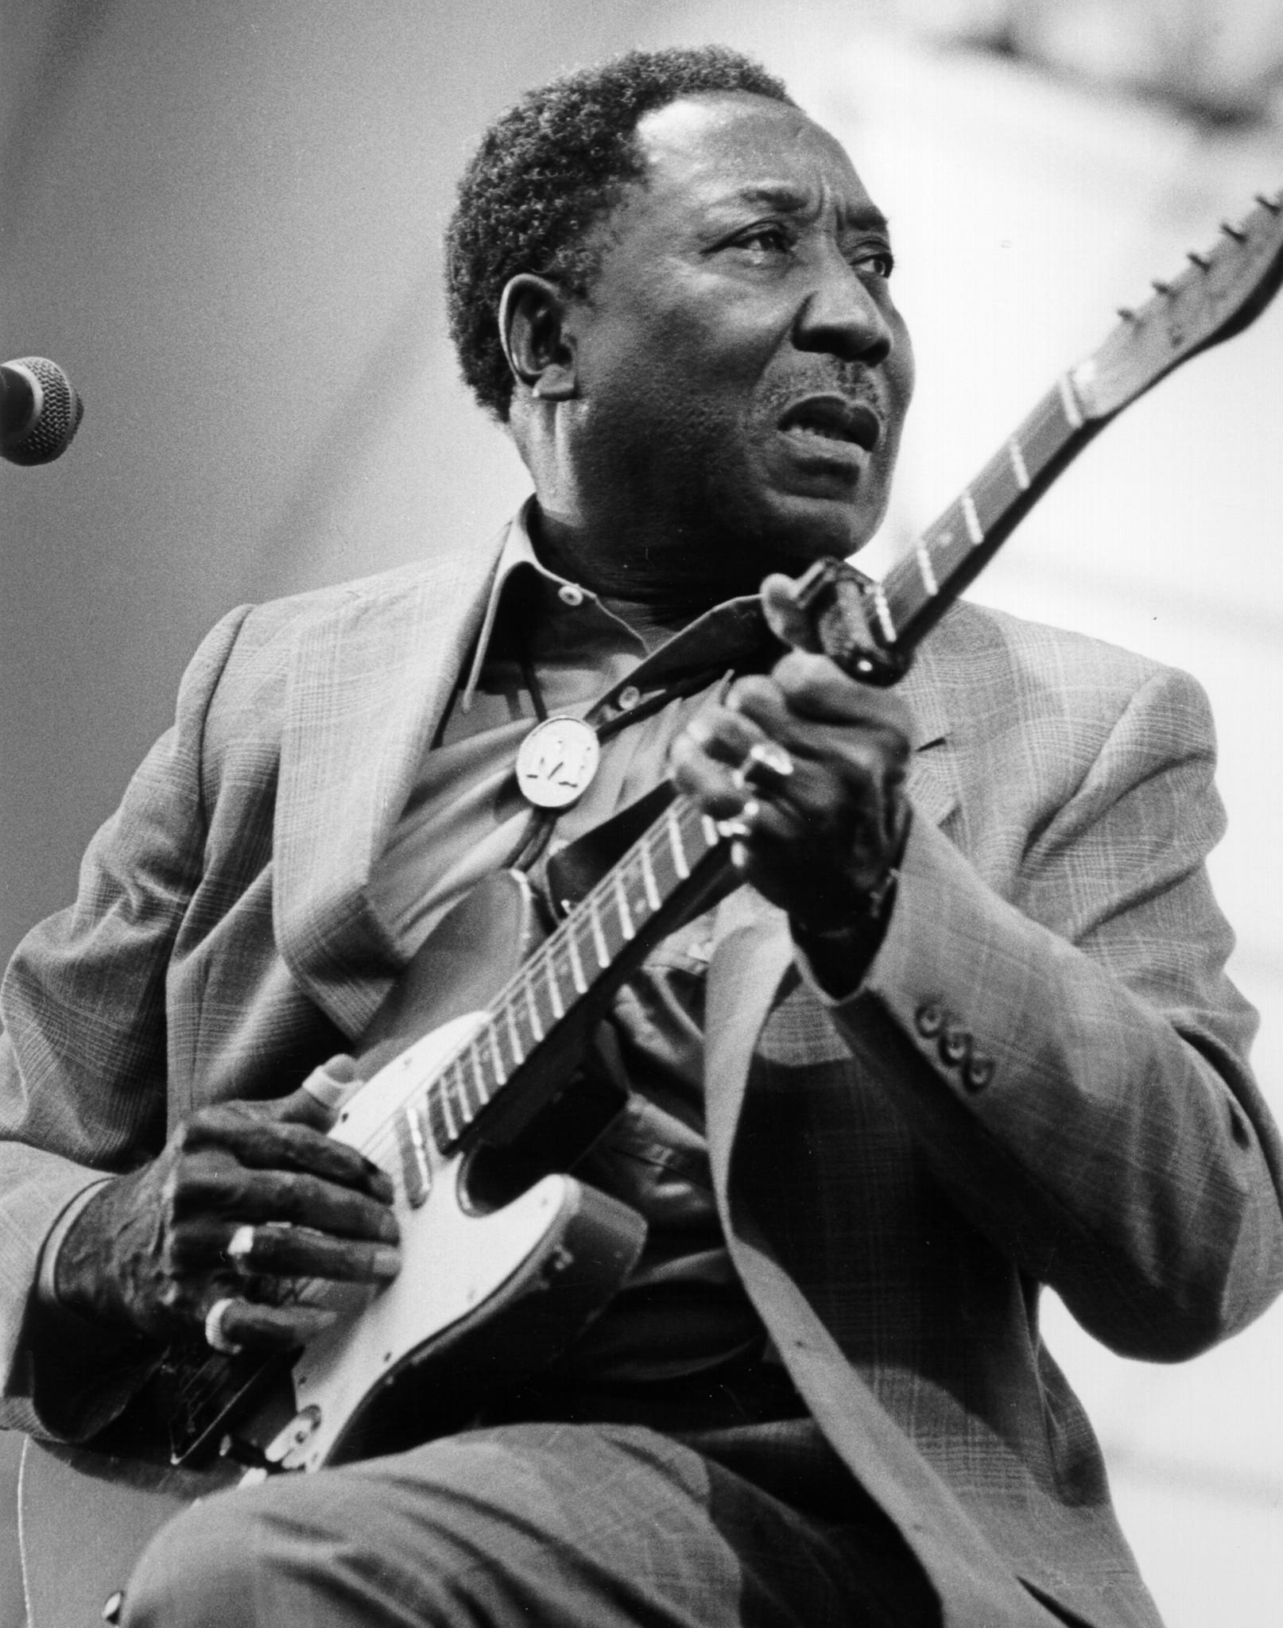
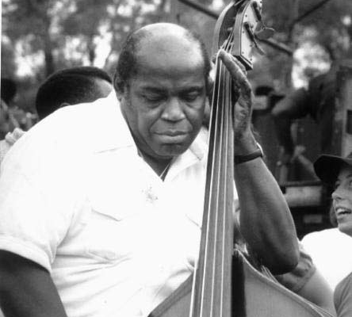
Impact of the Migration:
Cultural Diffusion> Urban Blues
Muddy Waters
Willie Dixon

Slide 13
Muddy Waters
VITAL STATISTICS
Born: April 4, 1915 in Rolling Fork, Mississippi
Joined: the Silas Green Tent Show and began to travel in 1941
Recorded: first to be recorded by Alan Lomax
Moved: to Chicago in 1943 and began performing in clubs
Career Takes Off: In 1950 Aristocrat Records became Chess Records and Waters career took off
Died: April 30, 1983, in Downers Grove, Illinois
Nationality: U.S.
Genre: Blues
Performed as: singer and guitarist
During the performer's lifetime: Mr. Waters was the A & R of Chess Records along with Willie Dixon-bass/ composer, Otis Spann-piano, Little Water-harmonica, Jimmy Rogers-guitar and Elgin Evans-drums. Hits like "I'm Your Hoochie Coochie Man" and "Rollin' Stone" made him an iconic Chicago blues man. Muddy won 6 Grammys.

Slide 14
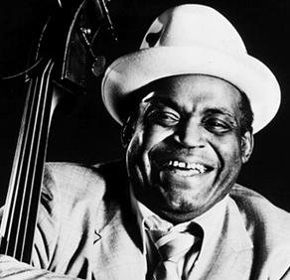
Willie Dixon
VITAL STATISTICS
Born: July 1, 1915 in Vicksburg, Mississippi, William James Dixon (Willie)
Died: January 29, 1992 in Burbank, California
Moved: to Chicago in 1936
Nationality: U.S.
Genre: Blues
Performed as: Producer, Songwriter, Singer, Bassist

Slide 15
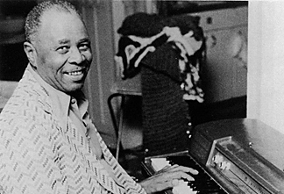
Sunnyland Slim
VITAL STATISTICS
Born: September 05, 1907 in Vance, Mississippi
Died: March 17, 1995 in Chicago, Illinois
Moved: to Chicago, IL in 1942
Nationality: U.S.
Genre: Blues
Performed as: pianist, organist and vocalist

Slide 16
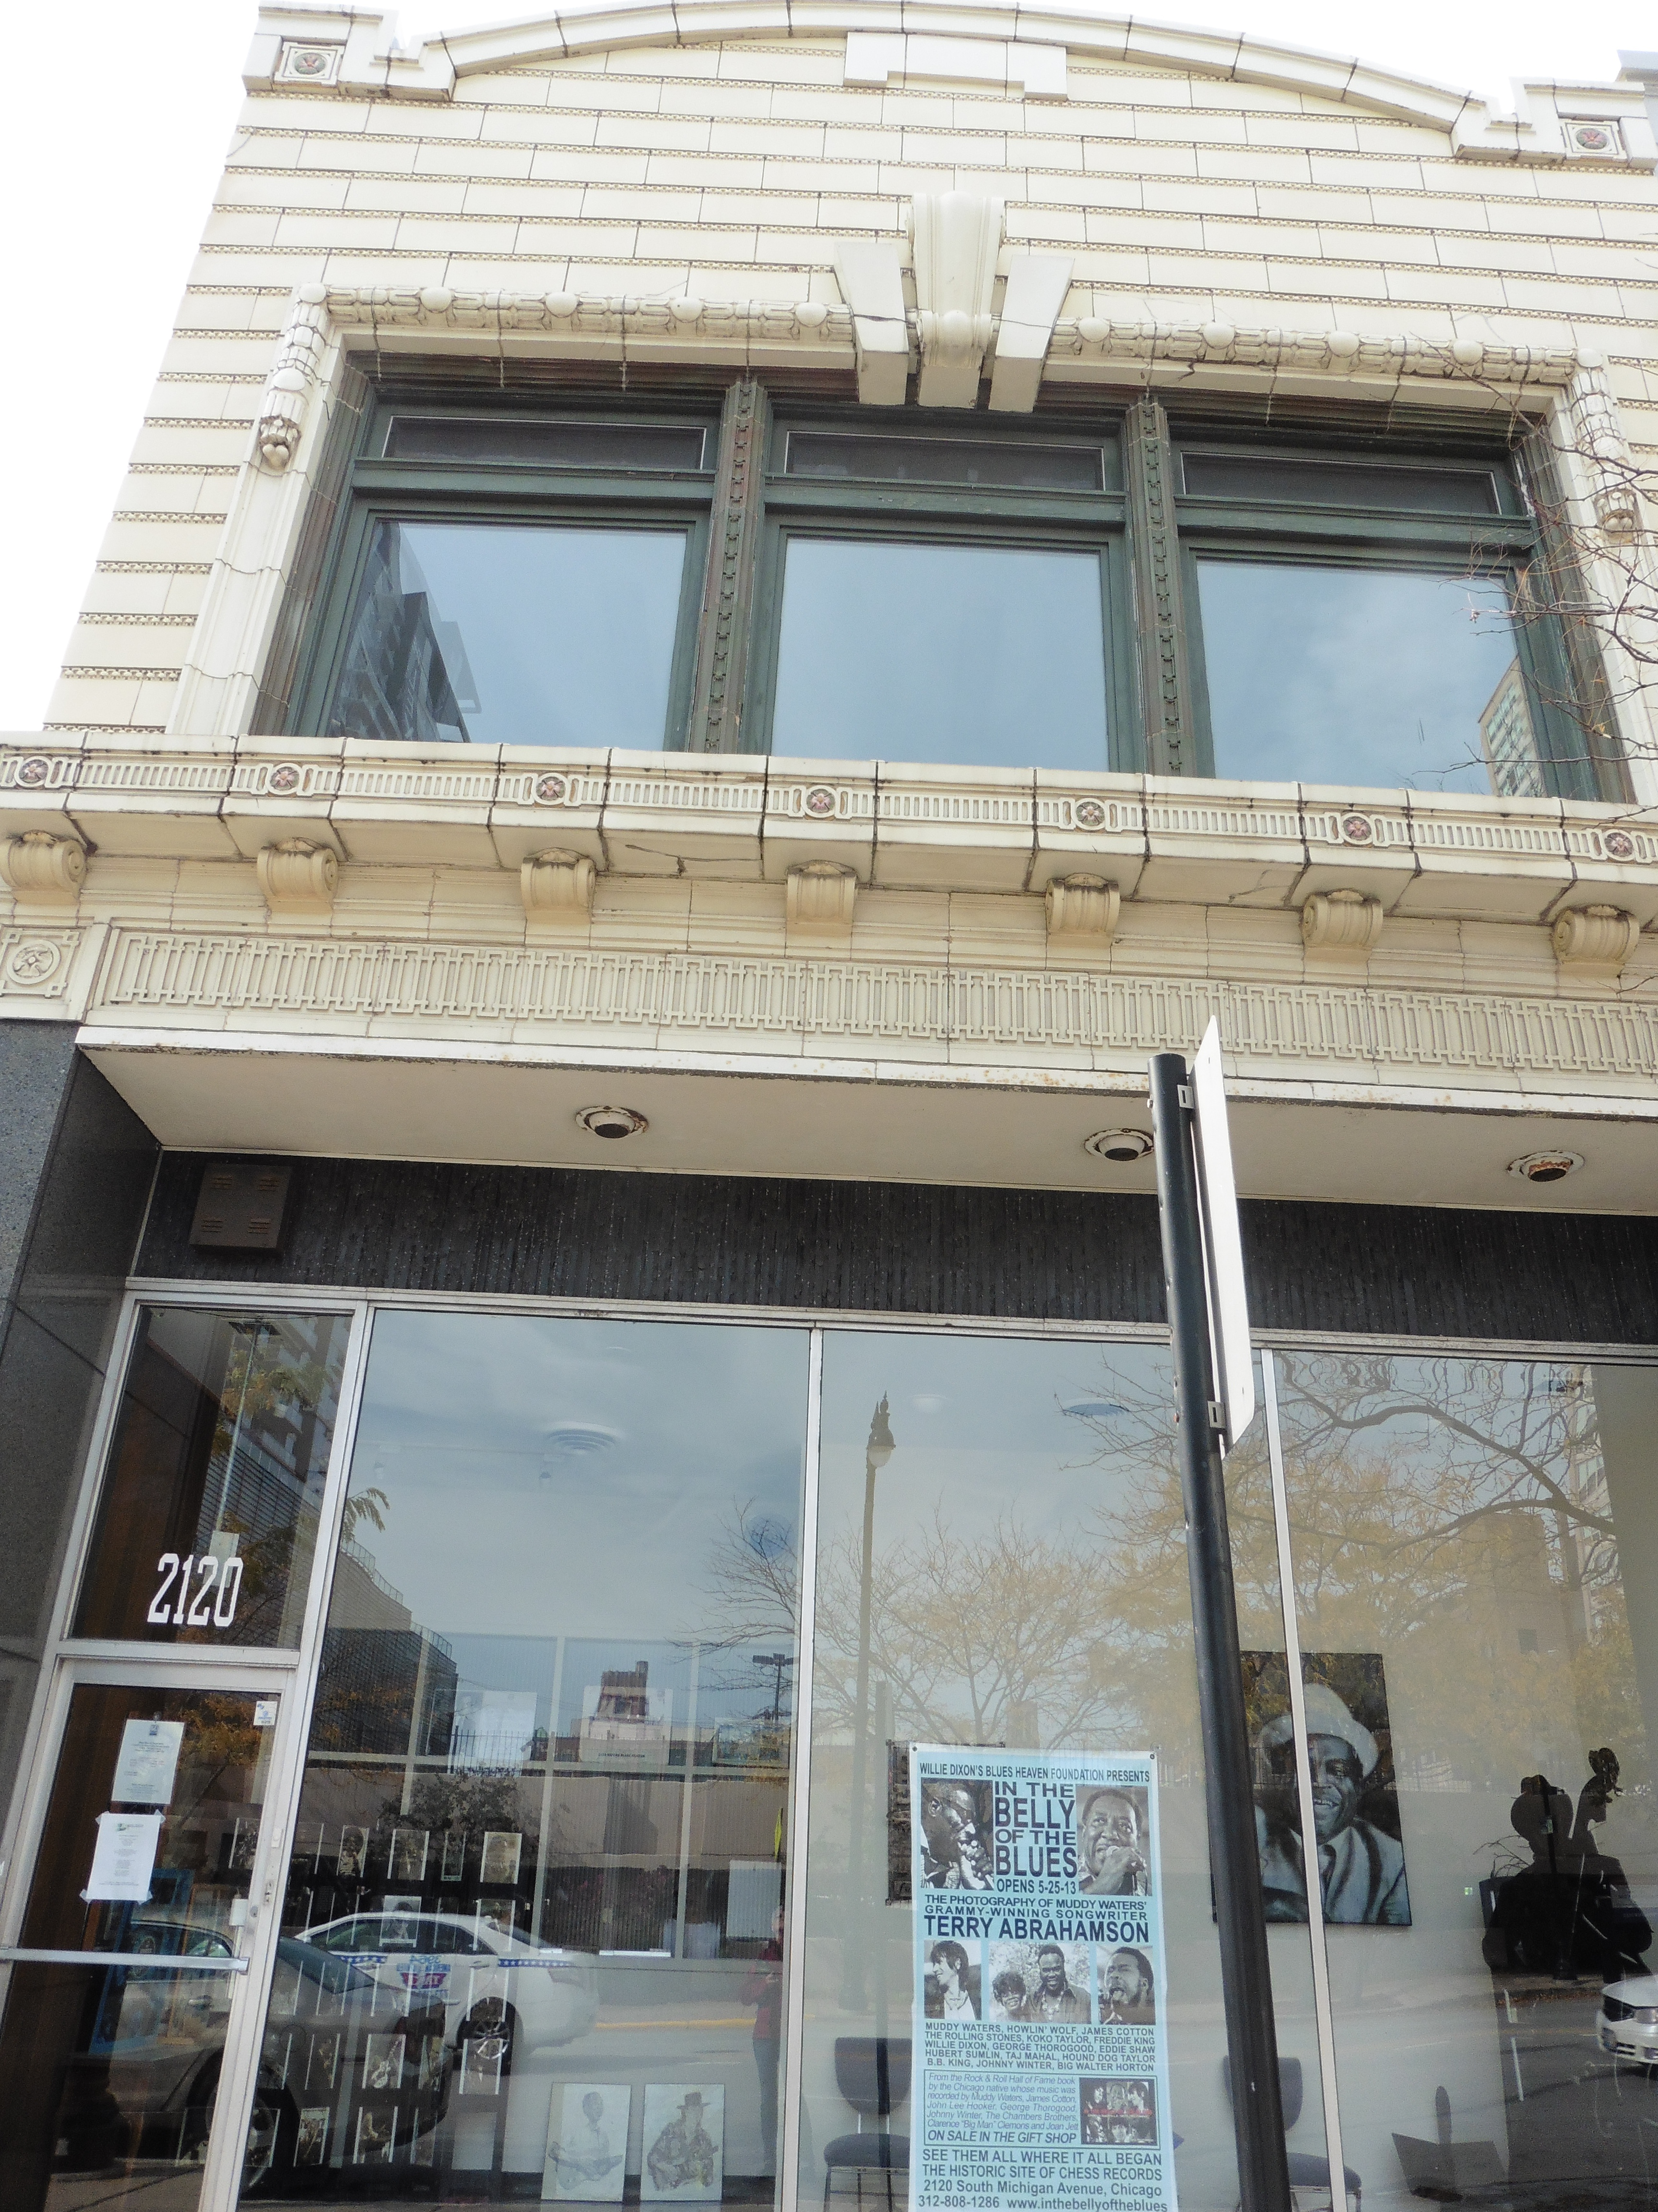
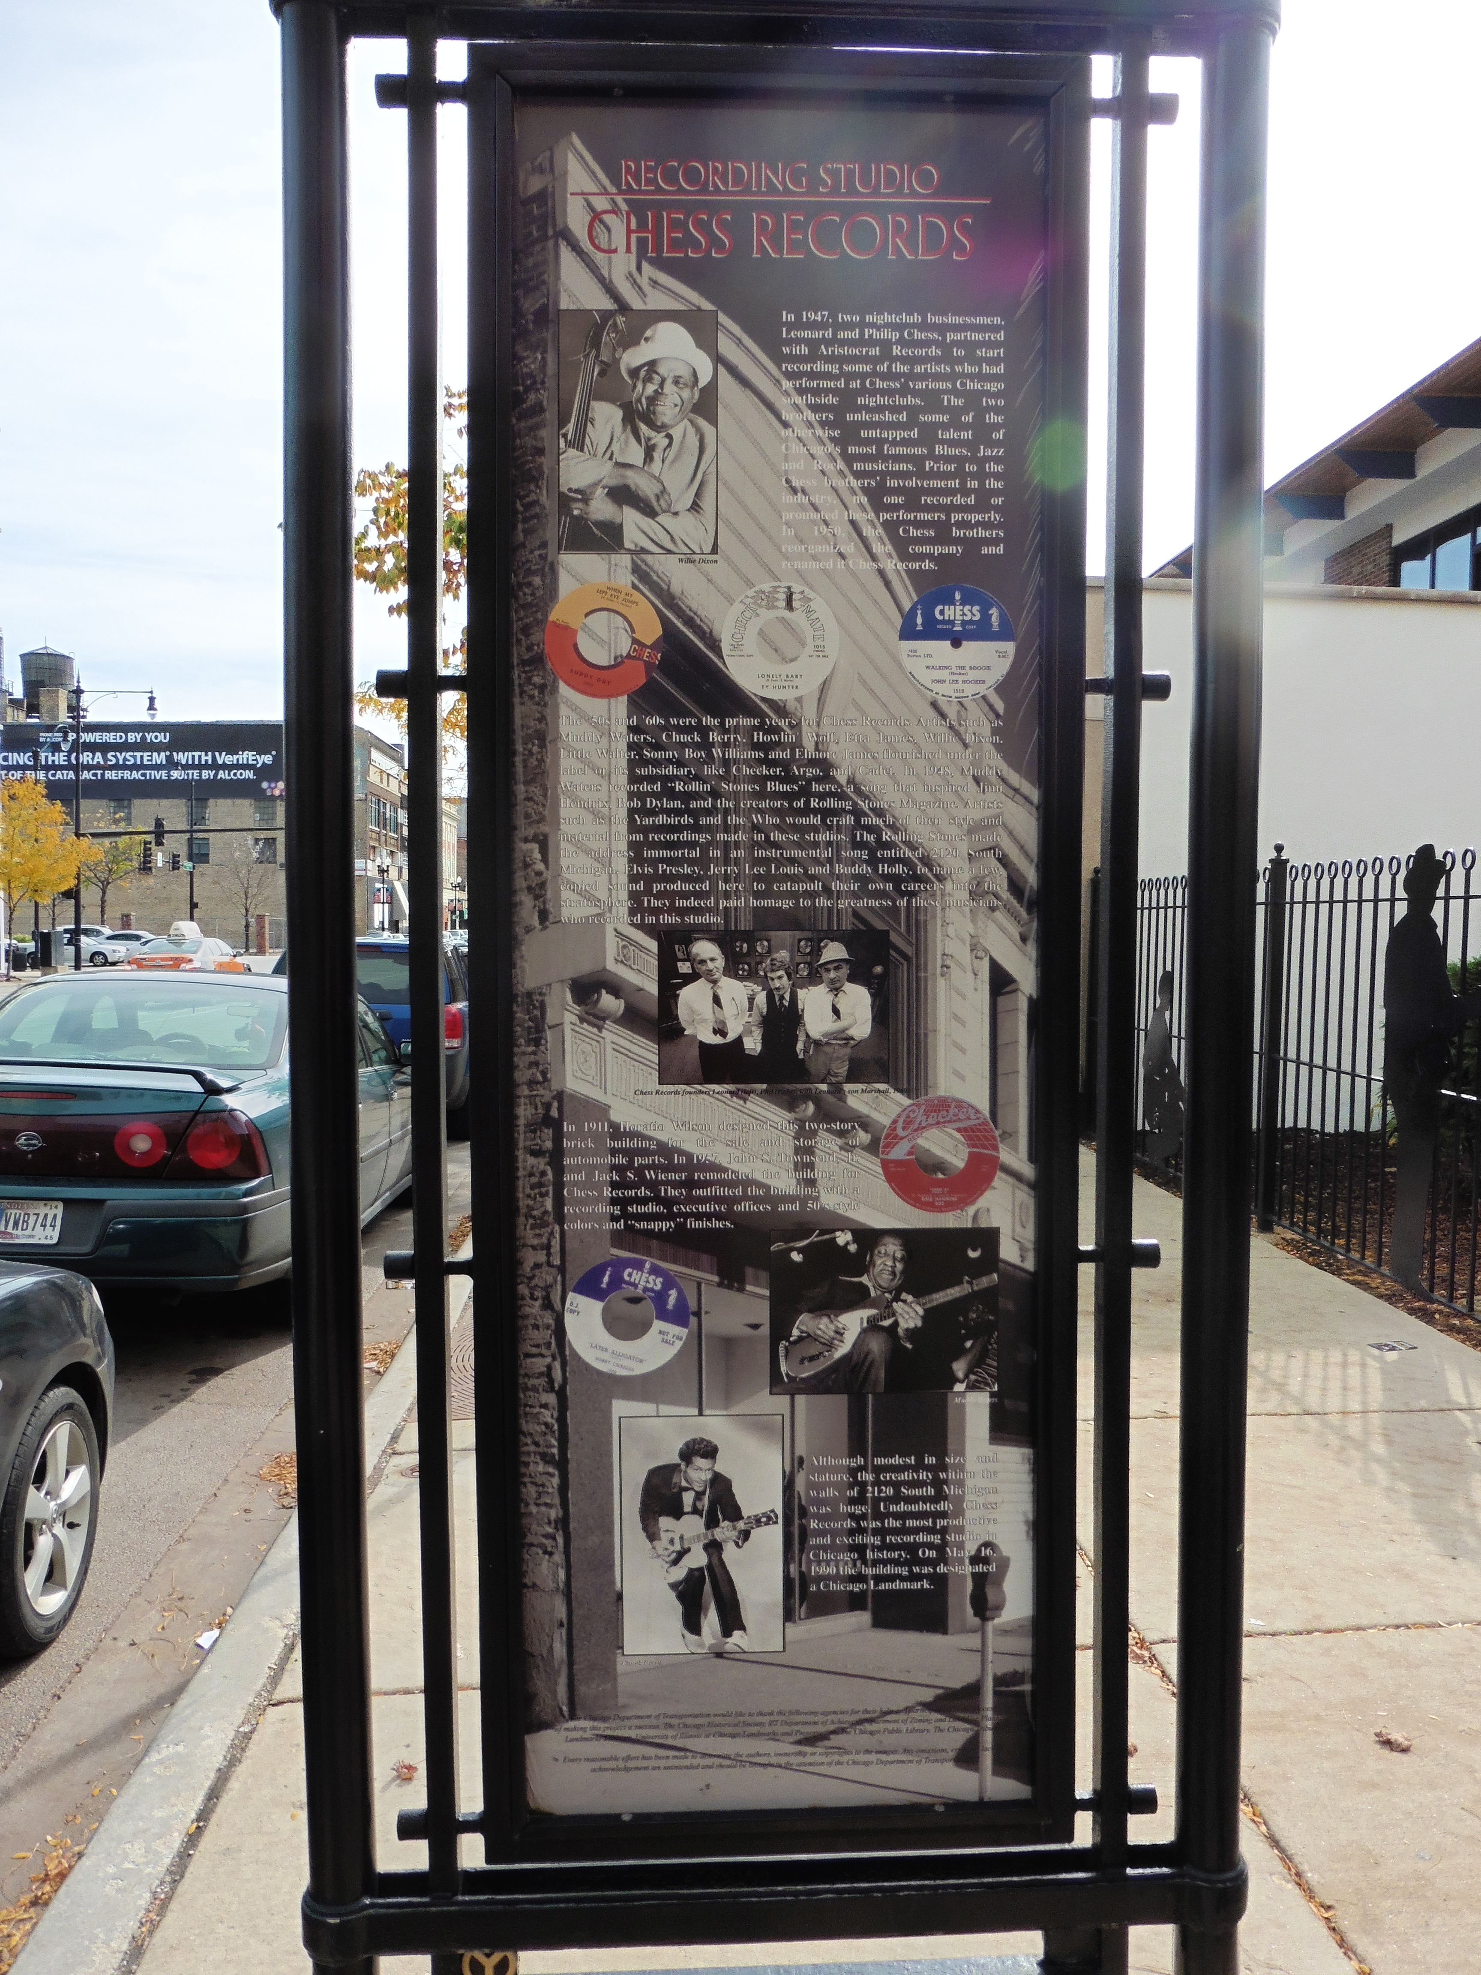
Urban Blues
Chess Records, 2120 S. Michigan Ave. Chicago

Slide 17
Impact of the Blues on Rock ‘n’ Roll
“The blues are the roots and the other musics are the fruits. It’s better keeping the roots alive, because it means better fruits from now on. The blues are the roots of all American music. As long as American music survives, so will the blues.”
Willie Dixon

Slide 18
Photo Credits
All photos credits for this PowerPoint can be accessed on the Jazz From A to Z content outline from the educator workshop “Everybody’s Got the Blues.”

