Slide 1
Motown
Berry Gordy

Slide 2
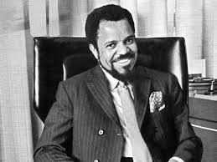
Berry Gordy, Jr.
November 28, 1929
Detroit, MI
Director, Producer
Entrepreneur
Founded Motown Records
in 1959
http://cmsimg.freep.com/apps/pbcsi.dll/bilde?Site=C4&Date=20090111&Category=ENT04&ArtNo=901110326&Ref=AR&MaxW=640&Border=0&Berry-Gordy-s-Motown-timeline

Slide 3
Radicalization of Motown
Black Cultural Production in Detroit
Motown Music, Afro America, Dignity, Brotherhood
Multiple Meanings of the Sound
“Dancing in the Streets”: Detroit Radical Anthem
Martha Reeves & The Vandellas– “Dancing in the Streets”

Slide 4
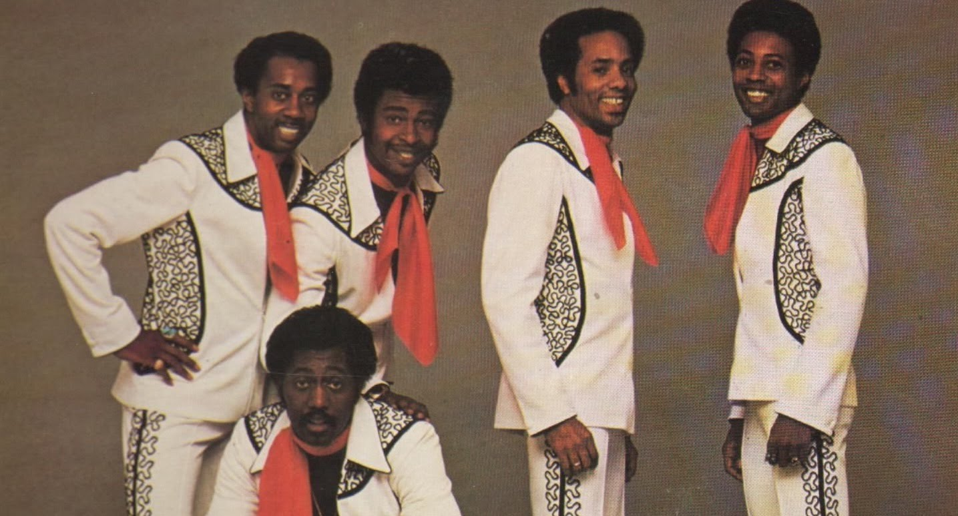
Sounds of the Struggle
Supremes – “Love Child” 1968
Stevie Wonder – “Down to Earth” 1966
Four Tops – “Still Waters Run Deep” 1970
Temptations – “Ball of Confusion” 1970
https://i.ytimg.com/vi/neWNcUEybfg/maxresdefault.jpg

Slide 5
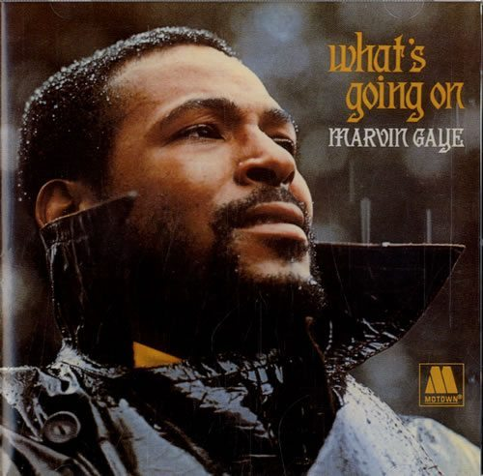
What’s Going On
“What’s Happening Brother”
“Flyin’ High”
“Mercy Mercy Me”
“Inner City Blues”
Release 1971
Critically Acclaimed
1st R&B Album w/Social Theme
http://www.udiscovermusic.com/wp-content/uploads/2015/10/Marvin-Gaye-Whats-Going-On-CD-ALBUM-581521.jpg

Slide 6
“What’s Happening Brother”
Hey baby, what'cha know good I'm just gettin' back, but you knew I would War is hell, when will it end, When will people start gettin' together again Are things really gettin' better, like the newspaper said What else is new my friend, besides what I read Can't find no work, can't find no job my friend Money is tighter than it's ever been Say man, I just don't understand What's going on across this land Ah what's happening brother, Ay, what's happening, what's happening my man Are they still gettin' down where we used to go and dance Will our ball club win the pennant, Do you think they have a chance And tell me friend, how in the world have you been Tell me what's out and I want to know what's in What's the deal man, what's happening What's happening brother What's happening brother Ah what's happening brother What's happening my man Ah what's happening brother Say it man! What's happening brother What's been shaken up and down the line I want to know 'cause I'm slightly behind the time

Slide 7
“Flyin' High”
Flying high in the friendly sky Flying high without ever leavin' the ground, no Rest of the folks are tired and weary Oh Lord, and have laid their bodies down. I go the place where danger awaits me And it's bound to forsake me. So stupid minded. I can't help it Oh ya, so stupid minded. But I go crazy when I can't find it, In the morning, I'll be alright, my friend. But soon the night will bring the pains, The pain, oh the pain Flying high in the friendly sky Without ever leaving the ground And I ain't seen nothing but trouble baby Nobody really understands, no no And I go to the place where the good feelin' awaits me Self-destruction in my hand Oh Lord, so stupid minded Oh and I go crazy when I can't find it Well I know I'm hooked my friend To the boy who makes slaves out of men. And oh believe me Flying high in a friendly sky Oh baby, flyin' high

Slide 8
“Mercy Mercy Me”
Woo ah, mercy mercy me Ah things ain't what they used to be, no no Where did all the blue skies go? Poison is the wind that blows from the north and south and east Woo mercy, mercy me, mercy father Ah things ain't what they used to be, no no Oil wasted on the ocean and upon our seas, fish full of mercury Ah oh mercy, mercy me Ah things ain't what they used to be, no no Radiation under ground and in the sky Animals and birds who live nearby are dying Oh mercy, mercy me Ah things ain't what they used to be What about this overcrowded land How much more abuse from man can she stand? Oh, na na... My sweet Lord... No My Lord... My sweet Lord

Slide 9
“Inner City Blues”
Rockets, moon shots Spend it on the have nots Money, we make it Fore we see it you take it Oh, make you wanna holler The way they do my life Make me wanna holler The way they do my life This ain't livin', this ain't livin' No, no baby, this ain't livin' No, no, no Inflation no chance To increase finance Bills pile up sky high Send that boy off to die Make me wanna holler The way they do my life Make me wanna holler The way they do my life Dah, dah, dah Dah, dah, dah Hang ups, let downs Bad breaks, set backs Natural fact is I can't pay my taxes Oh, make me wanna holler And throw up both my hands Yea, it makes me wanna holler And throw up both my hands Crime is increasing Trigger happy policing Panic is spreading God know where we're heading Oh, make me wanna holler They don't understand Dah, dah, dah
Mother, mother Everybody thinks we're wrong Who are they to judge us Simply cause we wear our hair long

