Slide 1
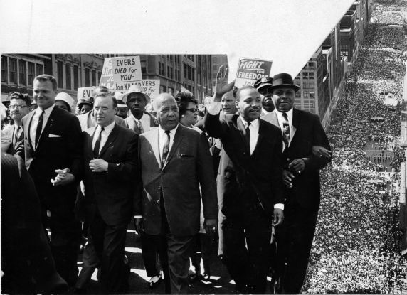
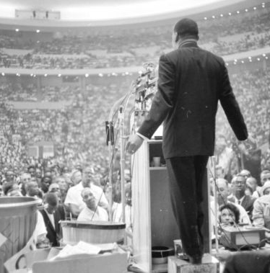
A Great Speech in Civil Rights History: MLK in Detroit- June 23, 1963

Slide 2
Historical References
“This executive order was called the Emancipation Proclamation. . . . But one hundred years later, the Negro in the United States of America still isn’t free.” (January 1, 1863)
“For Birmingham tells us something in glaring terms.” (Project C in Birmingham, April-May 1963)
“But then something happened to the Negro. Circumstances made it possible and necessary from him to travel more:” (Great Migration)
“We know that our brothers and sisters in Africa and Asia are moving with jet-like speed toward the goal of political independence.” (Post-World War II independence movements, decolonization)

Slide 3
Historical References
“And then we also need our support in order to get the civil rights bill that the President is offering passed.” (JFK’s televised speech on civil rights on June 11, 1963
“Before the victory is won, some like Medgar Evers, may have to face physical death.” (Medgar Evers was assassinated on June 12, 1963)
Why does Dr. King make historical references in his speech?

Slide 4
Literary Elements
Figurative Language
“The clock of destiny is ticking out, and we must act now before it is too late” (extended metaphor)
“Segregation is a cancer in the body politic, which must be removed before our democratic health can be realized” (extended metaphor)
“All men are made in His image, and … figuratively speaking, every man from a bass-black to a treble-white is significant on God's keyboard” (extended metaphor)

Slide 5
Literary Elements
Repetition/Parallelism
“And before the victory for brotherhood is won, some will have to get scarred up a bit. Before the victory is won, some more will be thrown into jail. Before the victory is won, some, like Medgar Evers, may have to face physical death. But if physical death is the price that some must pay to free their children and their white brothers from an eternal psychological death, then nothing can be more redemptive. Before the victory is won, some will be misunderstood and called bad names, but we must go on with a determination and with a faith that this problem can be solved” (italics not King’s)
“And so we must say, now is the time to make real the promises of democracy. Now is the time to transform this pending national elegy into a creative psalm of brotherhood. Now is the time to lift our nation. [Applause] Now is the time to lift our nation from the quicksands of racial injustice to the solid rock of racial justice. Now is the time to get rid of segregation and discrimination. Now is the time” (italics not King’s)

Slide 6
Literary Elements
Word Use
“Well, gradualism is little more than escapism and do-nothingism, which ends up in stand-stillism”
Literary/Biblical Allusion
“There is still a voice saying to every potential Peter, "Put up your sword." History is replete with the bleached bones of nations, history is cluttered with the wreckage of communities that failed to follow this command. And isn’t it marvelous to have a method of struggle where it is possible to stand up against an unjust system, fight it with all of your might, never accept it, and yet not stoop to violence and hatred in the process?”

Slide 7
Musical Passages
Ballad/blues story quality/stop-time
“You see, this method has a way of disarming the opponent. It exposes his moral defenses. It weakens his morale, and at the same time it works on his conscience, and he just doesn’t know what to do. If he doesn’t beat you, wonderful. If he beats you, you develop the quiet courage of accepting blows without retaliating. If he doesn’t put you in jail, wonderful. Nobody with any sense likes to go to jail. But if he puts you in jail, you go in that jail and transform it from a dungeon of shame to a haven of freedom and human dignity. And even if he tries to kill you, you’ll develop the inner conviction that there are some things so dear, some things so precious, some things so eternally true, that they are worth dying for. And I submit to you that if a man has not discovered something that he will die for, he isn’t fit to live

Slide 8
Musical Passages
Refrain/Verse (Repetition/Parallelism)
“And before the victory for brotherhood is won, some will have to get scarred up a bit. Before the victory is won, some more will be thrown into jail. Before the victory is won, some, like Medgar Evers, may have to face physical death. But if physical death is the price that some must pay to free their children and their white brothers from an eternal psychological death, then nothing can be more redemptive. Before the victory is won, some will be misunderstood and called bad names, but we must go on with a determination and with a faith that this problem can be solved” (italics not King’s)
“And so we must say, now is the time to make real the promises of democracy. Now is the time to transform this pending national elegy into a creative psalm of brotherhood. Now is the time to lift our nation. [Applause] Now is the time to lift our nation from the quicksands of racial injustice to the solid rock of racial (justice. Now is the time to get rid of segregation and discrimination. Now is the time” (italics not King’s)

Slide 9
Musical Passages
Call/Response Refrain/Limning
I have a dream this afternoon (I have a dream) that there will be a day that we will no longer face the atrocities that Emmett Till had to face or Medgar Evers had to face, that all men can live with dignity.
I have a dream this afternoon (Yeah) that my four little children, that my four little children will not come up in the same young days that I came up within, but they will be judged on the basis of the content of their character, not the color of their skin.
I have a dream this afternoon that one day right here in Detroit, Negroes will be able to buy a house or rent a house anywhere that their money will carry them and they will be able to get a job. (That’s right)
Yes, I have a dream this afternoon that one day in this land the words of Amos will become real and ‘justice will roll down like waters, and righteousness like a mighty stream.’
I have a dream this evening that one day we will recognize the words of Jefferson that ‘all men are created equal, that they are endowed by their Creator with certain unalienable Rights, that among these are Life, Liberty and the pursuit of Happiness.’ I have a dream this afternoon.

Slide 10
Photo Credits
All photos credits for this PowerPoint can be accessed on the Jazz From A to Z content outline from the educator workshop “Everybody’s Got the Blues.”

