Slide 1
Music Reviews
Evaluating the “fingerprint” of musical style through descriptive writing.
Curriculum Created by Rachel Collay, Westwood High School

Slide 2
Arizona college and career ready standards
Production and Distribution of Writing
Produce clear and coherent writing in which the development, organization, and style are appropriate to task, purpose, and audience.
Develop and strengthen writing as needed by planning, revising, editing, rewriting, or trying a new approach.
Text Types and Purposes
Write informative/explanatory texts to examine and convey complex ideas, concepts, and information clearly and accurately through the effective selection, organization, and analysis of content.
Introduce a topic; organize complex ideas, concepts, and information to make important connections and distinctions; include formatting (e.g., headings), graphics (e.g., figures, tables), and multimedia when useful to aiding comprehension.
Develop the topic with well-chosen, relevant, and sufficient facts, extended definitions, concrete details, quotations, or other information and examples appropriate to the audience’s knowledge of the topic.
Use appropriate and varied transitions to link the major sections of the text, create cohesion, and clarify the relationships among complex ideas and concepts.
Use precise language and domain-specific vocabulary to manage the complexity of the topic.
Establish and maintain a formal style and objective tone while attending to the norms and conventions of the discipline in which they are writing.
Provide a concluding statement or section that follows from and supports the information or explanation presented (e.g., articulating implications or the significance of the topic). (9-10.W.2)

Slide 3
the “Art” of the Music REview
Reviewers must bring the creative sounds of musical artists alive through their choice of words when reviewing an album or song.
Sensory language, precise verbs, and unique combinations of descriptors help to bring this music to readers who cannot immediately hear the song(s) being described.
Tom Ewing in his piece, “What Do You Look for in Music Writing?” claims that good music writing:
brings [readers] to the music
shows [readers] something new in the music
tries to start conversations, not stop them
excites [readers] with its insights and ideas
puts a focus on the listener

Slide 4
Some Thoughts on writing about music…
“One of the more successful and exciting ways of writing about music is to imitate the sounds, textures, and forms of music, to create, partly through the vocabulary of music, partly through controlling the sounds and rhythms of language, poems that make music”
-Robert DiYanni, Sound and Sense: Writing About Music
Writing about music is in some ways like writing about anything else: you need a convincing argument, interesting ideas, clear presentation, and thoughtful organization. But writing about music also entails listening, formulating observations in words, and shaping those observations into a form that communicates your opinions about music.
-Writing About Music: A Guide by Professor Thomas Forrest Kelley, Harvard Writing Project

Slide 5
Music Review Excerpt Charles Mingus: The Jazz Workshop Concerts 1964-65
Mingus' spring '64 setlists, favoring elastic forms with tons of solo space, seem designed to flatter his sidemen. This is especially evident on the 21-minute Amsterdam version of the Charlie Parker tribute "Parkeriana", during which Mingus yanks the rhythm section out from under each soloist in turn. Byard uses his break to bust into one of his patented stride-style jaunts, sounding like an overdriven player piano. Later, Dolphy swoops and yelps in the foreground as Jordan and Coles calmly quote the melody of the Dizzy Gillespie–Frank Paparelli bebop classic "A Night in Tunisia," which Mingus had played with Parker and Gillespie at a famed 1953 gig at Toronto's Massey Hall. Moments such as this illustrate one of Mingus's chief imperatives as a bandleader: Honor the past but interrogate it, juxtapose it with the sound of now.
-By Hank Shteamer, Pitchfork Media, 2012

Slide 6
Jazz Review by Whitney Balliett
…Whitney Balliett, the jazz critic, in language which tries to capture the sound and feeling of the experience, describes a performance:
Taylor, as is his wont, played just one number, but it lasted forty minutes. It was full of his usual devices-the slamming chords, the agitated staccato passages, the breathtaking arpeggios, the blizzard density- but it had two new qualities: lyricism and gentleness. Again and again, after Taylor had launched one of his tidal waves, his hands going up and down like driving rods, he slipped into clear lagoons where shadows of melody glided just below the surface.

Slide 7
what creates vivid descriptive writing?
Energetic, lively verbs
Original and deliberate choices
Magnified moments -zoom in on a handful of important parts
Specific and precise wording
Sensory, visual language – paint a picture with words
Distinctive metaphor and simile
Natural language appropriate for the intended audience
Writing about music allows us to approach the inexpressible thing that makes a piece beautiful or powerful or difficult to grasp.
-Robert DiYanni from “Sound and Sense: Writing About Music”

Slide 8
Common Word Choice Mistakes
Clichés, slang, and repetition (unless for effect)
Fancy words used only to impress readers
Meaningless or bland diction (avoid words like: good, neat, fun, big, great, very, many, etc.)
Overusing imagery (use it powerfully and wisely)
Over-explaining, running on and on
Describing every moment and every detail

Slide 9
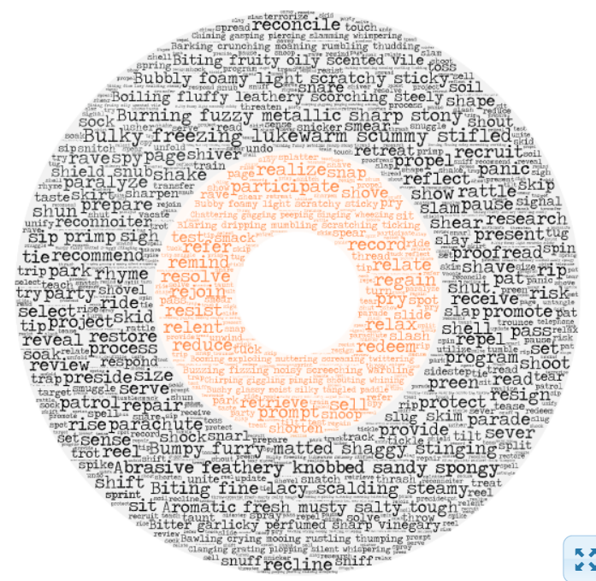
Sensory Language and Vivid Verbs Make your descriptions come alive

Slide 10
Now Let’s listen and brainstorm…
Listen carefully at the three songs we will play and think of unusual ways to describe the sounds you hear.
Write down any words or phrases that come to mind (no matter how silly or unusual they seem) to describe the instruments, vocals, harmonies, etc.
Then, write a 3-4 sentence review of the piece using the raw material from your brainstorm.
Refine and revise using varied sentence structure to construct an effective and poetic description.
Be prepared to share with your table mates and perhaps the larger group.

Slide 11
“Nuages” by Django Reinhardt –
High School Sample
The playful clarinet lures listeners in with a suspenseful, two-steps-forward-two-steps back montage. As the tension mounts, a sudden pause into a peaceful silence and then we are gently eased into the “clouds,” blissfully content as we make our ascent. The clarinet glides and stretches as an easy guitar both whimsically strums and then shakes with tension. But the stroll of the guitar and the whisper of the clarinet maintain the dream for the listener. This trance won’t break that easily. Even as an awkwardly-timed cowbell tries to fracture the melody, the persistent and lighthearted guitar accompanies the clarinet through to the end, helping listeners to float like feathers into the clouds.

Slide 12
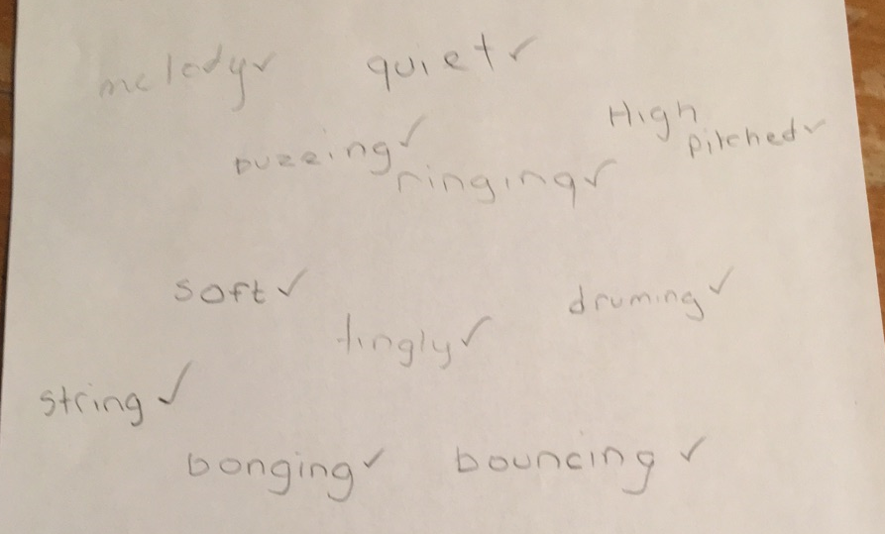
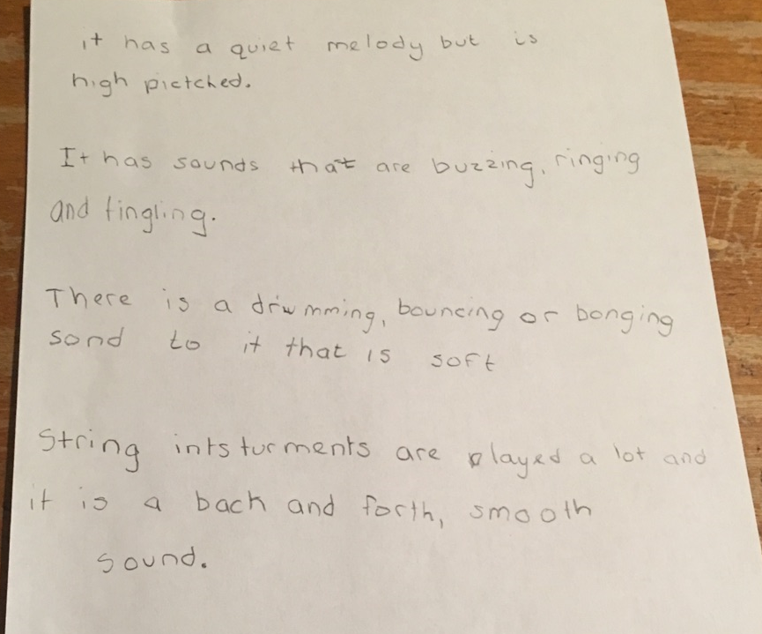
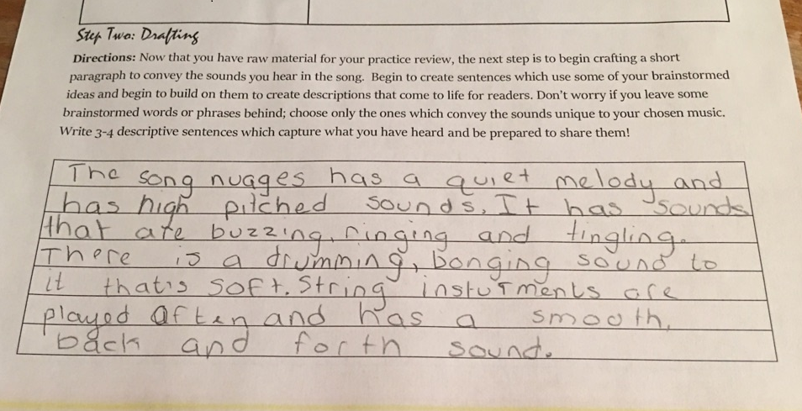
elementary student sample

Slide 13
Final Assignment: Music Review Explanatory Essay
Now it is your turn to choose a song!
Think of a song that you love and follow this process to brainstorm interesting imagery, unique figurative comparisons, and vivid verbs as you listen. Then, craft an essay which conveys the unique sounds and themes present in your song in a memorable way.
Step One: Listen to your song multiple times to really “hear” the layers that combine together to make the song really groove. As you listen, brainstorm unique descriptors, brilliant imagery, and vivid verbs.
Step Two: Begin crafting your ideas into an essay by deciding on an organizational structure and perhaps a uniting “thread.”
Step Three: Continue through the writing process until you have a polished review ready to publish!

