Slide 1
Jazz from A to Z
Educator Workshop
Keeping Time and Place: Jazz Cities in History
Detroit: The Urban Crisis in the Motor City

Slide 2
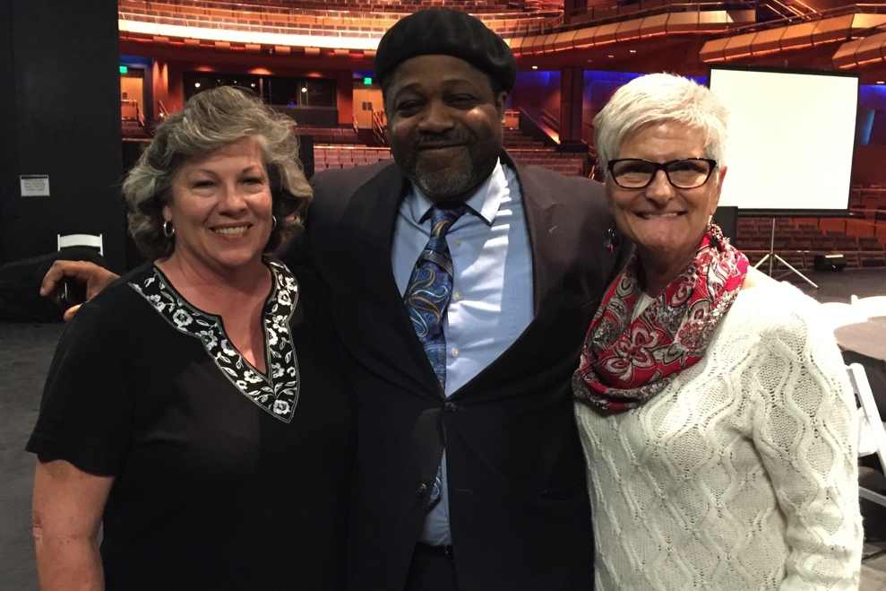
Your Presenters:
Pam Baack: English Language Arts
Rodney Whitaker: Music
Marcie Hutchinson: History

Slide 3
Essential Questions
What was it that turned America’s former industrial centers like Detroit into economic backwaters, abandoned by manufacturers?
Why has discrimination by race in Detroit persisted in both urban neighborhoods and workplaces?
How did the music (jazz and Motown) created in Detroit’s black community after World War II reflect the challenges African Americans faced in a major Northern industrial city?
How can our exploration of the history and culture of the Motor City inform our current conversations on race relations in the United States?

Slide 4
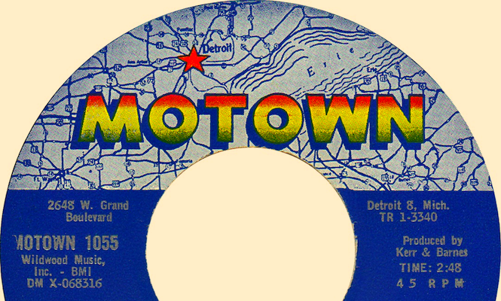
Detroit: The Urban Crisis in the Motor City
http://thevinylfactory.com/wp-content/uploads/2015/04/motown-2.png

Slide 5
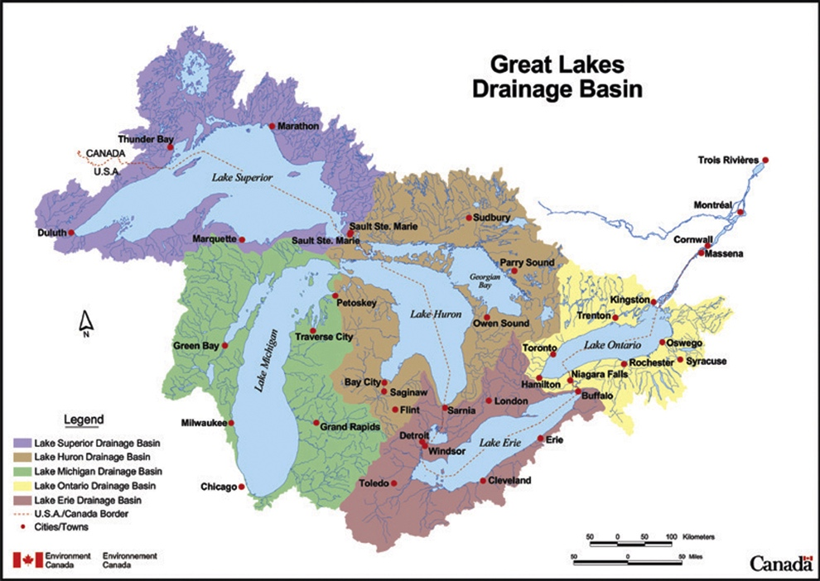
Why Detroit?
Location, Location, Location
https://www.ec.gc.ca/grandslacs-greatlakes/03B3F448-D76E-46BC-95F3-72C4CF270237/gl_basin_e_1800.jpg

Slide 6
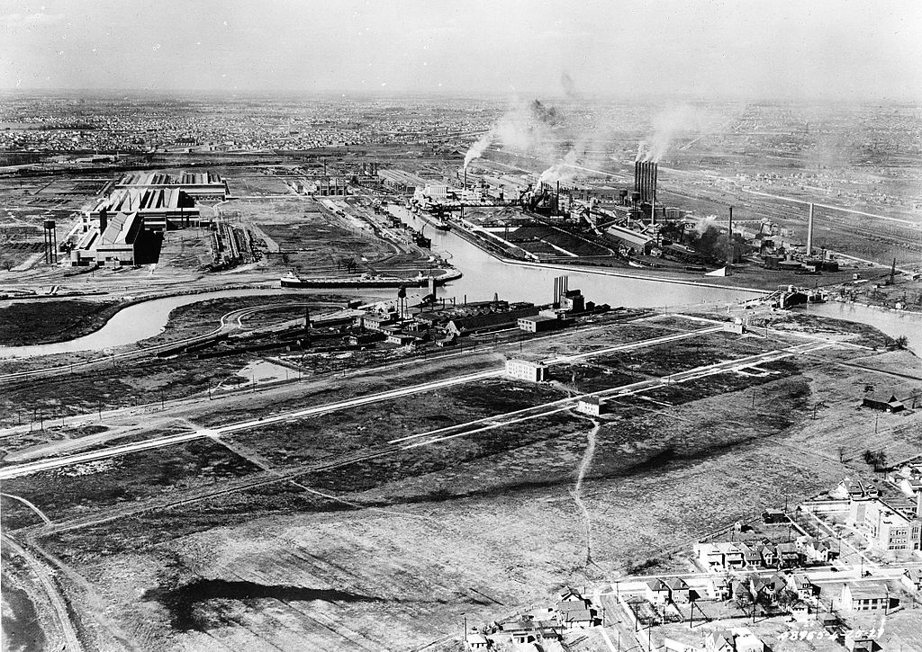
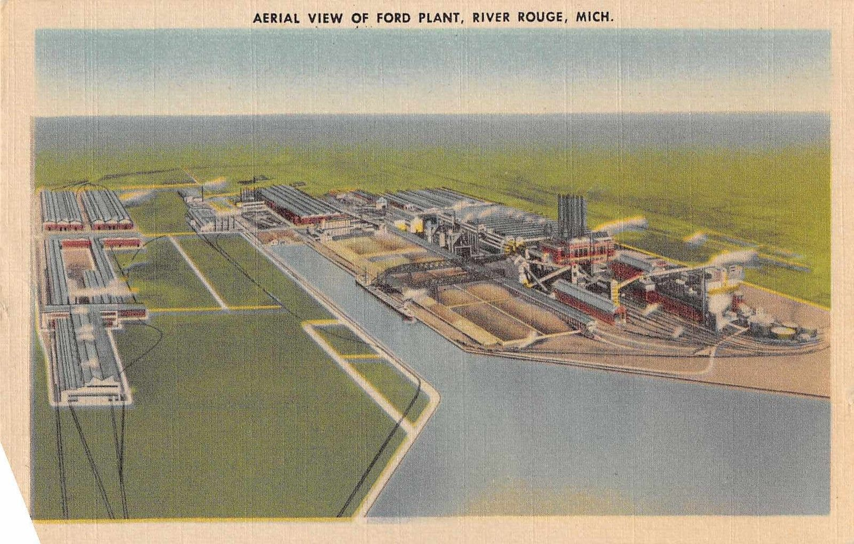
Ford’s River Rouge Plant
http://i.dailymail.co.uk/i/pix/2013/01/29/article-2269966-173BBB58000005DC-8_634x475.jpg
https://commons.wikimedia.org/wiki/File:River_Rouge_aerial_4a25915r.jpg#/media/File:River_Rouge_aerial_4a25915r.jpg

Slide 7
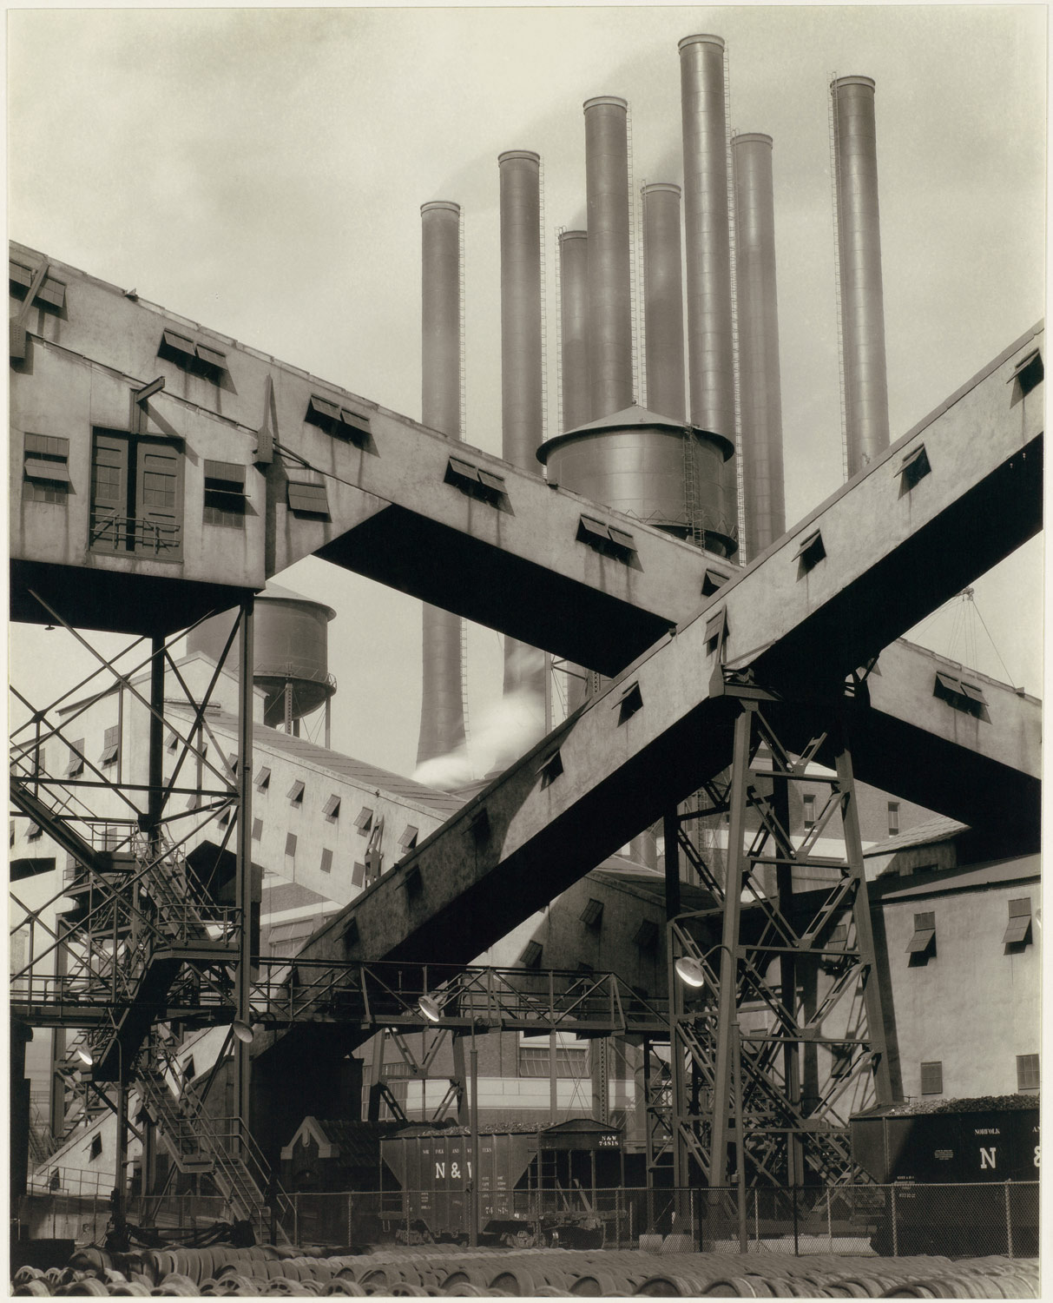
River Rouge Plant as Art:
The Commercial Photography of Charles Sheeler
http://www.metmuseum.org/toah/works-of-art/1987.1100.1/

Slide 8
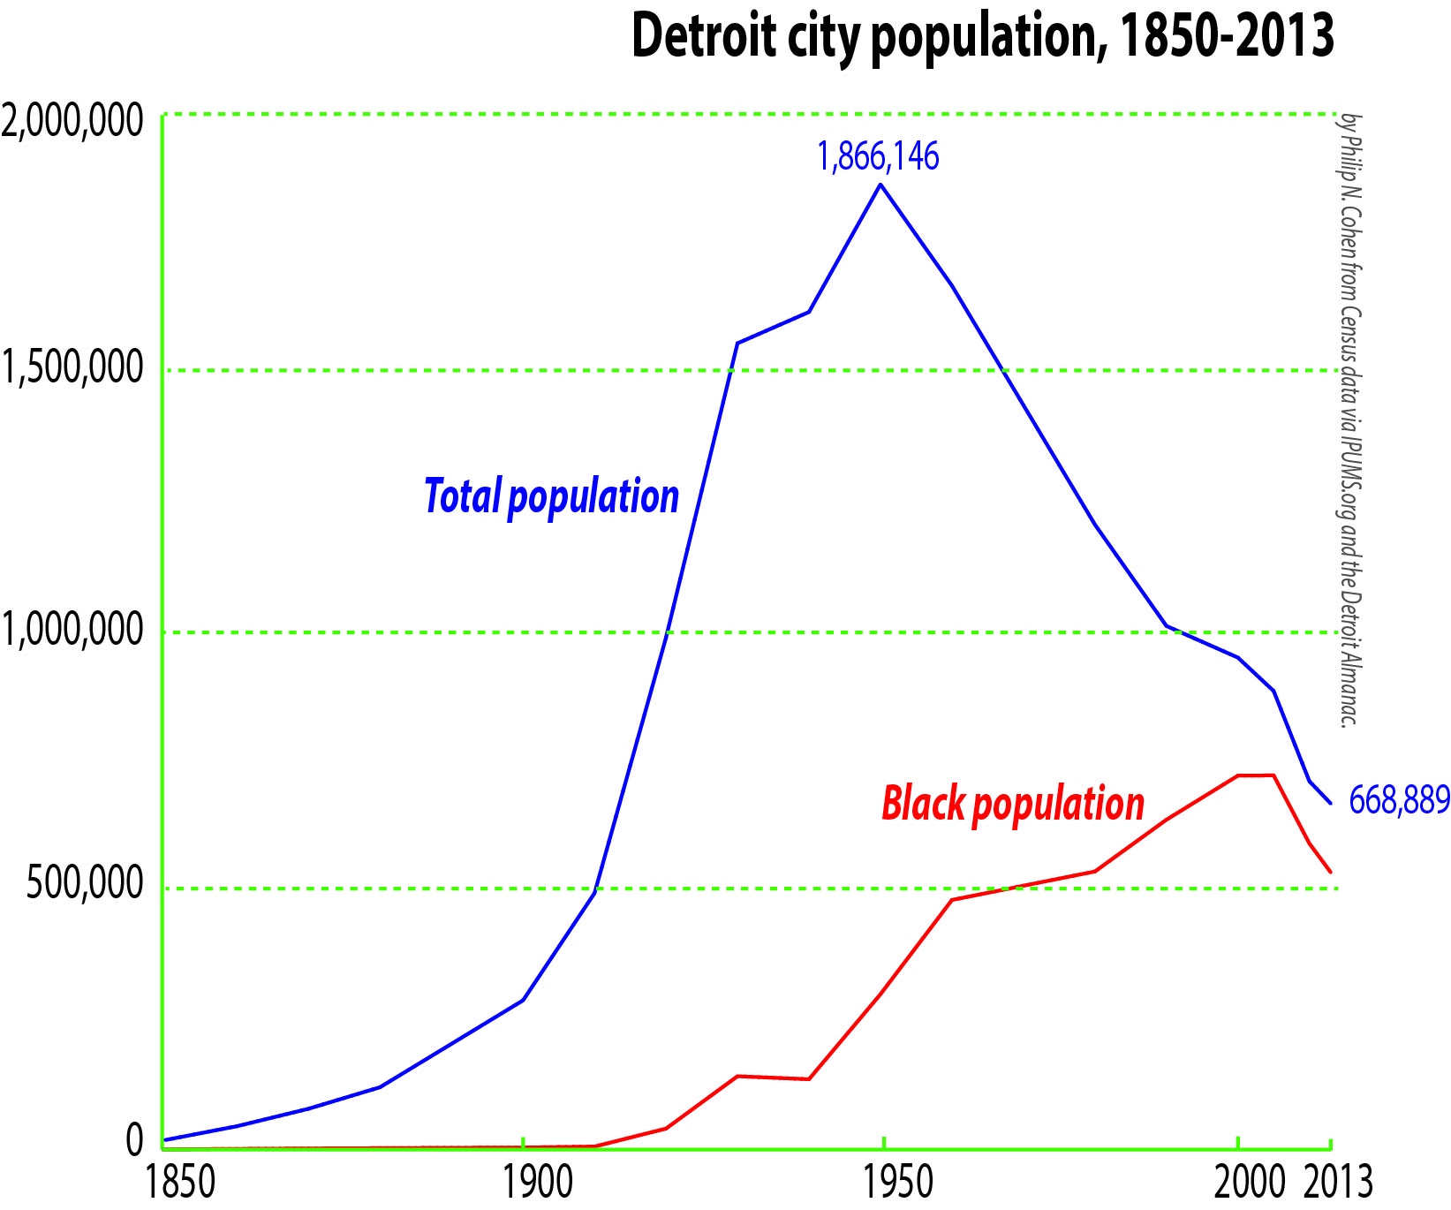
Detroit’s Mid-Century Population Explosion

Slide 9
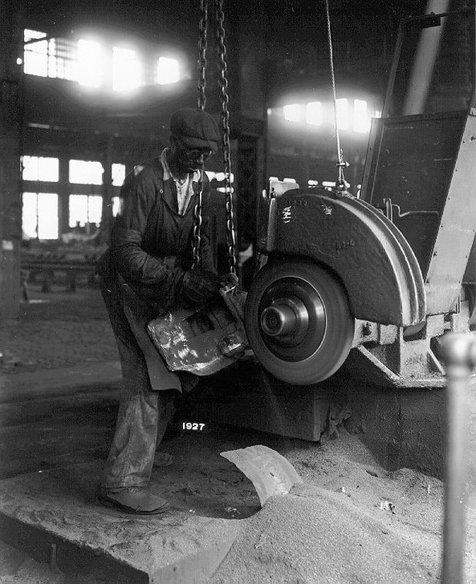
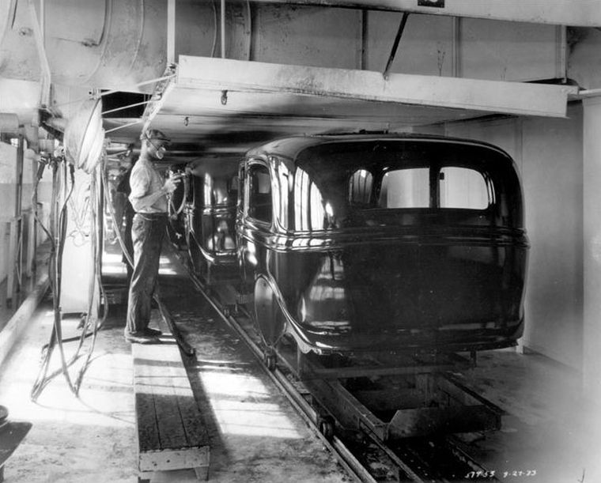
Ford Hires African Americans
http://www.inmotionaame.org/gallery/detail.cfm?migration=8&topic=99&id=465407&page=5&type=image

Slide 10
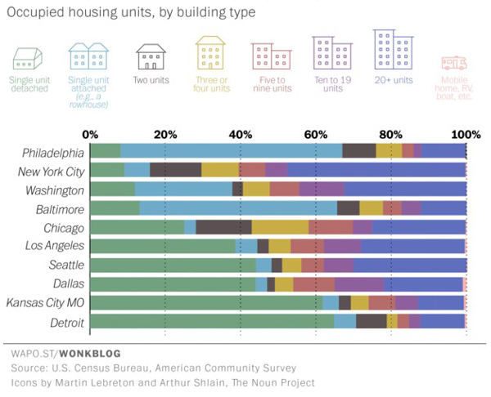
The Nature of Housing
http://www.modeldmedia.com/features/detroit-housing-pt1-111715.aspx

Slide 11
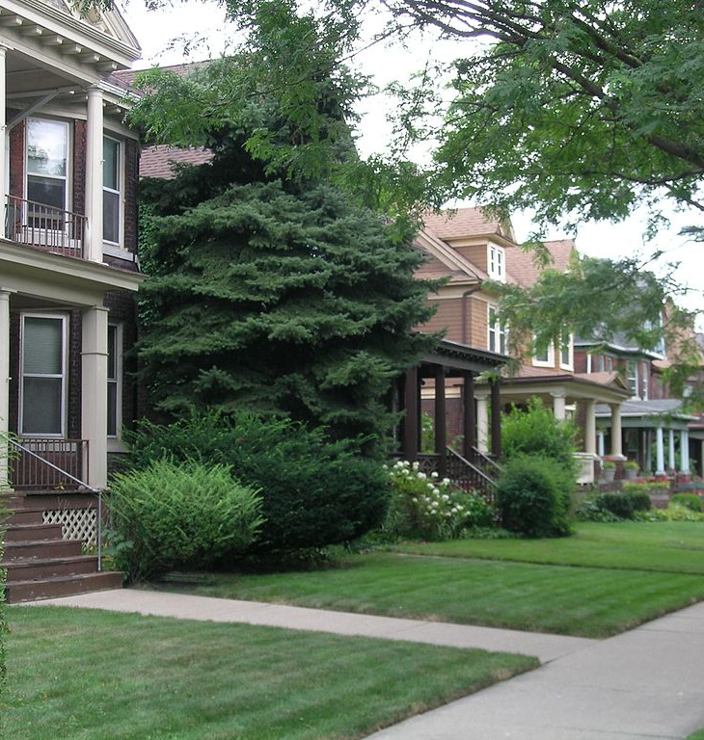
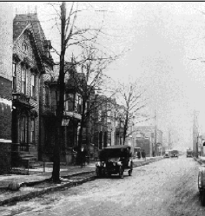
The Nature of Housing
Avery and Willis in Woodbridge
Black Bottom street
1920
https://en.wikipedia.org/wiki/Neighborhoods_in_Detroit#/media/File:Street_scene_on_Avery_Woodbridge_Detroit.jpg
http://www.motorcities.org/Story/Detroits+Black+Bottom+and+Paradise+Valley-37.html

Slide 12
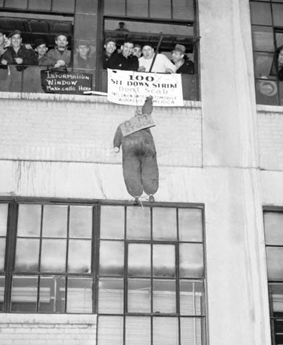
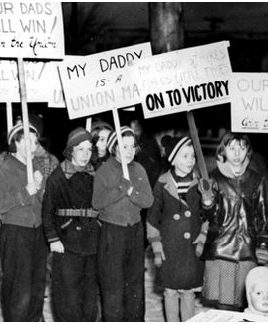
United Auto Workers and the Flint Sit-Down Strike
https://libcom.org/history/great-flint-sit-down-strike-against-gm-1936-37-walter-linder
http://350lab.blogs.brynmawr.edu/files/1939/05/child-sitdowners.jpg

Slide 13
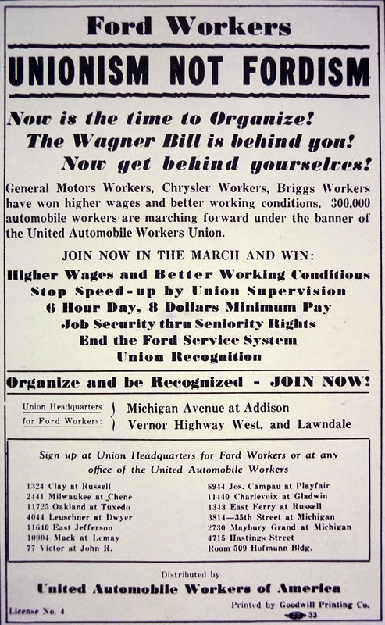
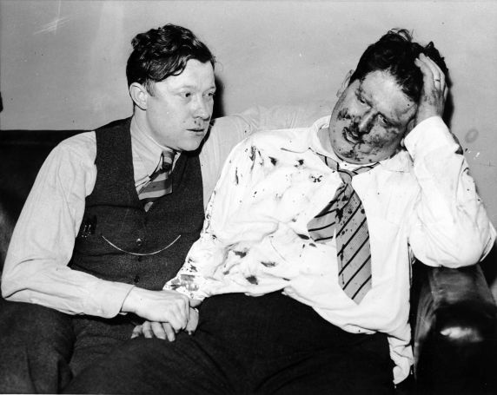
“The Battle of the Overpass”
http://www.upworthy.com/nearly-80-years-ago-the-battle-of-the-overpass-was-a-national-pr-disaster-for-ford-motor-company

Slide 14
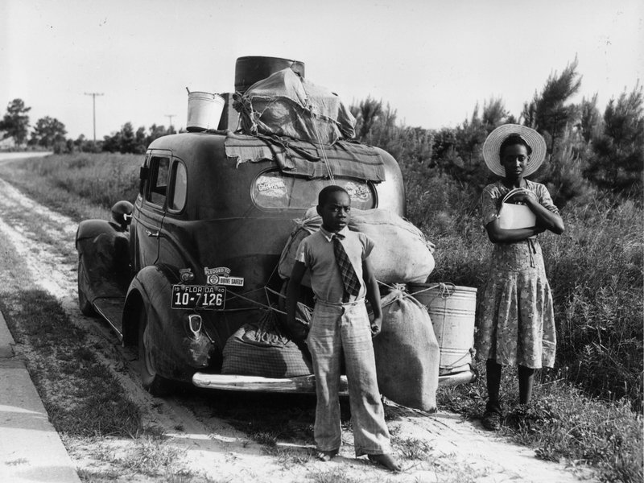
The Great Migration: African Americans in Detroit Before WWII
1910: 5,741
1920: 40,836
1930: 120,066
1940: 149,119
http://www.smithsonianmag.com/history/long-lasting-legacy-great-migration-180960118/

Slide 15
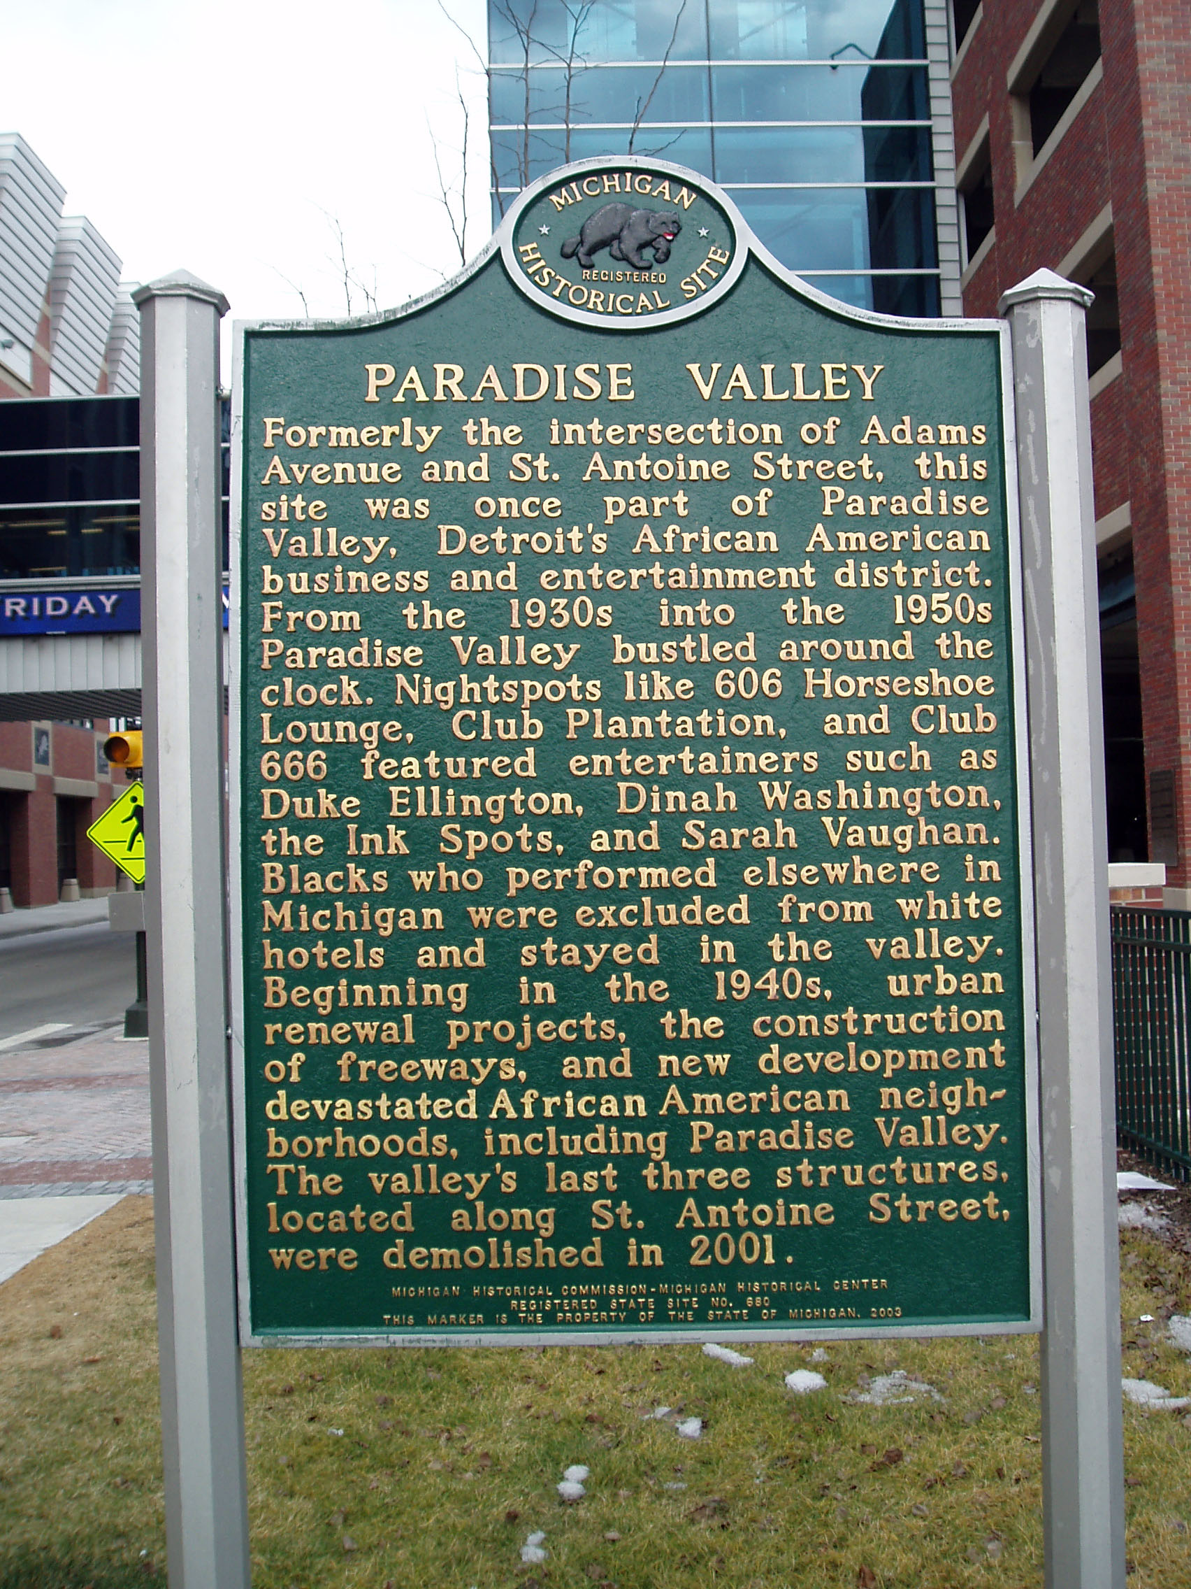
“Two Separate Cities, one black and one white.”
Black Neighborhoods
Paradise Valley
West Side
Eight-Mile Wyoming
Conant Gardens
http://detroit1701.org/Paradise%20Valley%20Marker.html

Slide 16
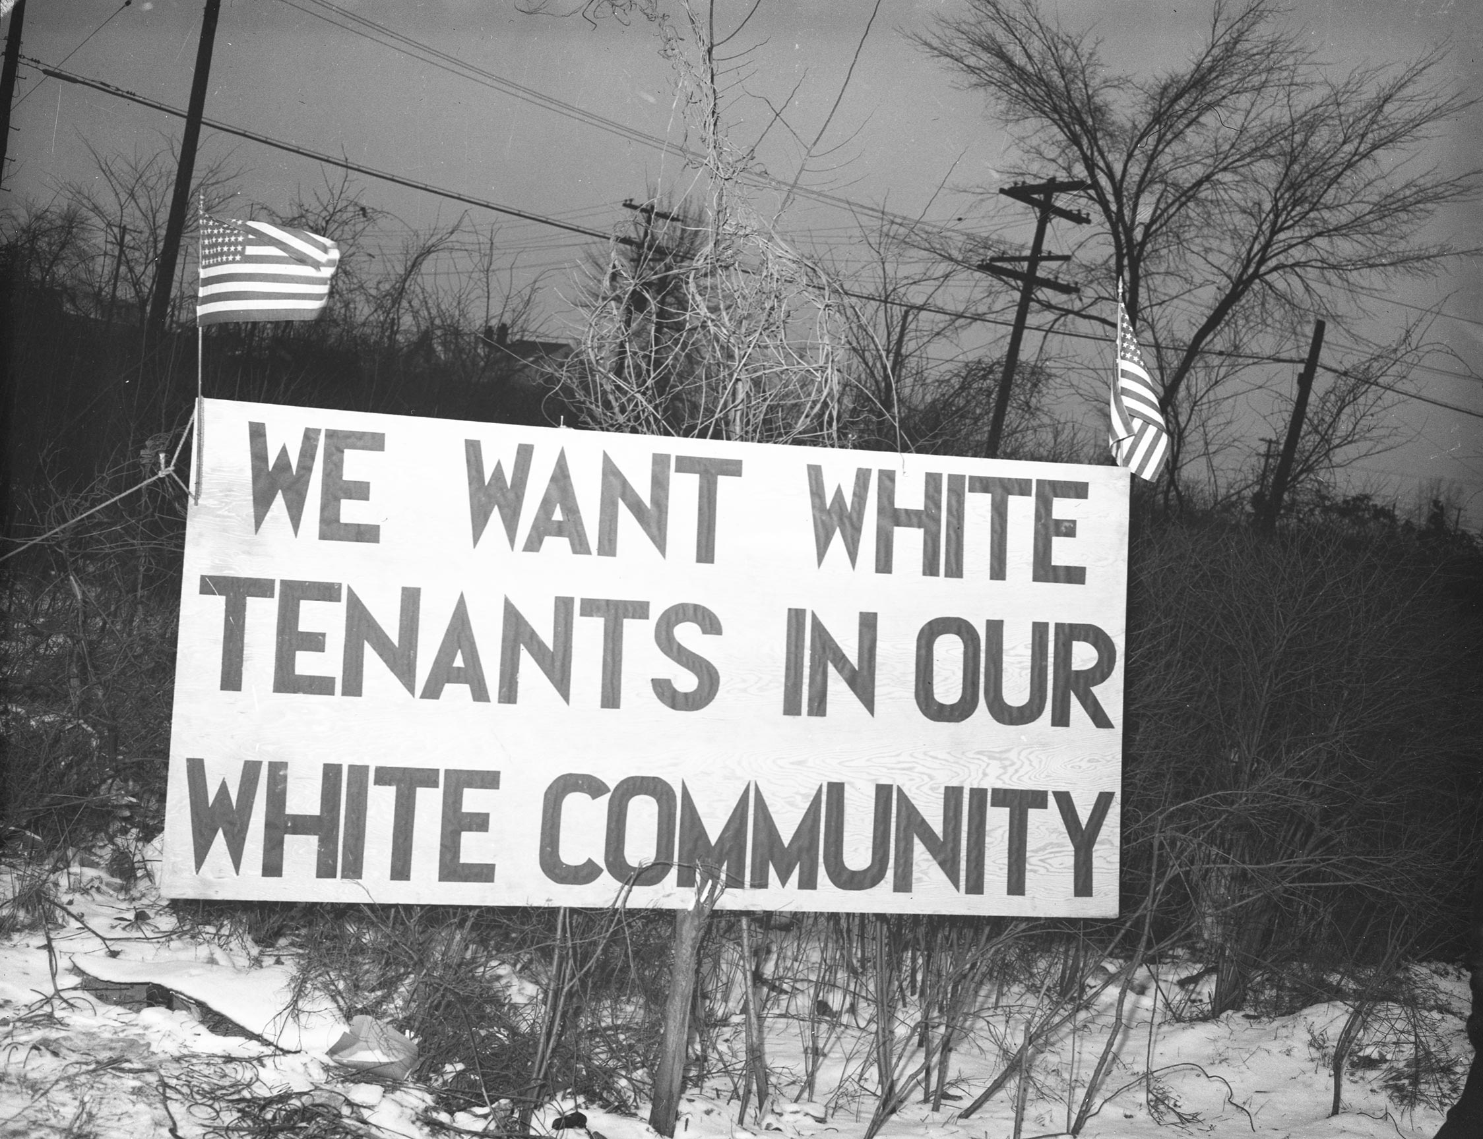
Means of Segregation
Refusal to sell to blacks
Use of force and threats of violence
Real estate agents won’t show properties in white neighborhoods
Restrictive covenants
“. . . Shall not be sued or occupied by any person or persons except those of the Caucasian race.”
http://www.moma.org/interactives/exhibitions/2015/onewayticket/static/panel/49/

Slide 17
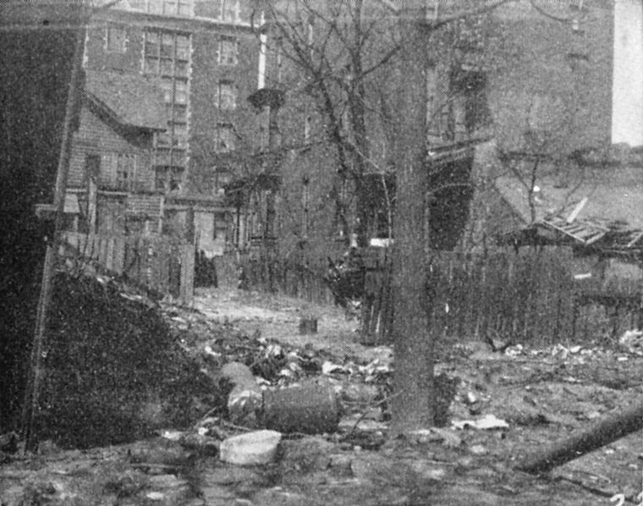
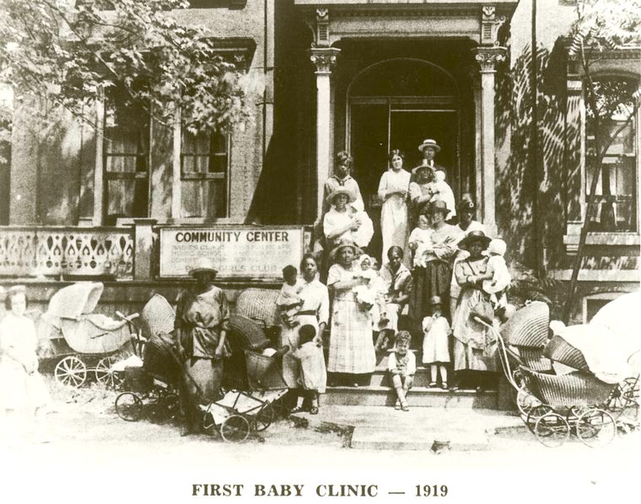
Severe Housing Shortage
http://www.inmotionaame.org/gallery/large.cfm?migration=8&topic=99&id=465433&type=image&metadata=&page=7
http://www.inmotionaame.org/gallery/large.cfm?migration=8&topic=99&id=465433&type=image&metadata=&page=7

Slide 18
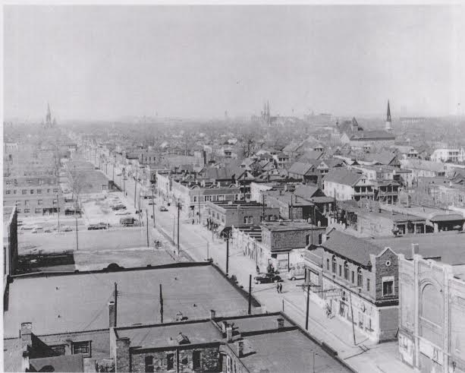
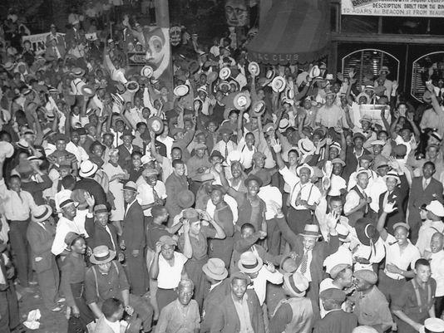
Hastings Street
https://detroitenvironment.lsa.umich.edu/wp-content/uploads/2014/04/Hastings.jpg
http://www.detroitnews.com/story/opinion/2015/08/04/ken-coleman-black-biz-district/31070703/

Slide 19
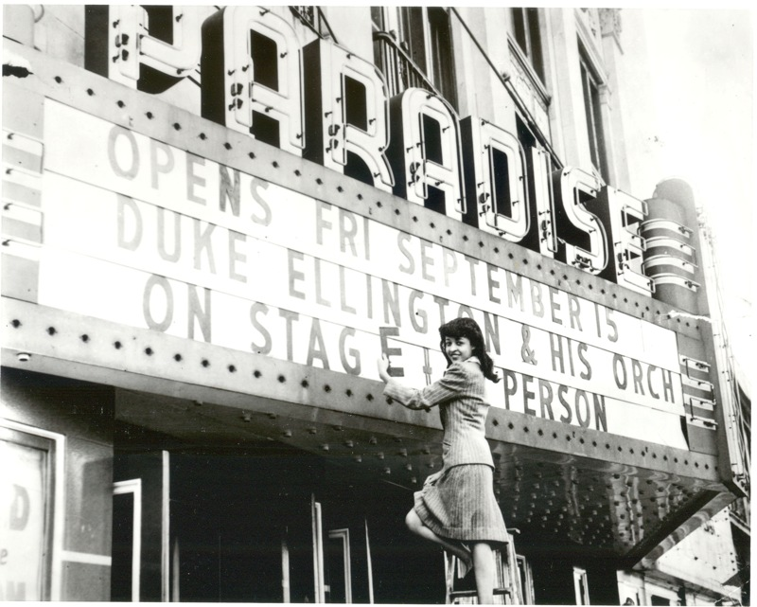
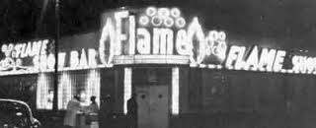
Clubs
http://www.blackbottomarchives.com/blackhistory/2016/2/16/remembering-paradise-valley

Slide 20
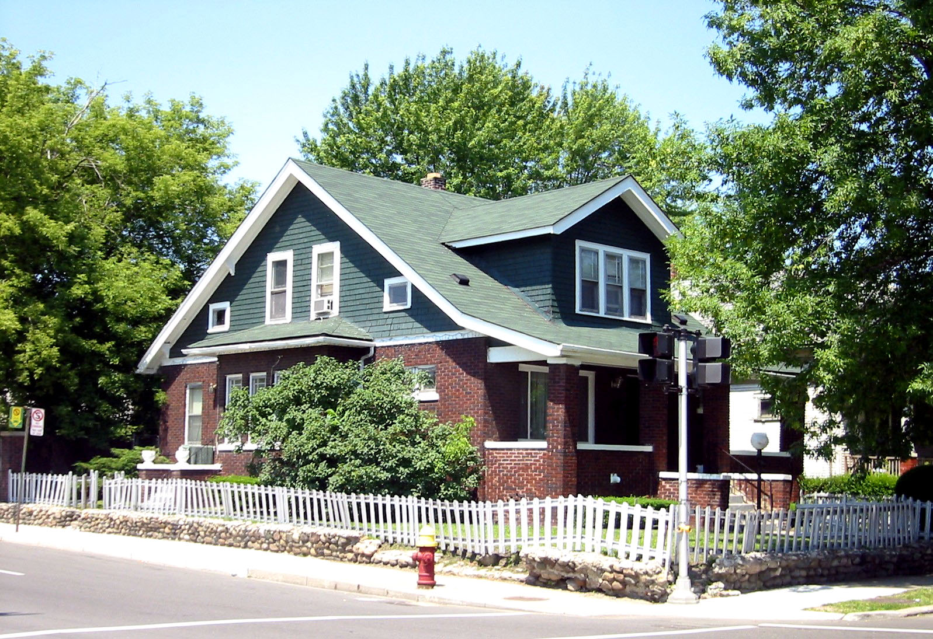
The Case of
Dr. Ossian Sweet
http://detroit1701.org/SweetHome.htm

Slide 21
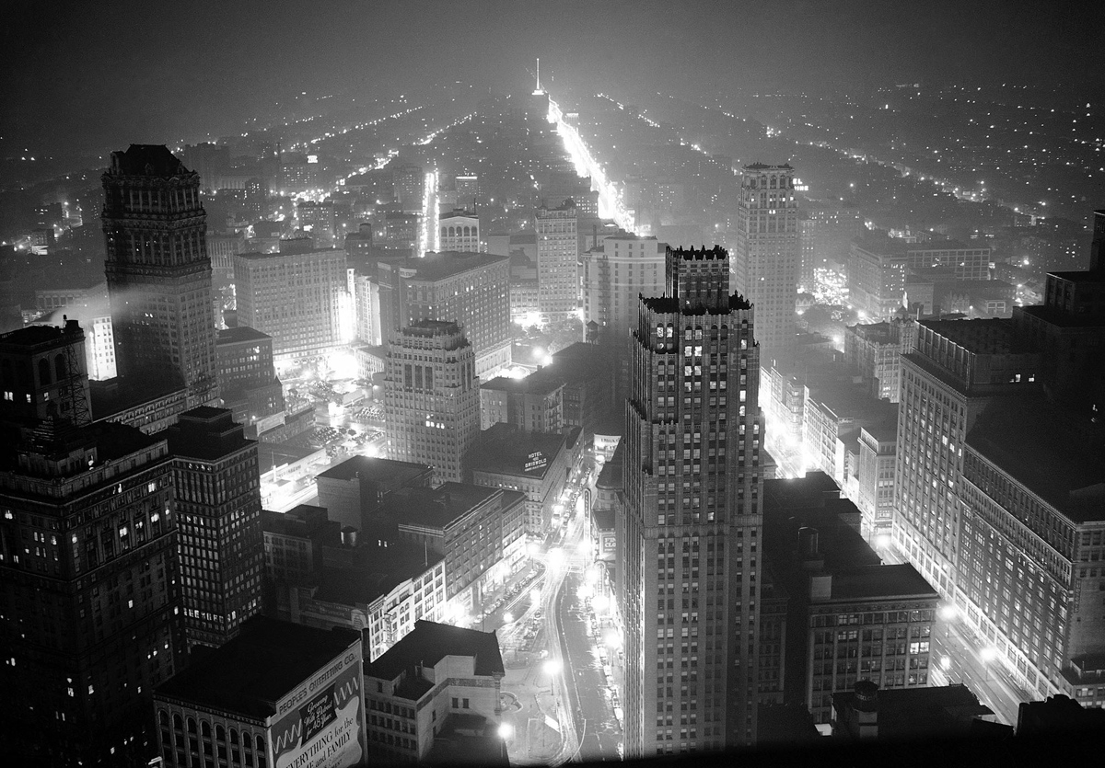
World War II Detroit
http://www.theatlantic.com/photo/2015/01/detroit-in-the-1940s/384523/

Slide 22
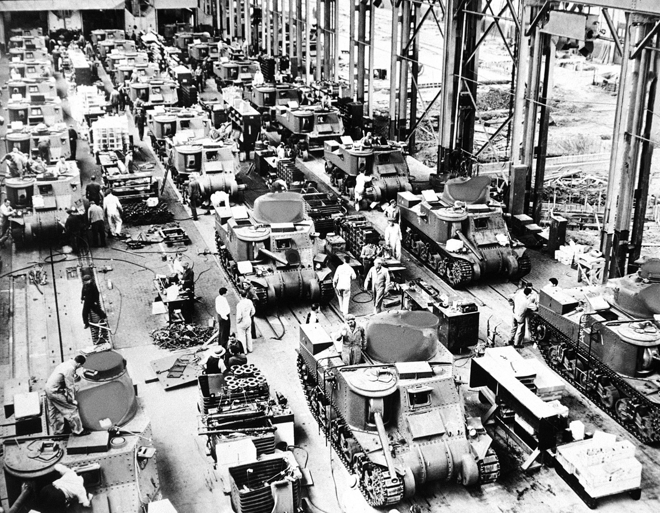
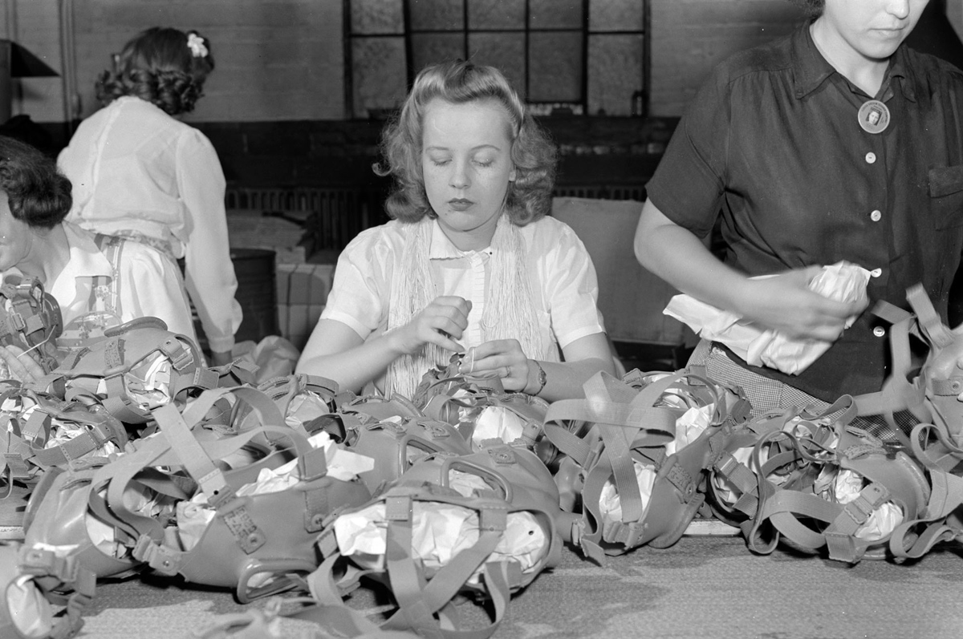
The “Arsenal of Democracy”
http://www.theatlantic.com/photo/2015/01/detroit-in-the-1940s/384523/

Slide 23
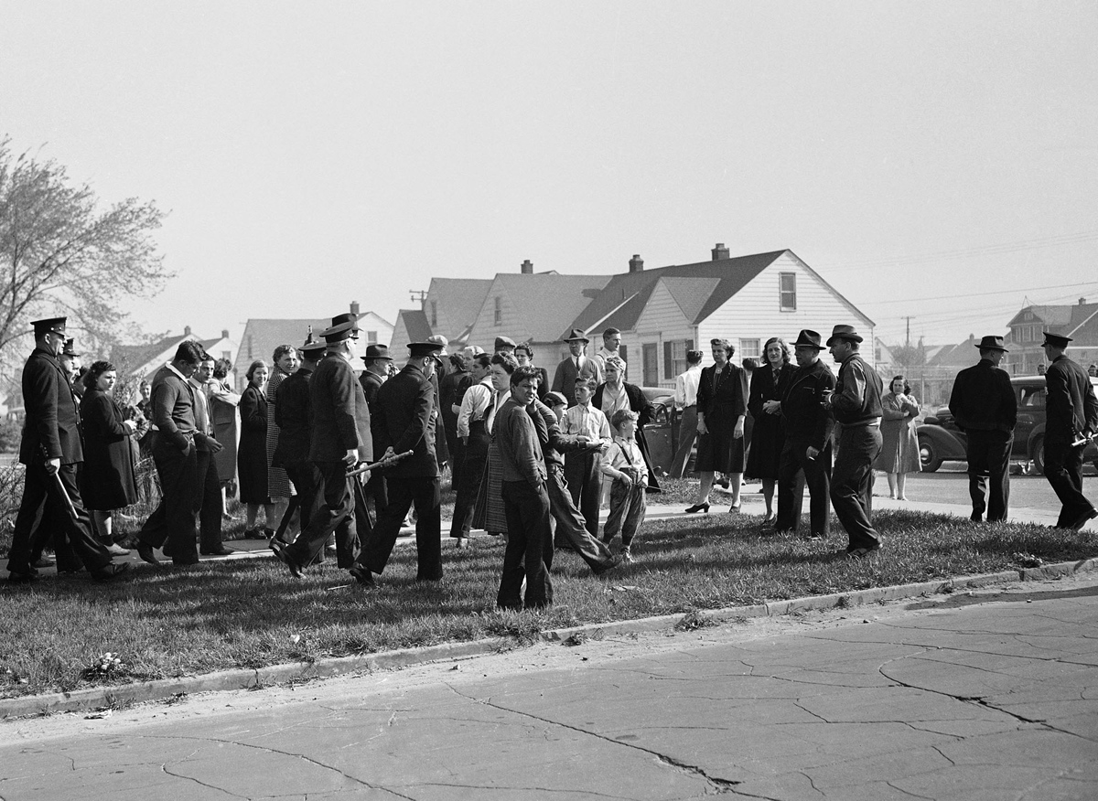
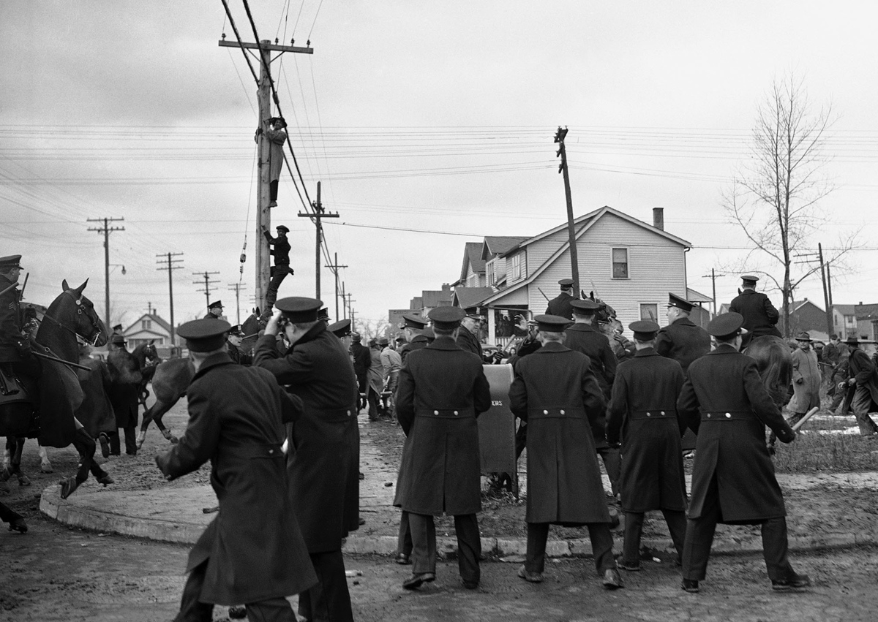
Sojourner Truth Public Housing Project
http://www.theatlantic.com/photo/2015/01/detroit-in-the-1940s/384523/

Slide 24
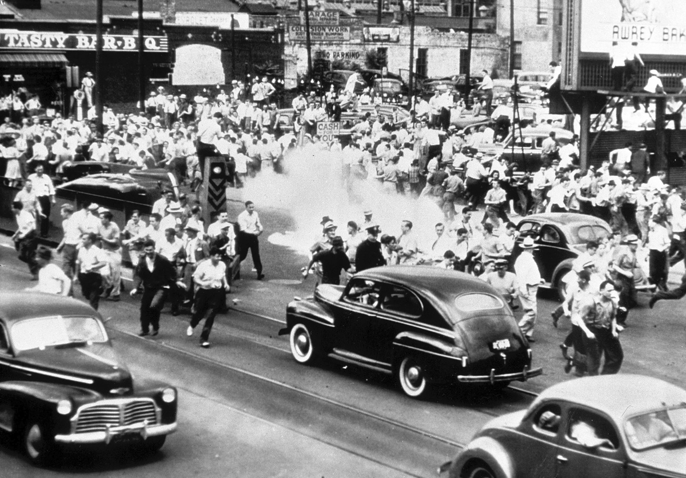
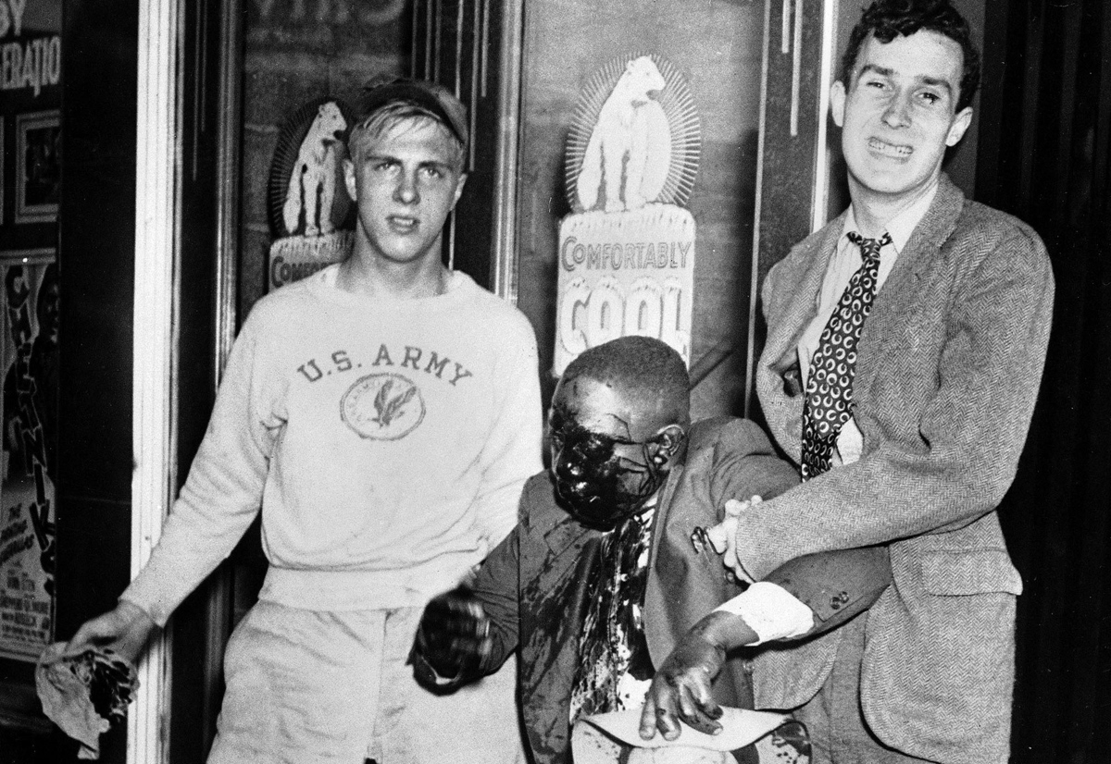
Riot of 1943
“Detroit is Dynamite. It can either blow up Hitler or blow up the U.S.”
http://www.theatlantic.com/photo/2015/01/detroit-in-the-1940s/384523/

Slide 25
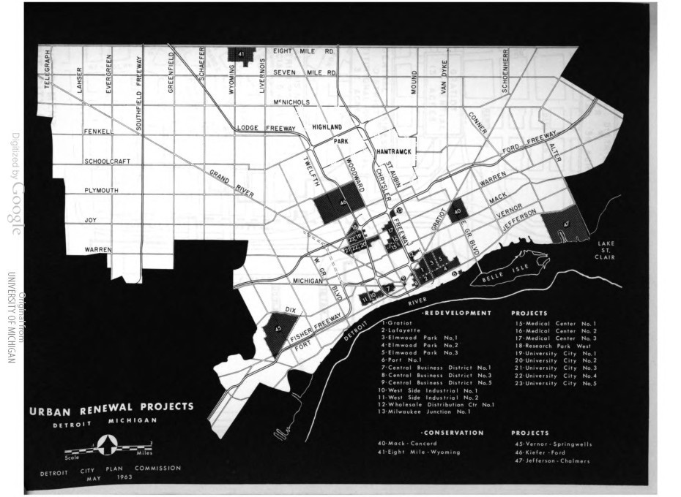
Effects
https://detroitenvironment.lsa.umich.edu/they-paved-paradise-and-put-up-a-freeway-demolishing-detroits-hastings-street/

Slide 26
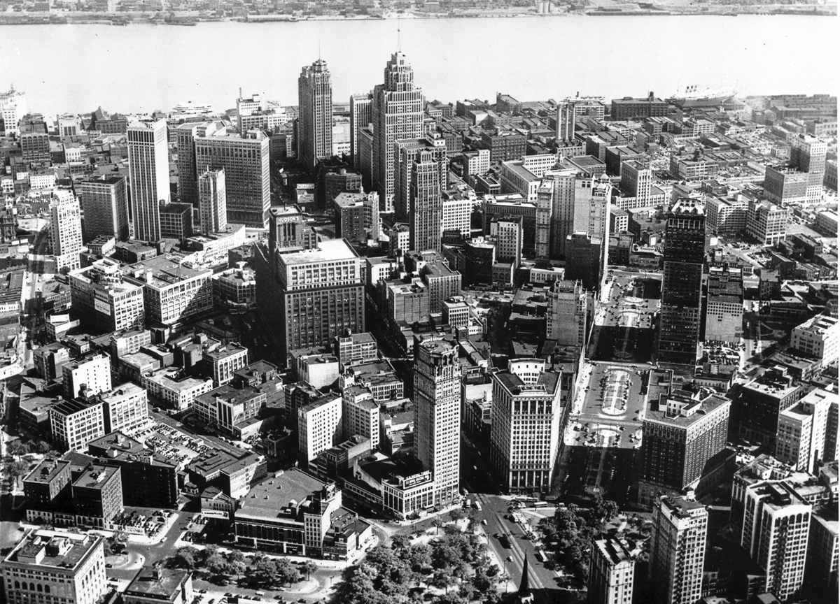
Detroit’s Golden Age
http://www.theatlantic.com/photo/2015/01/detroit-in-the-1940s/384523/

Slide 27
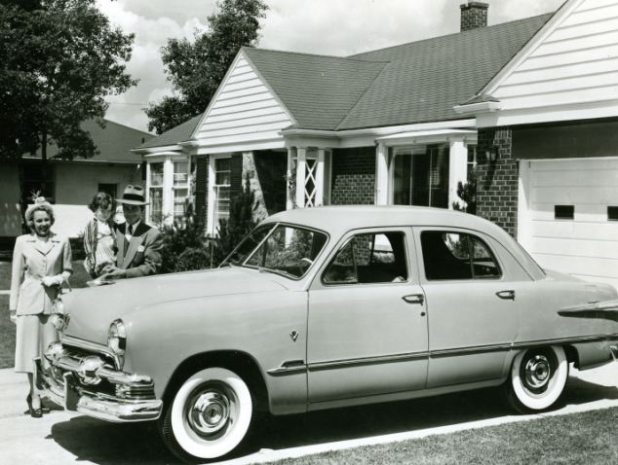
Impacts of WWII and the Growth of Unions
Higher Wages
Better benefits, pensions
Job security though union contracts and codes
Unionization of other industries due to success in auto industry
Blue-collar homeownership
http://www.dailymail.co.uk/news/article-2269966/Blighted-home-says-Detroit-going-bankrupt-Families-flee-leaving-streets-broken-governor-cuts.html

Slide 28
Barriers to Detroit Housing for African Americans
540,000 units available, only 47,000 for blacks
Reasons
  Low paying, insecure jobs
  Market is limited and expensive
  Black clients shunned
  Restrictive covenants
  Neighborhood improvement associations
  Bankers won’t lend to blacks
http://www.autolife.umd.umich.edu/
“Automobile in American Life and Society”
By Thomas Sugrue

Slide 29
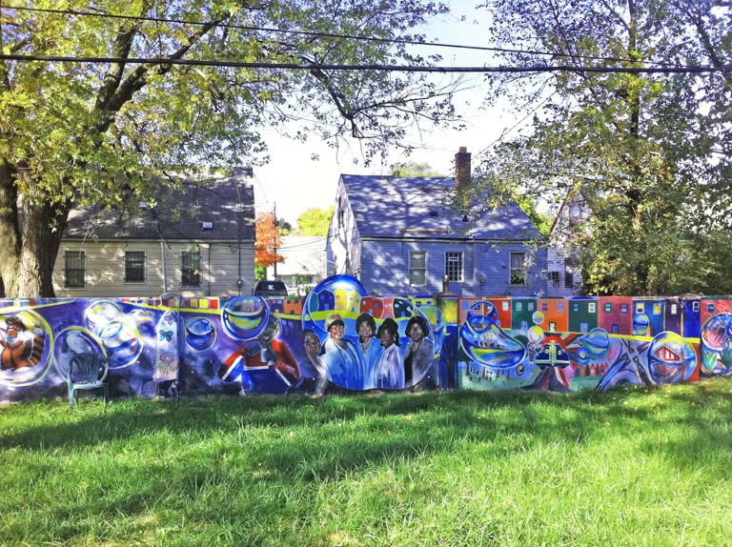
Redlining
Construction of “highly restricted and carefully controlled community.”
Federal Policy
  FHA
  HOLC
  VA
Construction of “highly restricted and carefully controlled communities”
Federal Home Loan Bank Board classified neighborhoods
“D” rating if African Americans in neighborhood
Results in ghettoization
http://detroit1701.org/Black-WhiteWall.htm

Slide 30
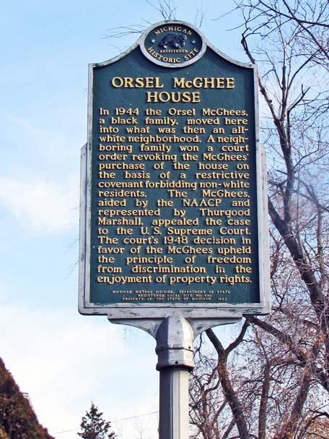
Challenging Restrictive Covenants in Court
McGhee vs. Sipes
Shelley vs. Kraemer (1948)
“. . .it is violative of the equal protection clause of the Fourteenth Amendment for state courts to enforce them.”
http://detroit1701.org/McGheeHome.html#.V-G-YrXerV1

Slide 31
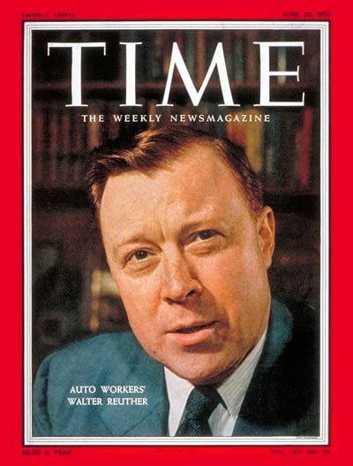
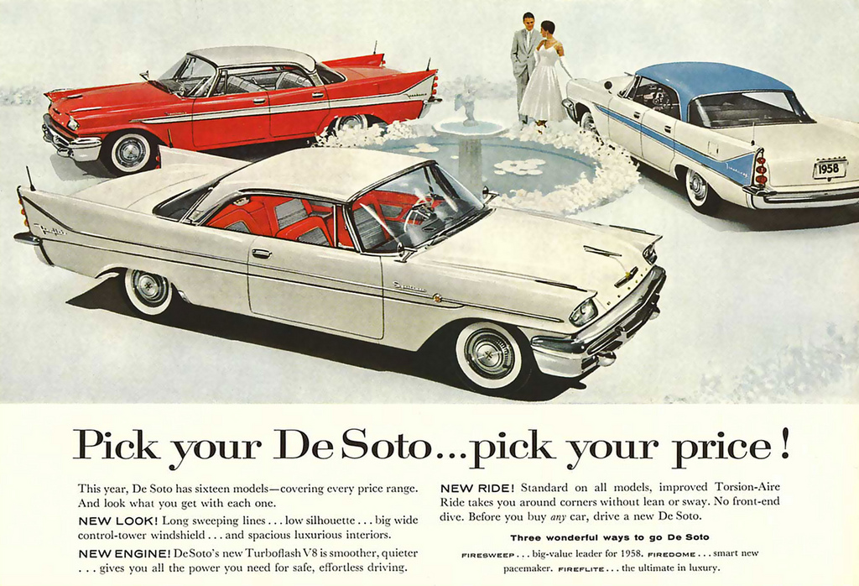
Live By the Car:
The Auto Industry at Its Peak
(1948-1967)
https://s-media-cache-ak0.pinimg.com/originals/f6/55/b7/f655b7a324cfbd4121c801c2471cf393.jpg
http://img.timeinc.net/time/magazine/archive/covers/1955/1101550620_400.jpg

Slide 32
Die by the Car: The Decline of the Auto Industry in Detroit
Decentralization
  Corporate Actions
    Movement
    Reasons
  Federal Actions- Military Spending
Automation
  Replace assembly-line jobs
  Reasons
Effects
The Origins of the Urban Crisis: Race and Inequality in Postwar Detroit
By Thomas Sugrue

Slide 33
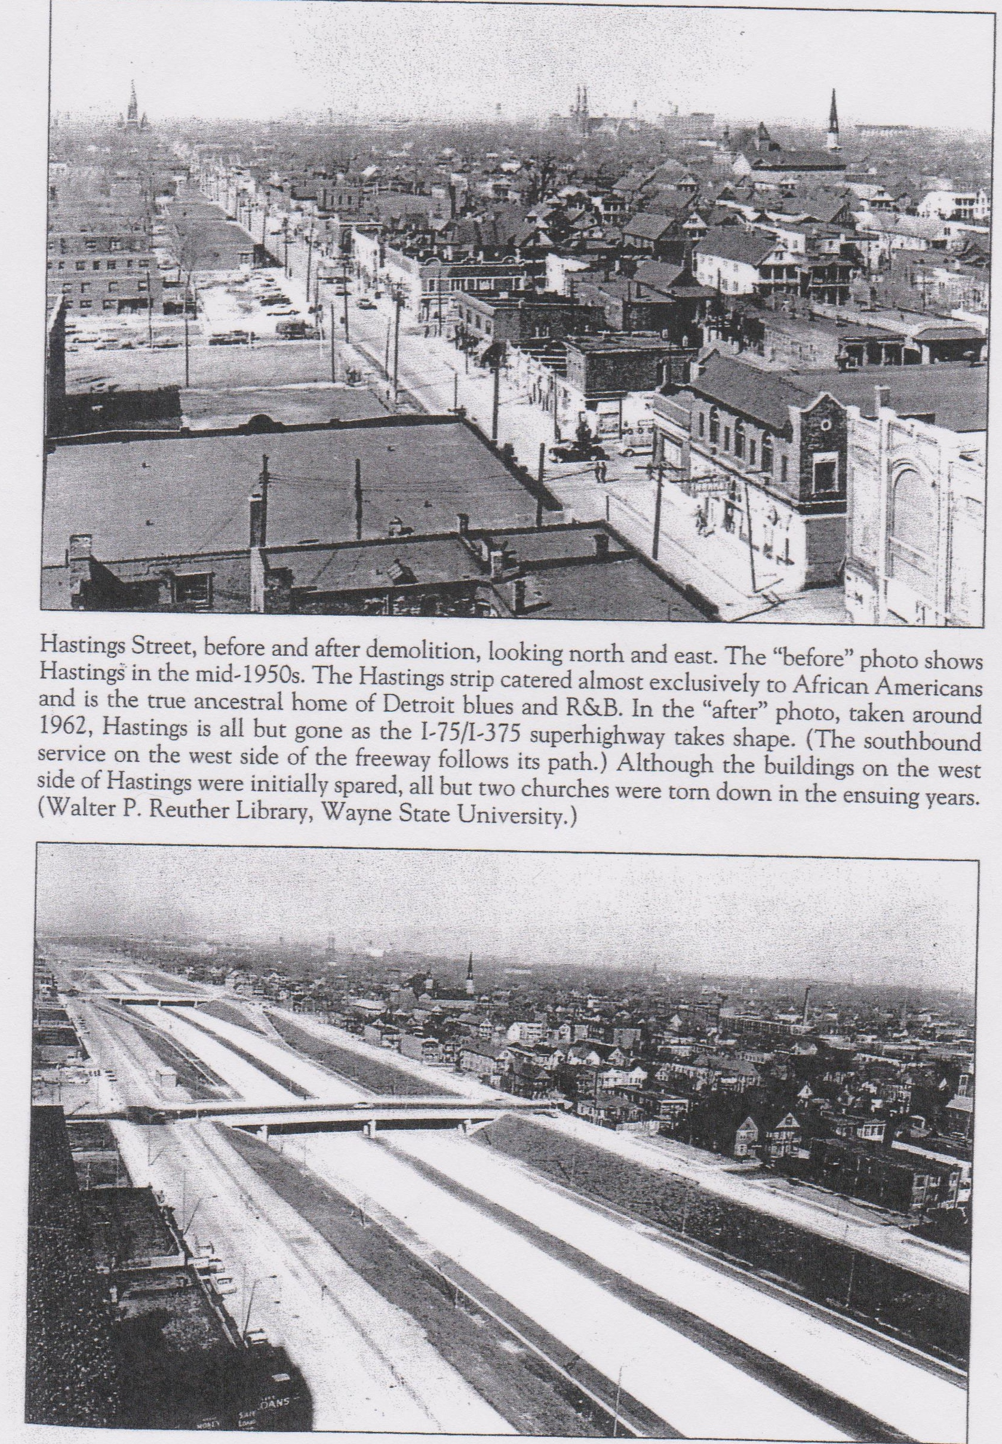
Die by the Car:
The Decline of Detroit
Depopulation of Detroit
  White Flight
  Federal and Local Governments Role
    Federal Highway Act
    Housing FHA, HOLC, VA
    Urban Renewal
  Private Actions
Disinvestment in Detroit
https://detroitenvironment.lsa.umich.edu/they-paved-paradise-and-put-up-a-freeway-demolishing-detroits-hastings-street/

Slide 34
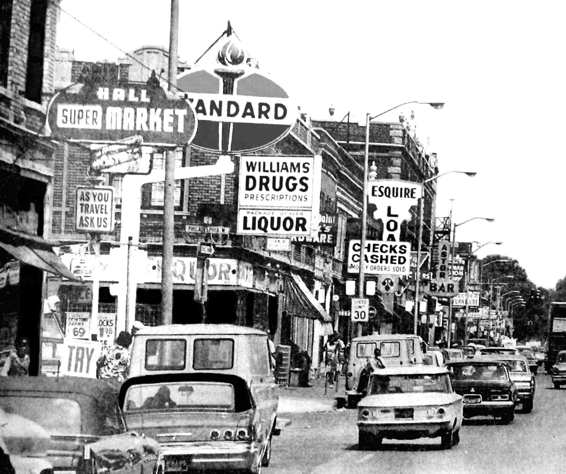
Impact on a City of African Americans
Devastating loss of manufacturing jobs
African American population increases
Cannot leave the central city
  Cars
  Lack of public transportation
  Cannot relocate
No investment in African American neighborhoods
  Schools
  Social services
  Public transportation
https://detroitenvironment.lsa.umich.edu/wp-content/uploads/2014/04/12th_street_detroit_before.jpg

Slide 35
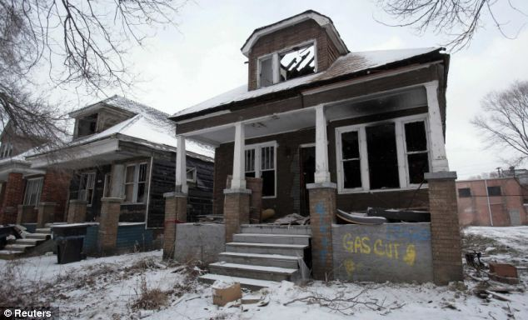
The Industrial Decline of the Motor City: “Choices Made and Not Made”
Deindustrialization
  Corporate Actions
  Federal Actions
Depopulation
  Federal and State Actions
  Private Actions
Disinvestment
Discrimination
http://www.dailymail.co.uk/news/article-2269966/Blighted-home-says-Detroit-going-bankrupt-Families-flee-leaving-streets-broken-governor-cuts.html

Slide 36
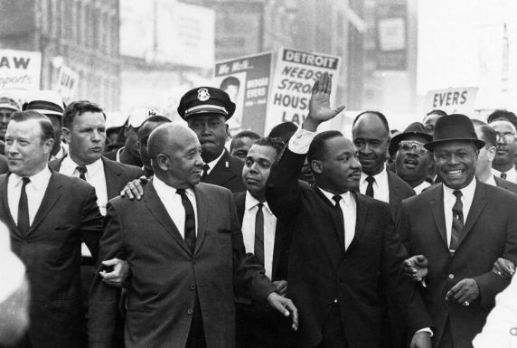
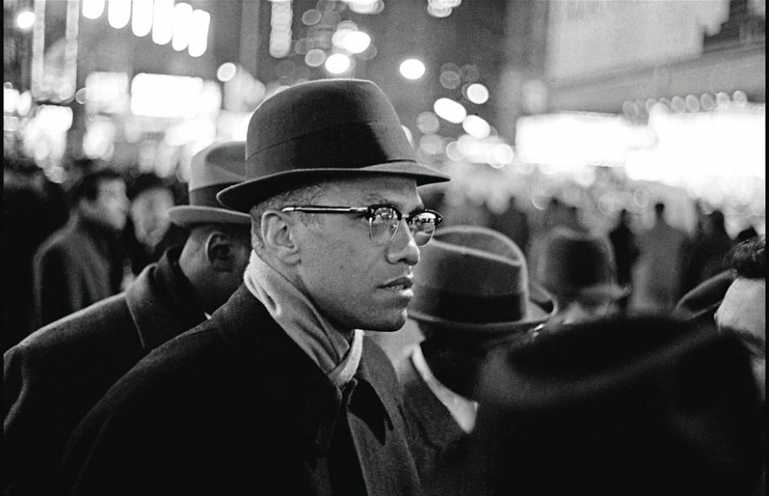
Activism and the Radicalization of Detroit: “Two Centers of Gravity”
Dr. Martin Luther King, Jr.
Malcolm X
http://reuther.wayne.edu/files/images/306.preview.jpg
http://theredlist.com/media/database/muses/icon/iconic_men/1960/malcolm-x/042-malcolm-x-theredlist.jpg

Slide 37
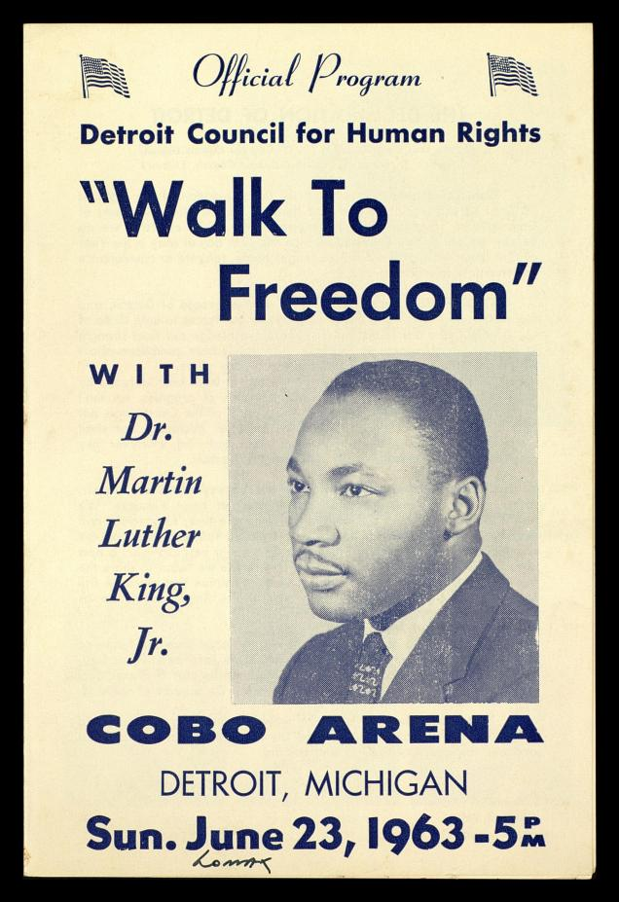
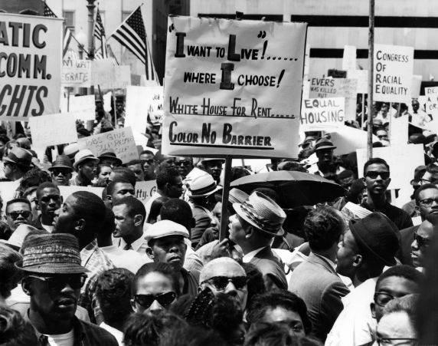
Great March on Detroit
June 23, 1963
http://www.thekingcenter.org/archive/document/detroit-council-human-rights-walk-freedom
http://motorcitymuckraker.com/wp-content/uploads/2013/01/MLK-March.jpg

Slide 38
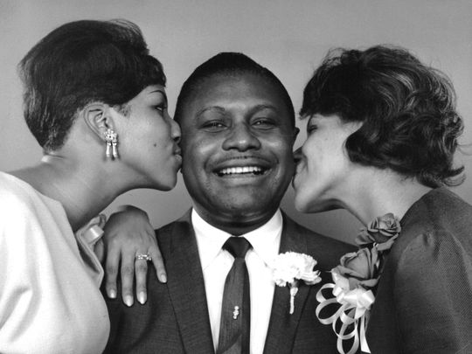
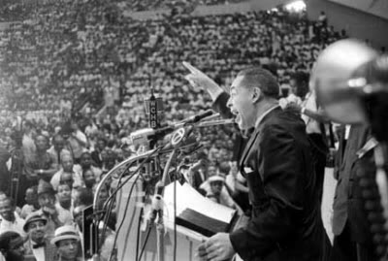
Great March on Detroit Organizers
Rev. C.L. Franklin
Rev. Albert B. Cleage
http://www.freep.com/story/news/local/michigan/detroit/2016/06/24/aretha-franklin-sings-detroit-street-renamed-her-dad-rev-cl/86358544/
http://cmpnorway.blogspot.com/2009/11/did-you-know-aboutrev-albert-cleage-aka.html

Slide 39
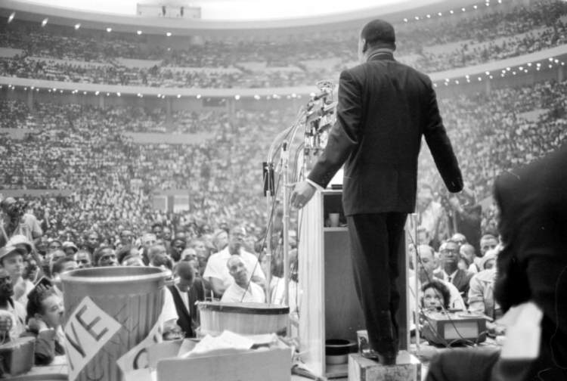
MLK Speech at the Great March on Detroit Analysis
http://photos.metrotimes.com/photos-martin-luther-king-jr-visits-detroit-1963/?slide=8&11342jp2-wi-he-re1-x0-y0-sw-sh-ro-final

Slide 40


Nation Of Islam in Detroit
Elijah Poole
Elijah Muhammad
Malcolm Little
Malcolm X
http://www.arogundade.com/Resources/malcolm-x-young-BIG.jpg
http://www.biography.com/people/elijah-muhammad-9417458

Slide 41

“Message to the Grass Roots”
Malcolm X at the Northern Negro Grass Roots Leadership Conference
http://swagghopent.com/main/black-history/happy-birthday-malcolm-x/

Slide 42

Diversity of Detroit Activism: The Black Panthers
Diversity of Detroit Activism:

Slide 43

Diversity of Detroit Activism: Rosa Parks
http://www.handsupunited.org/black-history-month/2015/2/4/todays-birthday-rosa-parks-civil-rights-leader

Slide 44

Diversity of Detroit Activism: Grace Lee and James Boggs
http://michiganradio.org/post/remembering-detroits-grace-lee-boggs#stream/0

Slide 45

Diversity of Detroit Activism: Viola Gregg Liuzzo
http://reuther.wayne.edu/node/12782

Slide 46


Diversity of Detroit Activism: DRUM
https://www.tumblr.com/search/dodge%20revolutionary%20union%20movement
http://portland.indymedia.org/en/2007/06/361157.shtml

Slide 47


Detroit Riot in 1967
Analysis of Langston Hughes’s
“The Backlash Blues”
https://libcom.org/gallery/1967-detroit-riots
http://atlantablackstar.com/2014/07/28/9-facts-know-detroit-race-riots/2/

Slide 48


Detroit Riot in 1967
https://libcom.org/gallery/1967-detroit-riots

Slide 49


Detroit Riot in 1967
https://libcom.org/gallery/1967-detroit-riots
http://www.freep.com/story/news/local/michigan/detroit/2016/06/16/1967-detroit-riots-historical-museum/85904736/

Slide 50


Aftermath
http://www.freep.com/story/news/local/michigan/detroit/2016/06/16/1967-detroit-riots-historical-museum/85904736/

