Slide 1
EXCHANGE
The Life and Music of George and Ira Gershwin

Slide 2
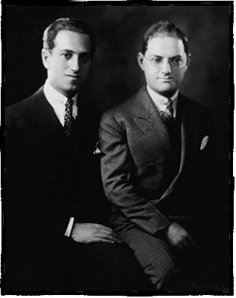
George and Ira Gershwin

Slide 3
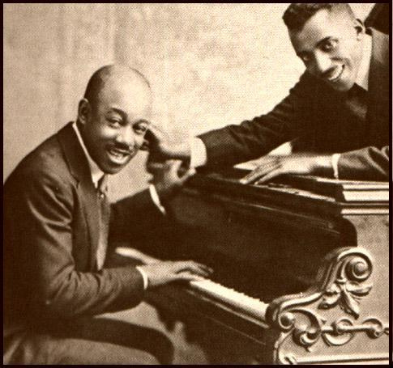
Musical Influences on Gershwin:
Eubie Blake and Nobel Sissle
First famous African American songwriting team
First African Americans to produce vaudeville and Broadway shows
Members of Europe’s Clef Club and the Harlem Hellfighters
“Charleston Rag”
“Shuffle Long”
https://dbhsharlemrenaissance3.wikispaces.com/Eubie+Blake

Slide 4
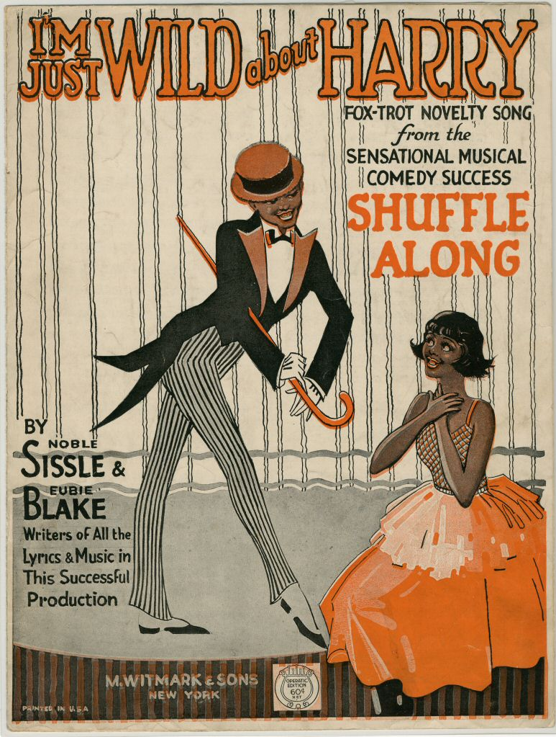
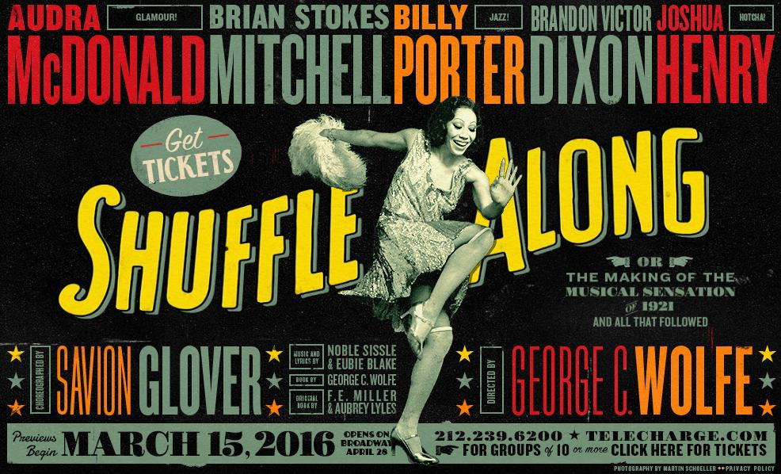
Eubie Blake and Nobel Sissle
http://broadwayblack.com/shuffle-along-getting-ready-go-full-swing/
http://static.wixstatic.com/media/1b0c93_a91b38e9aa234e9092f05827bd022994.jpg

Slide 5
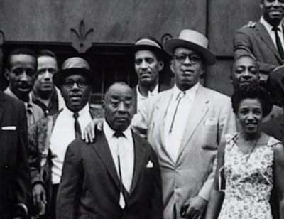
Musical Influences on Gershwin:
Luckey Roberts
Harlem Hellfighter’s piano player
Wrote music for shows and piano rolls after WWI
First pianist to record Harlem stride
“Junk Man Rag”
http://www.a-great-day-in-harlem.com/lion.html

Slide 6
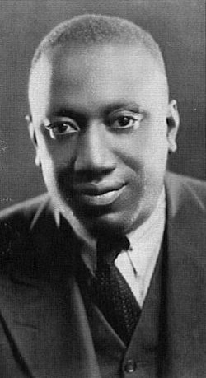
Musical Influences on Gershwin
James P. Johnson
Father of Stride Piano
The most influential stride pianist
“Carolina Shout”
http://www.findagrave.com/cgi-bin/fg.cgi?page=gr&GRid=47379076

Slide 7
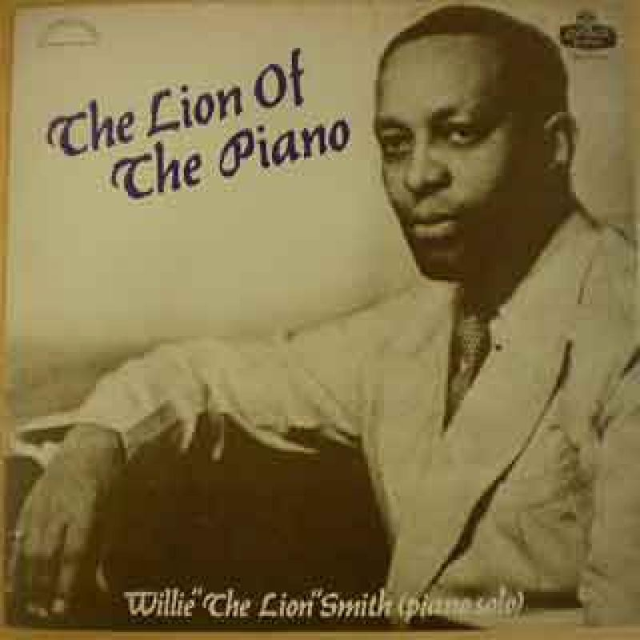
Musical Influences on Gershwin:
Willie “The Lion” Smith
Enlisted in U.S. Army during WWI
While in France, exposed to major French composers: Debussy, Ravel, Satie
Mentored young musicians such as Ellington and Monk
“Echoes of Spring”
http://www.njarts.net/350-jersey-songs/finger-buster-willie-the-lion-smith/

Slide 8
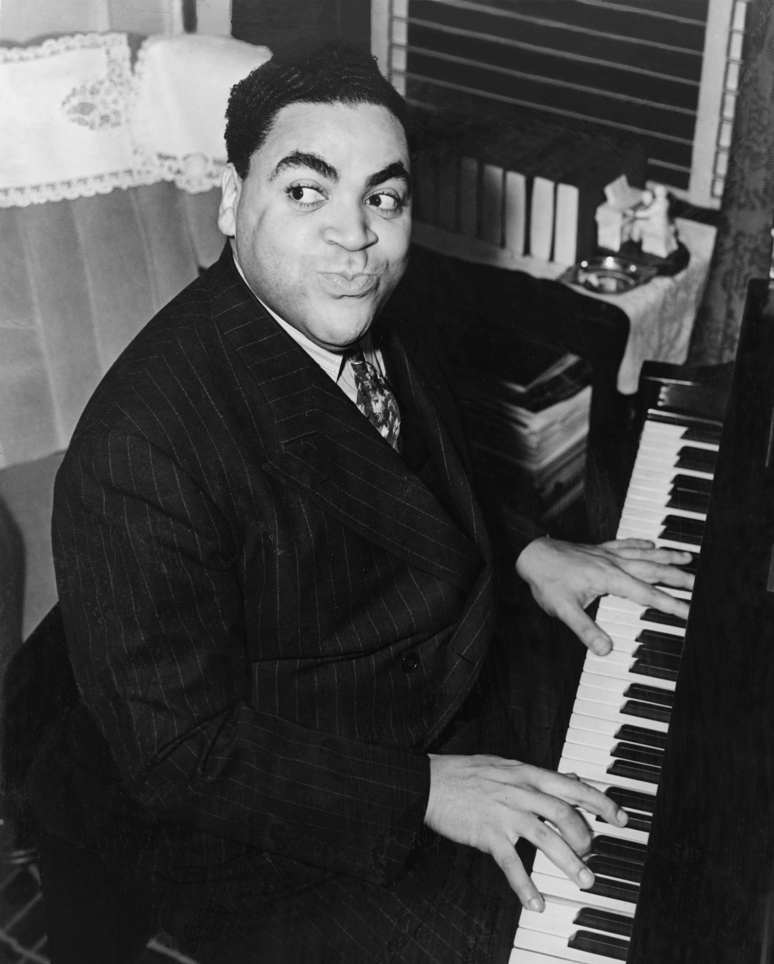
Contemporary Jazz Pianists:
Influences on the Gershwins
Fats Waller
“Show Business”
Accomplished Harlem Stride pianist
Composed over 600 songs
Ghost writer for many Broadway shows
“Ain’t Misbehavin’”
https://en.wikipedia.org/wiki/Fats_Waller

Slide 9
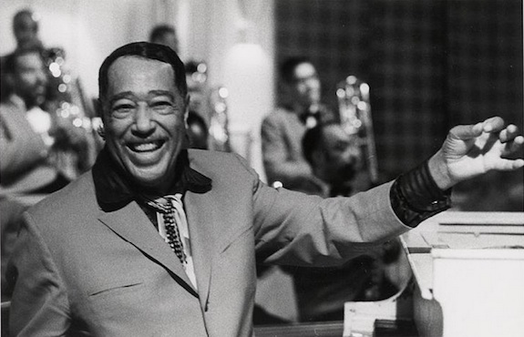
Contemporary Jazz Pianists:
Influences on the Gershwins
Duke Ellington
Most influential American composer
Made great music for over 50 years
Student of Will Marion Cook and Willie “The Lion” Smith
Compositions influenced by George Gershwin’s early works
“Harlem”
http://www.smithsonianmag.com/ist/?next=/smithsonian-institution/photos-wynton-marsalis-honoring-duke-ellington-13393661/

Slide 10
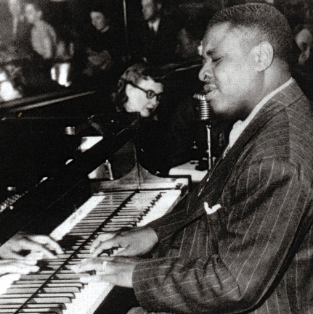
Contemporary Jazz Pianists:
Influences on the Gershwins
Art Tatum
Most virtuosic jazz pianist in history
Harmonic knowledge informed the bebop style
Vladimir Horowitz was his biggest fan
“Willow Weep for Me”
http://arttatum.jazzgiants.net/biography/

Slide 11
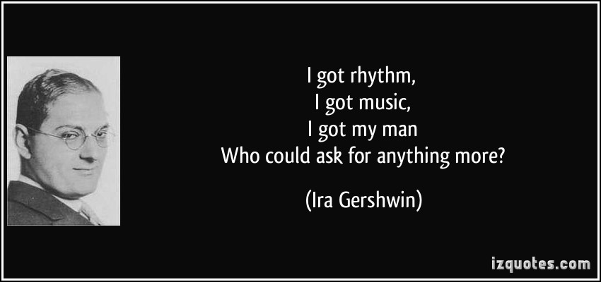
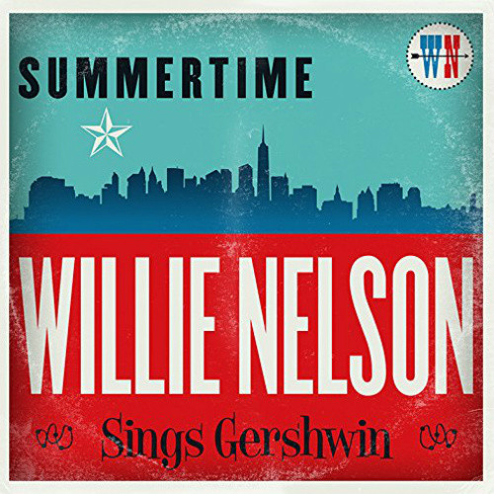
Gershwin Compositions:
Evidence of the Exchange
http://quotesgram.com/gershwin-quotes/
http://zumic.com/music-videos/217804/summertime-willie-nelson-gershwin-cover-youtube-official-video/

Slide 12
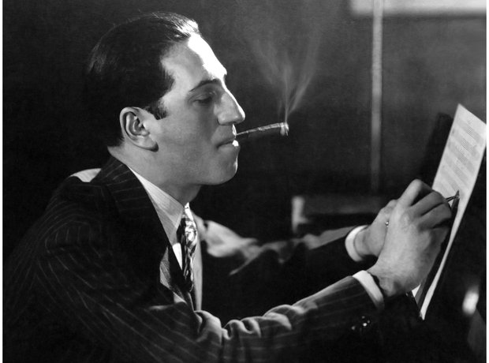
Gershwin Contributions to Jazz
Chord progressions
Songs were favorites of jazz musicians
Jazzy rhythms
Rich harmonies
American song form –
32 bar
http://www.classicfm.com/composers/gershwin/guides/gershwin-facts/gershwin-piano-6/

Slide 13
Gershwin’s Contribution to Jazz
“Embraceable You” – Charlie Parker Quartet
“They Can’t Take That Away From Me” – Sarah Vaughn
“S’Wonderful” – Sarah Vaughn and Clifford Brown
“Bess You is My Woman Now” – Dinah Washington and Clifford Brown

