Slide 1
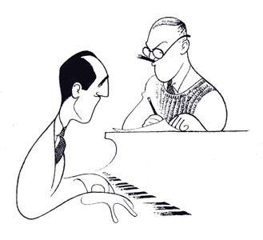
The Gershwin Legacy:
Fascinating Rhythms of the People of New York

Slide 2
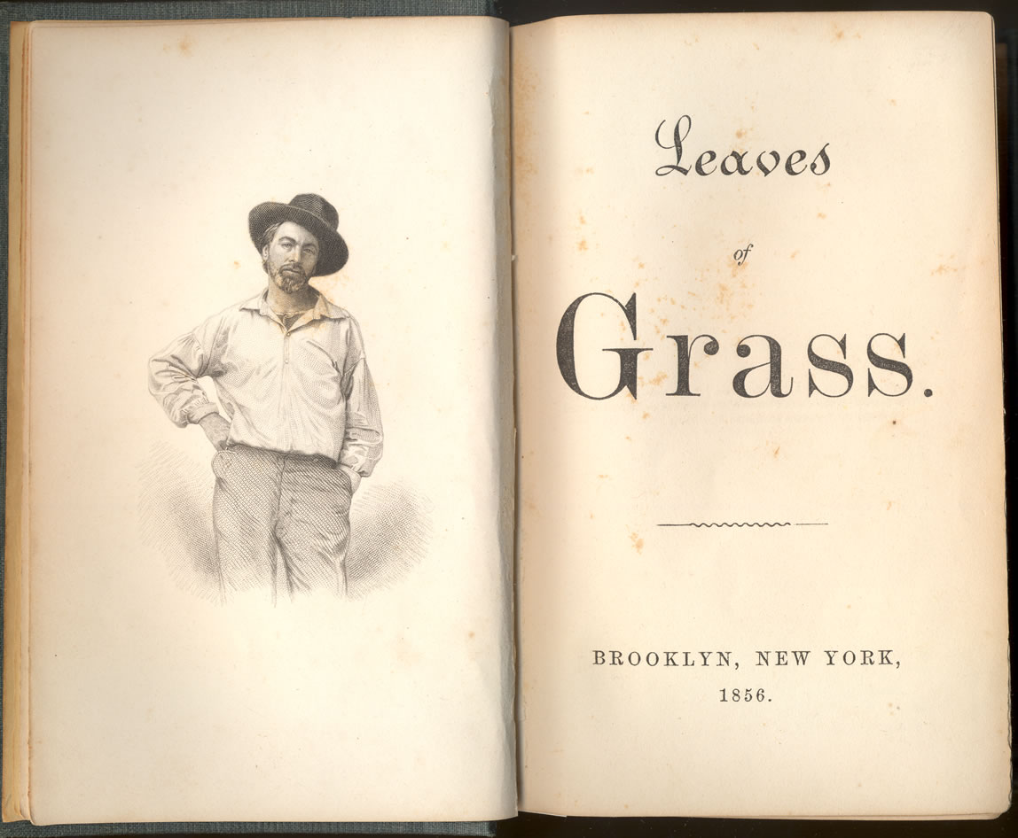
Walt Whitman
“You Whoever You Are”
https://prezi.com/weyuffcs71lr/walt-whitman/

Slide 3
The Walt Whitman Connection
Whitman found in the dialect of the freed slaves, the possibility of a “grand American opera.”
Jewish migrants took Whitman seriously, calling him the “great gray father,” and believing he was “a comrade whose embrace included them.”

Slide 4
“You Whoever You Are” from
“Salut au Monde” (1856)
Each of us is inevitable,
Each of us is limitless –
Each of us with his or her right upon the earth,
Each of us allow’d the eternal purports of the earth,
Each of us here as divinely as any is here.

Slide 5
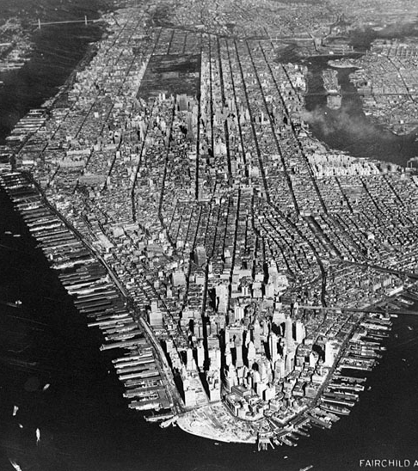
Consider:
That the Great Migration and East European Jewish migration were part of an international migration pattern
The similar, yet unique experiences of African Americans and Jewish Americans as migrants in the United States

Slide 6
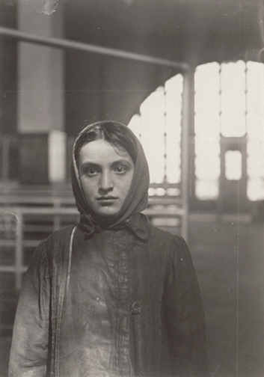
Jewish Migration: 1880-1924
Statistics:
1820-1920- 45 million immigrants to the U.S., 3 million are Jewish
1881-1924 – 2.5 million East European Jewish immigrants
  10x over previous 6 decades
1/3 of East European Jews leave
http://www.geh.org/fm/lwhprints/htmlsrc/ellis-island_sum00010.html#77:0177:0148

Slide 7
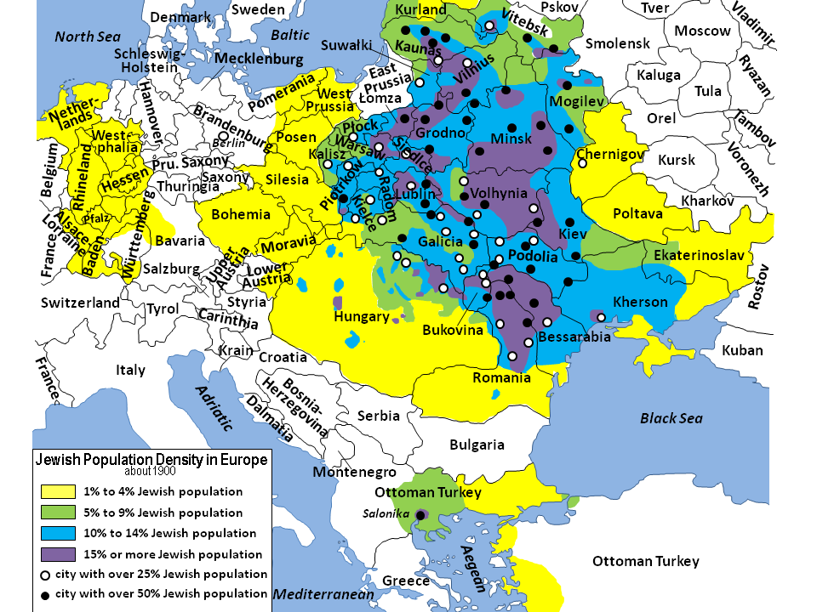
Jewish Population Density in Europehttps://familysearch.org/learn/wiki/en/Jewish_Population_Maps

Slide 8
Push Factors
Population Explosion
1800- 1.25 million
1900- 6.5 million despite migration to U.S. and no migration to the area
Economic Factors
Scarcity
Jewish trades in decline
Railroads
European economy not sustainable
Galician Jews among the poorest in Europe

Slide 9
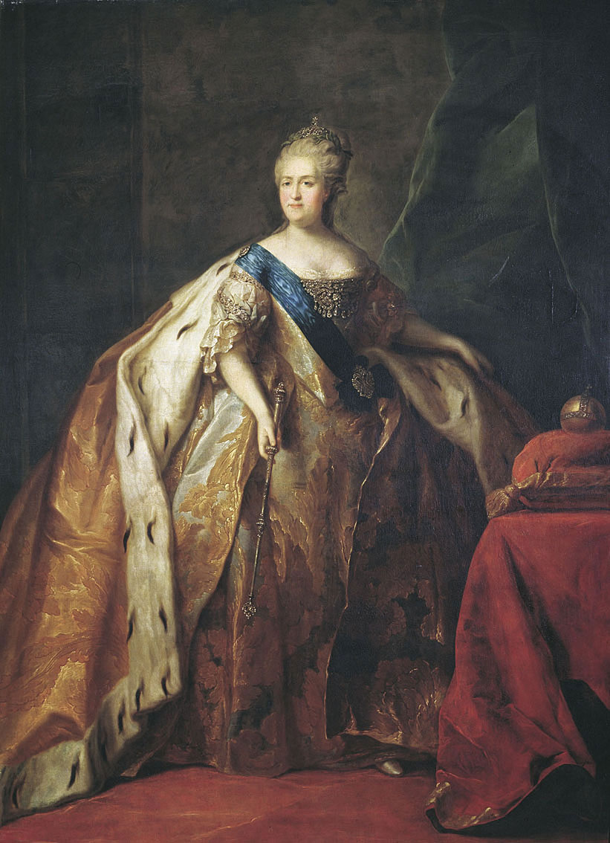
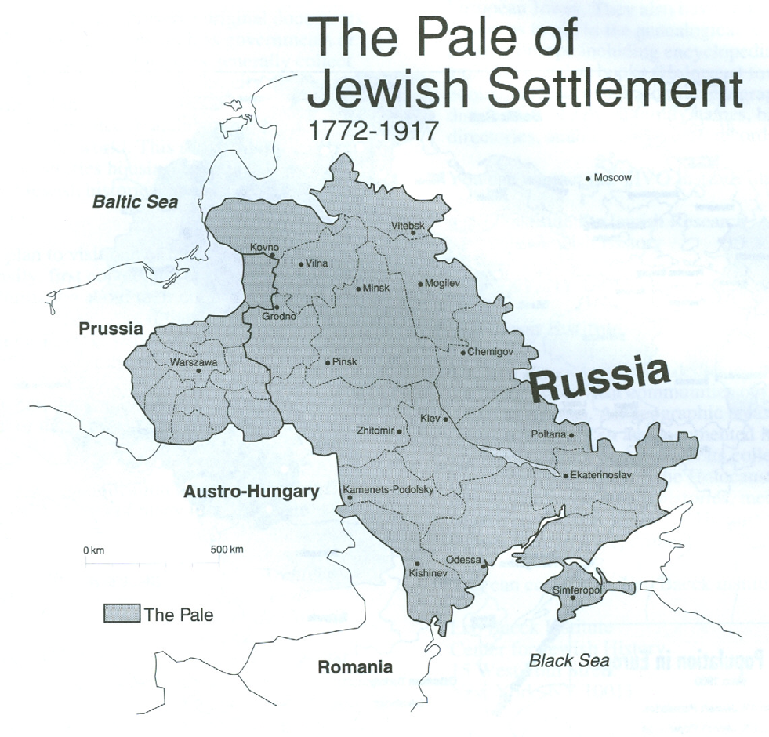
Tsarist Policies
http://expositions.nlr.ru/MusicalManuscripts/images/4.jpg
https://familysearch.org/learn/wiki/en/File:Pale_of_Jewish_Settlement.png

Slide 10
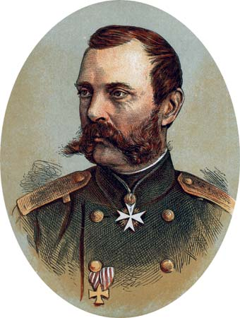
Alexander II: “Tsar Liberator”

Slide 11
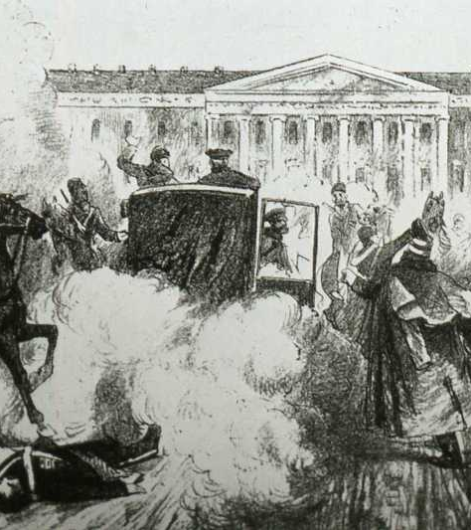
Assassination of Alexander II - 1881
Impact on Jews
No rights
Harassment by authorities
Restrictions on urban Jews and educational institutions
Pogroms
http://pages.uoregon.edu/kimball/images/1881mr01%20A-2%20asx%20CIV773.jpg

Slide 12
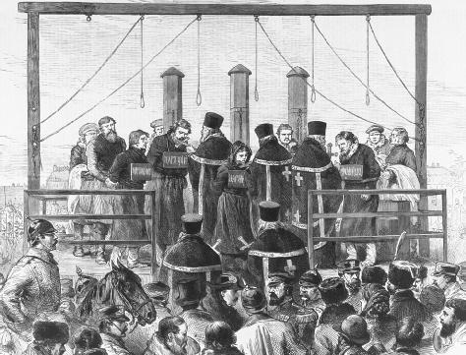
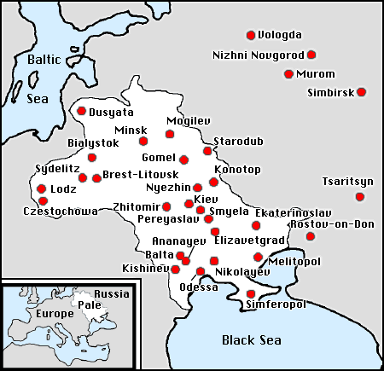
First Wave: 1881-1884 Pogroms
http://callisto.ggsrv.com/imgsrv/FastFetch/UBER2/eaie_0001_0004_0_img0538
http://zionism-israel.com/dic/Russian_pogrom_map.gif

Slide 13
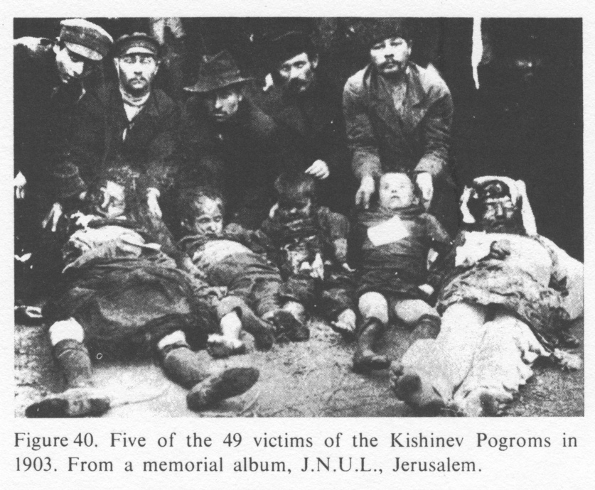
Second Wave
1903-1906
1903 – Kishinev (Chisinau, Moldova)
45 Jews murdered
1,300 homes and shops destroyed
1905 – Odessa
400 Jews murdered
1600 properties destroyed
http://www.hist-chron.com/russland-bis-1917/EncJud_Russia03-russ-pogrom-angewohnheit-1881-1914-ENGL.html

Slide 14
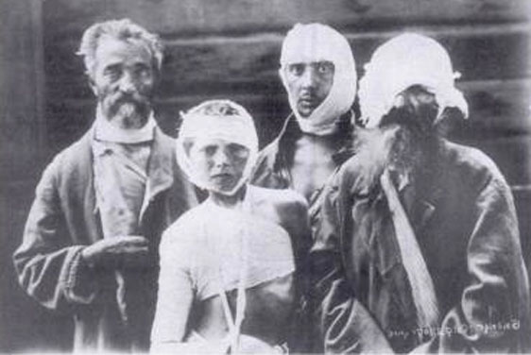
Third Wave: World War I, 1917-1921
Kiev – 1919
Murder
Rape
Destruction of property
Homelessness
White Army troops
http://www.allrussias.com/images/interp_pogrom_victims.jpg

Slide 15
Impacts
May or Temporary Laws – 1882
  Prohibited Jewish settlement in large numbers in rural villages of Pale
  Jews cannot rent or buy property
  Jews removed from liquor trade and selling on Sundays and holidays
  No civil service jobs for Jews
  ½ million forced from homes
Jews a haunted people
Impossibility of integration into Russian society

Slide 16
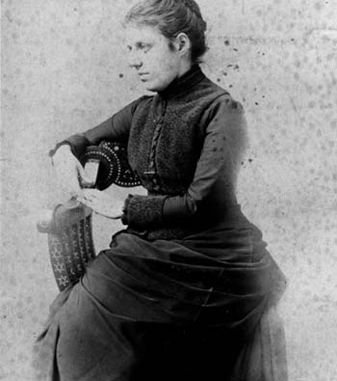
Impacts: Emma Lazarus
Songs of a Semite (1882)
“The New Colossus”
http://jwa.org/media/emma-lazarus

Slide 17
Poetry Analysis
Emma Lazarus, “The New Colossus”
  Systematic, Process-based, Discussion- producing, Content Analysis
  Proprietary Concerns?—Different ages, different groups, different “baggage.”
  Uses:
    Whole or Group Activity
    Independent Reading
    Reinforcement Activity
    Enrichment Activity

Slide 18
Impacts
Mass Protests in U.S.
Galvanizes American Jews Politically
NAACP
Jews Turn to Two Ideologies
  Marxist Socialism (The Bund)
  Zionism

Slide 19
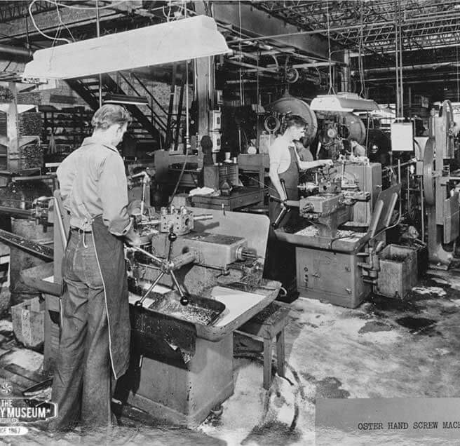
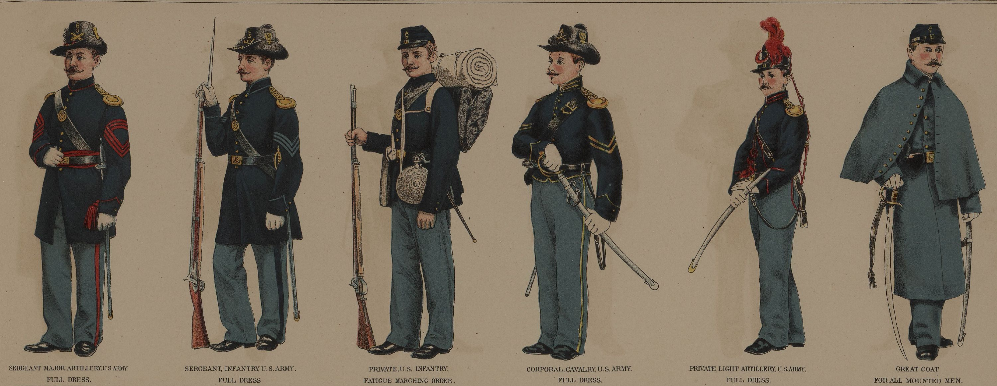
Pull Factors: The Garment Industry
http://historymuseumsb.org/singer-sewing-machine-company/
http://www.civilwaracademy.com/civil-war-uniform.html

Slide 20
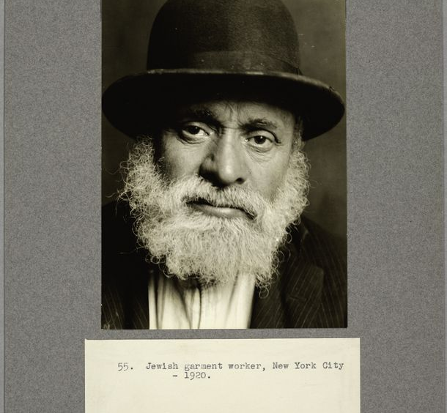
Jews and the Garment Industry
http://digitalcollections.nypl.org/items/510d47d9-4d9c-a3d9-e040-e00a18064a99/book?parent=be4f71d0-c608-012f-0ae7-58d385a7bc34#page/25/mode/2up

Slide 21
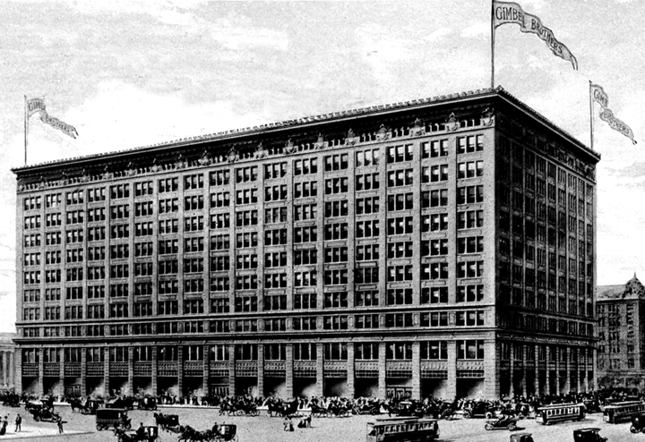
Merchandising
The “Trading Network”
German Jews
Language
Wholesalers
Newspapers
http://www.thedepartmentstoremuseum.org/2010/05/gimbel-brothers-new-york-city-new-york.html

Slide 22
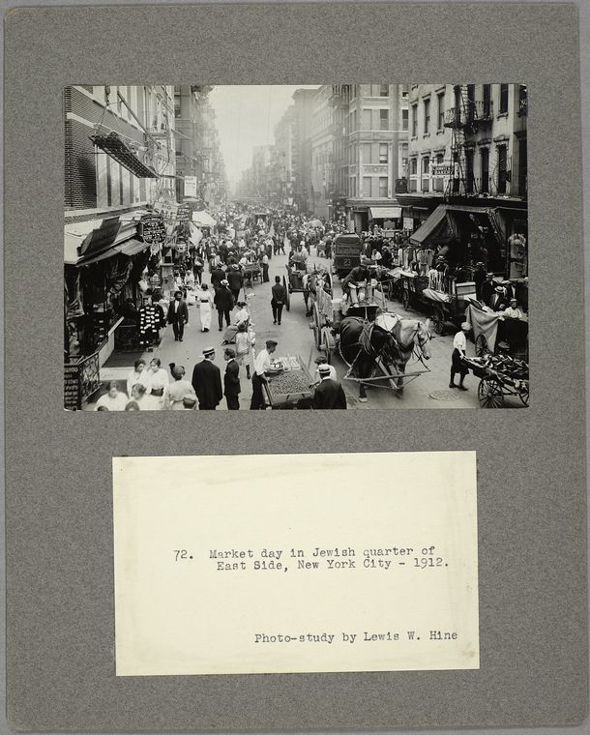
Peddling
Post- 1880
Language
“Trading network” expansion
Newspapers
http://digitalcollections.nypl.org/items/510d47d9-4d9c-a3d9-e040-e00a18064a99/book?parent=be4f71d0-c608-012f-0ae7-58d385a7bc34#page/25/mode/2up

Slide 23
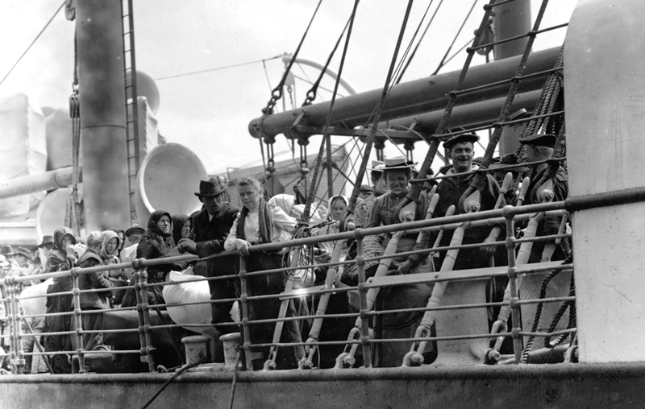
The Journey http://americanhistory.si.edu/onthewater/

Slide 24
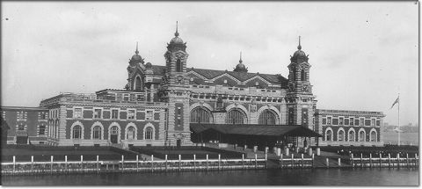
Ellis Island http://www.nps.gov/elis/learn/historyculture/index.htm

Slide 25
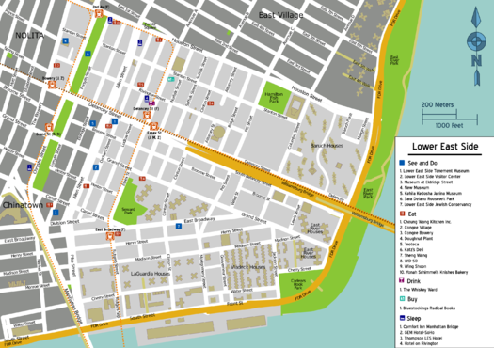
The Lower East Side
Location and Statistics
Location:
Lower Manhattan
Jewish Population Statistics in NYC
1890 – 60,000
1915-975,000, 28%
1924- 1,765,000
1927- 44%
https://en.wikivoyage.org/wiki/Manhattan/Lower_East_Side

Slide 26
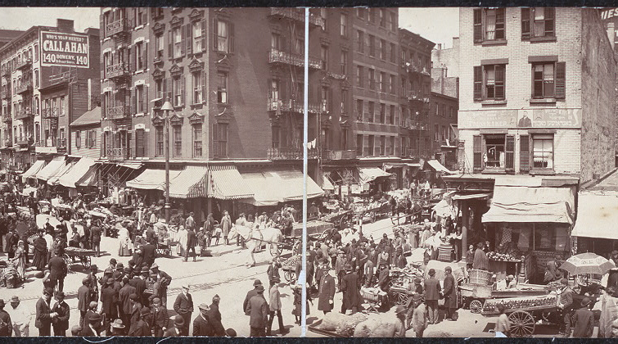
The Lower East Side http://www.loc.gov/teachers/classroommaterials/presentationsandactivities/presentations/immigration/polish6.html

Slide 27
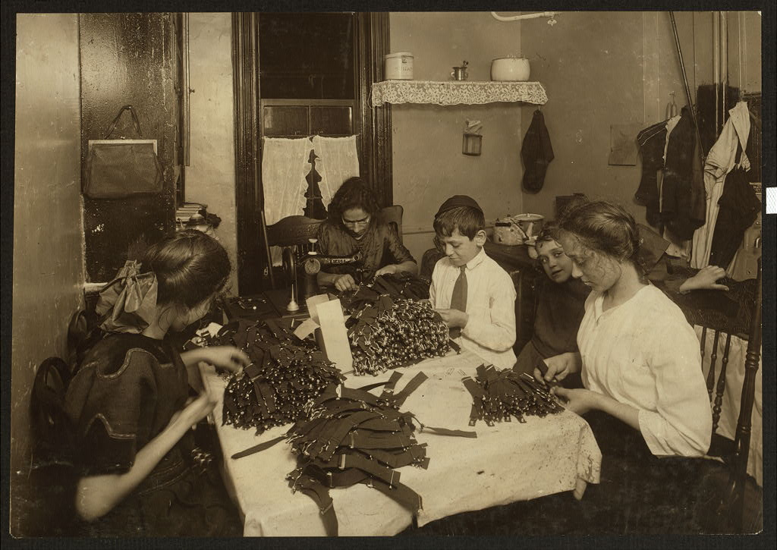
Anzia Yezierska
Salome of the Tenements
Take her away “from the crowded windows that hung dirty mattresses and bedding – flaunting banners of poverty.”

Slide 28
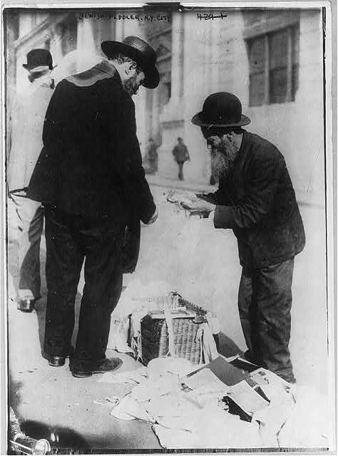
Anzia Yezierska
Salome of the Tenements
“the teeming ghetto, the haggling pushcart peddlers, and the dirt and din of “screaming hucksters”

Slide 29
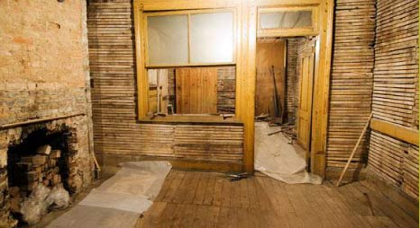
Tenement Museum https://tenement.org/about.html

Slide 30
Visualizing History

Slide 31
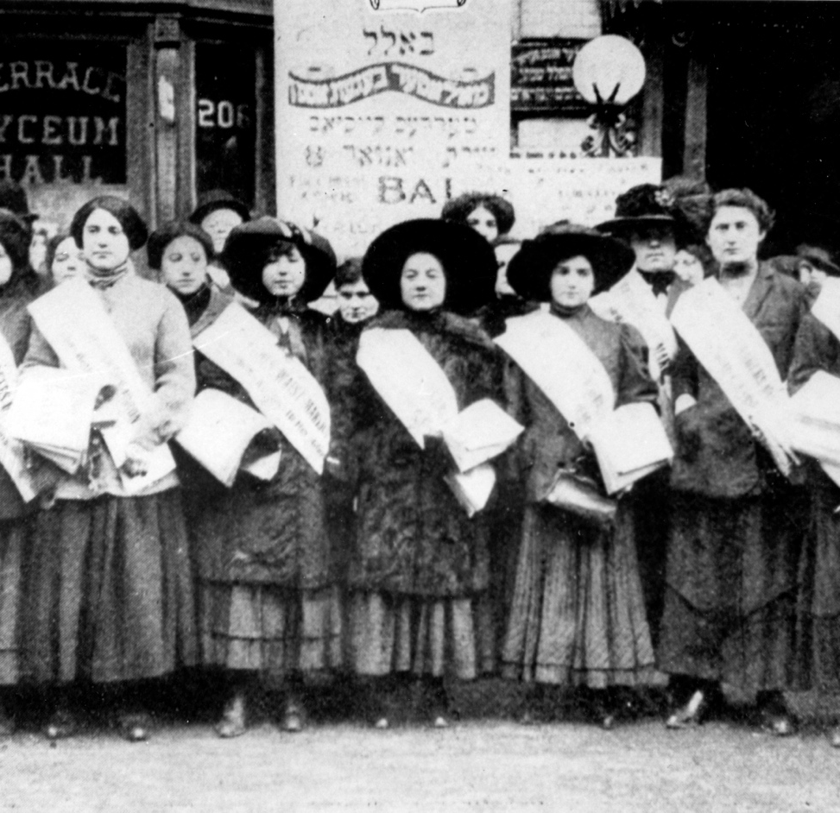
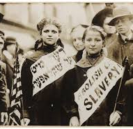
Work and Mobility:
Unionization of the Garment Industry
http://quod.lib.umich.edu/m/mp/images/9460447.0009.105-00000002.jpg
http://jwa.org/triangle/map/ilgwu

Slide 32
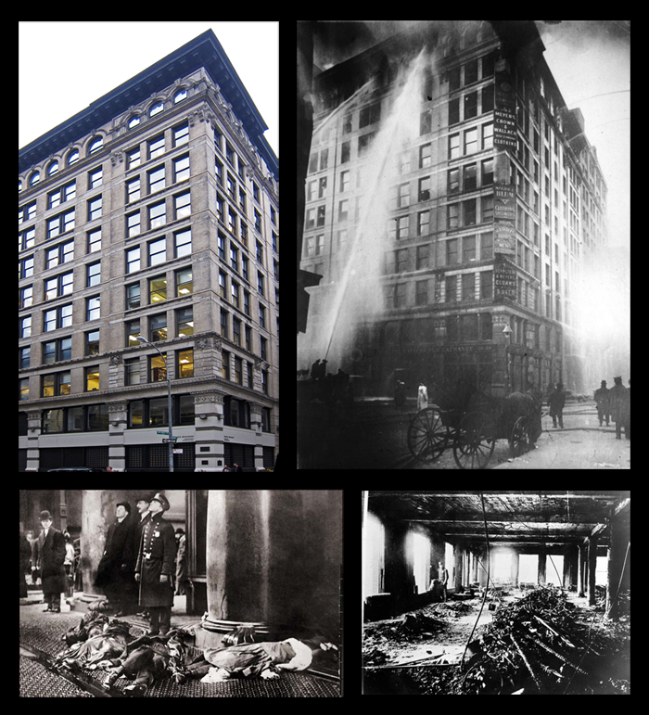
Triangle Factory Fire https://www.osha.gov/oas/trianglefactoryfire.html
Resources:
“Remembering the Triangle Fire” – Cornell University
“Triangle Factory Fire” – NEA
“Triangle Shirtwaist Factory Fire” – OSHA
Triangle: The Fire That Changed America by David Von Drehle

Slide 33

Adjustment, Assistance, Assimilation:
Major Themes http://digitalcollections.nypl.org/collections/ellis-island-photographs-from-the-collection-of-william-williams-commissioner#/?tab=navigation

Slide 34
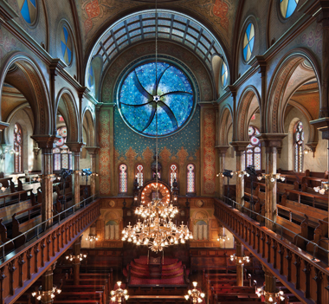
Adjustment, Assistance, Assimilation: Judaism
Eldridge Street Synagogue
Opened in 1887
First synagogue opened by Jews from Eastern Europe
http://www.eldridgestreet.org/

Slide 35
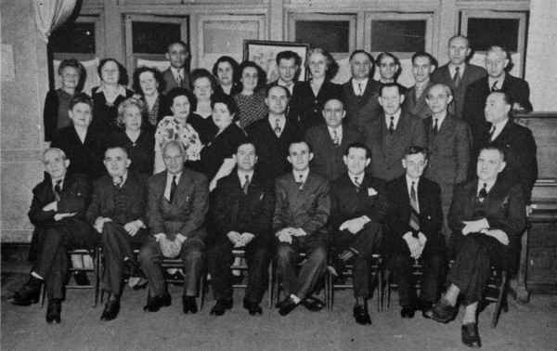
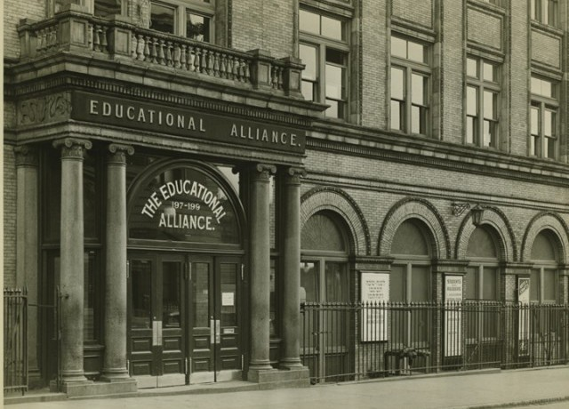
Adjustment, Assistance, Assimilation:
Communal Service
http://www.jewishgen.org/Yizkor/Czestochowa1/cze292.html
http://www.edalliance.org/our_history

Slide 36
Jewish Education
“What we want in this country is not Jews who can successfully keep up their Jewishness in a few large ghettos, but men and women who have grown up in freedom and can assert themselves wherever they are.”
Samson Benderly,
Jewish education reformer 1908
Day Schools
Sunday Schools
Female Leadership
Public Schools
Ideological Schools
Kehillah

Slide 37
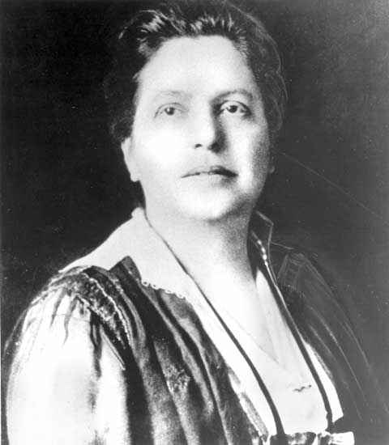
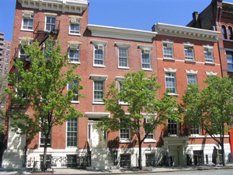
Henry Street Settlement House
Lillian Wald
http://jwa.org/encyclopedia/article/wald-lillian-d
http://www.henrystreet.org/about/our-buildings/henry-street-headquarters.html

Slide 38

Jewish Politics
Active in both major parties
Socialism
Zionism
  https://www.youtube.com/watch?v=1iVQdjMg_Y4

Slide 39

Jewish Press
Multi-lingual
Americanization
Forward still in print
http://observer.com/2015/04/the-jewish-daily-forward-is-assimilating/

Slide 40
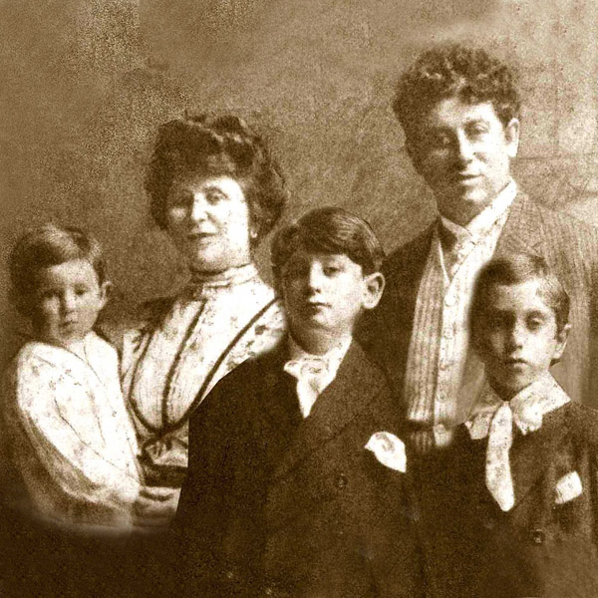
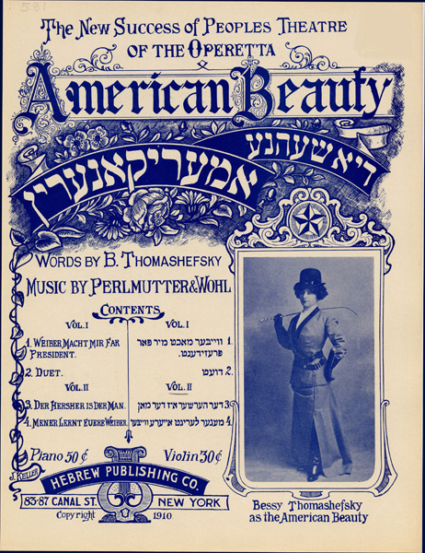
Yiddish Theater
Boris and Bessie Tomashefsky
http://www.thomashefsky.org/

Slide 41
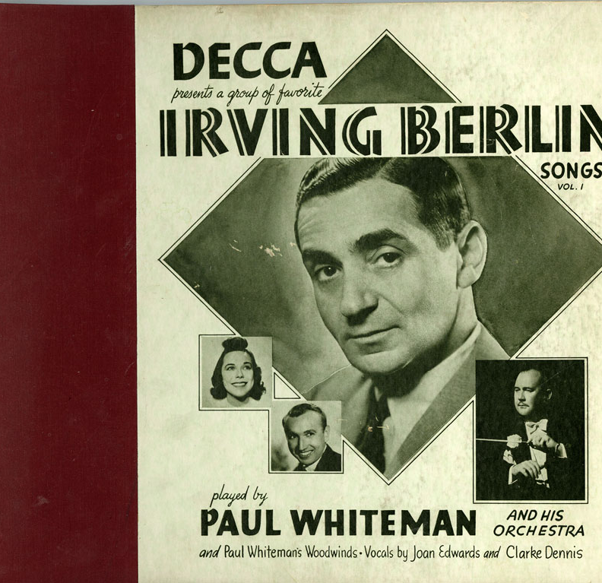
Jewish Musical Influences on Gershwin: Irving Berlin
Irving Berlin
Born Israel Isidore Baline
Yiddish-speaking home
Compositions written using the 32-bar American song form
Inspired the Gershwins
“God Bless America”
“Alexander’s Ragtime Band”
“White Christmas”
“Cheek to Cheek”
http://faujsa.fau.edu/blog/tag/irving-berlin/

Slide 42
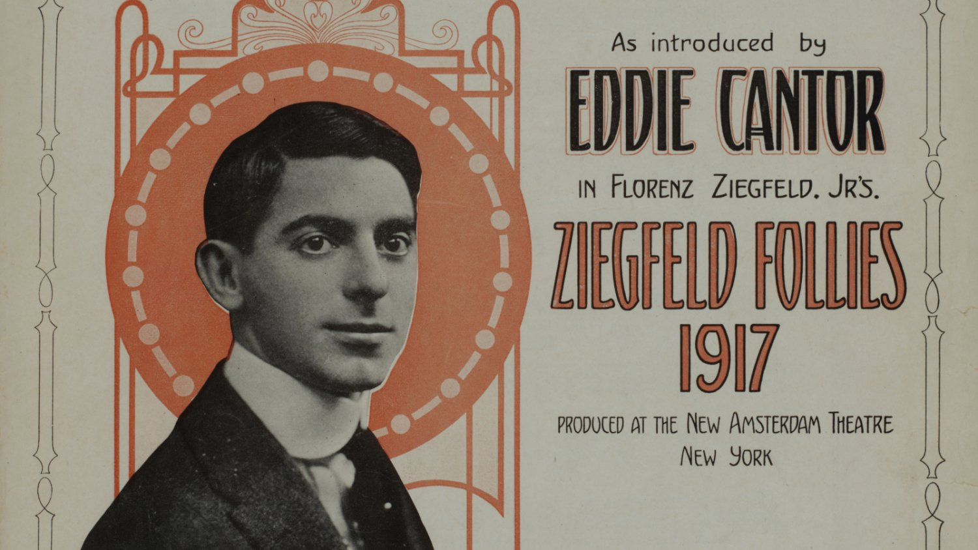
Musical Influences on Gershwin
Eddie Cantor
Born Edward Israel Itzkowitz
Started career in Yiddish Theater
To sing jazz he went to Detroit to sing with the Jean Goldkette Orchestra
Arrangers of the Goldkette Orchestra help make Gershwin famous
Use of slang inspired Ira Gershwin
“Makin’ Whoopee”
http://www.spotlightonbroadway.com/broadway-stars-0

Slide 43
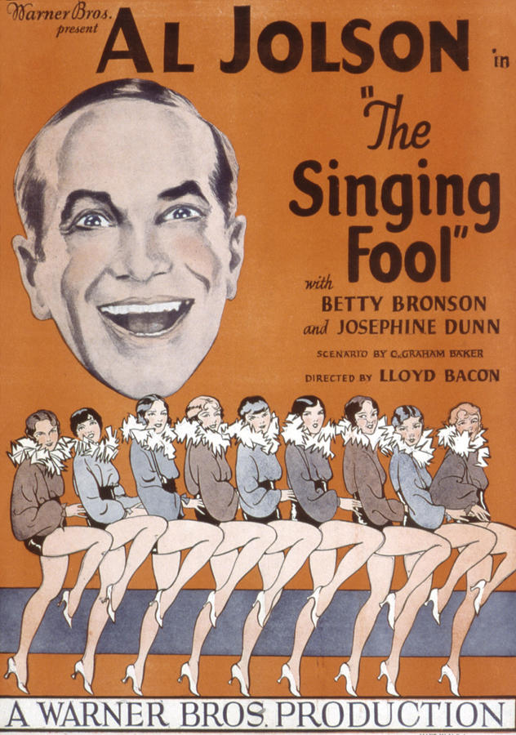
Musical Influences on Gershwin
Al Jolson
Famous for singing in black-face
George Gershwin’s first hit song, “Swanee,” was sung by Jolson
Starred in the first talkie,
The Jazz Singer
One of the most famous Jewish performers
https://dannyfriar.files.wordpress.com/2014/05/the-singing-fool-al-jolson-1928-everett.jpg

Slide 44
Review in the Forward
“It is a curious thing that there are so many points of resemblance between Jews and Negroes. . .
Is there an incongruity in this Jewish boy (Jolson) with his face painted like a Southern Negro singing in the Negro dialect? No, there is not. Indeed I detected again and again the minor key of Jewish music, the wail of the Chazan, the cry of anguish of a people who had suffered. The son of a line of rabbis well knows how to sing the songs of the most cruelly wronged people in the world’s history.”

Slide 45
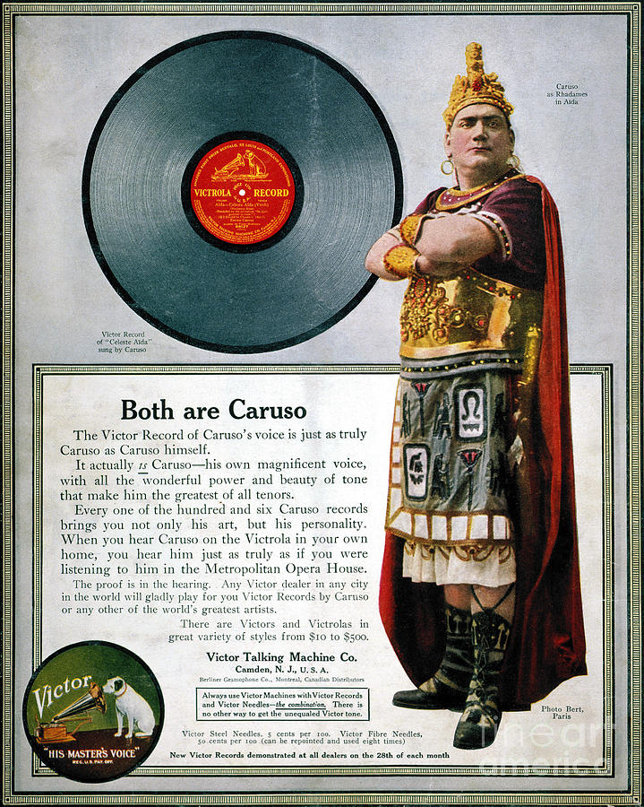
Musical Influences on Gershwin: Opera
Enrico Caruso
The most famous performer of the time.
Influenced both the Gershwin brothers and Louis Armstrong
Stage presence was a model for performers
“Mama Mia”
http://fineartamerica.com/featured/enrico-caruso-1873-1921-granger.html

Slide 46
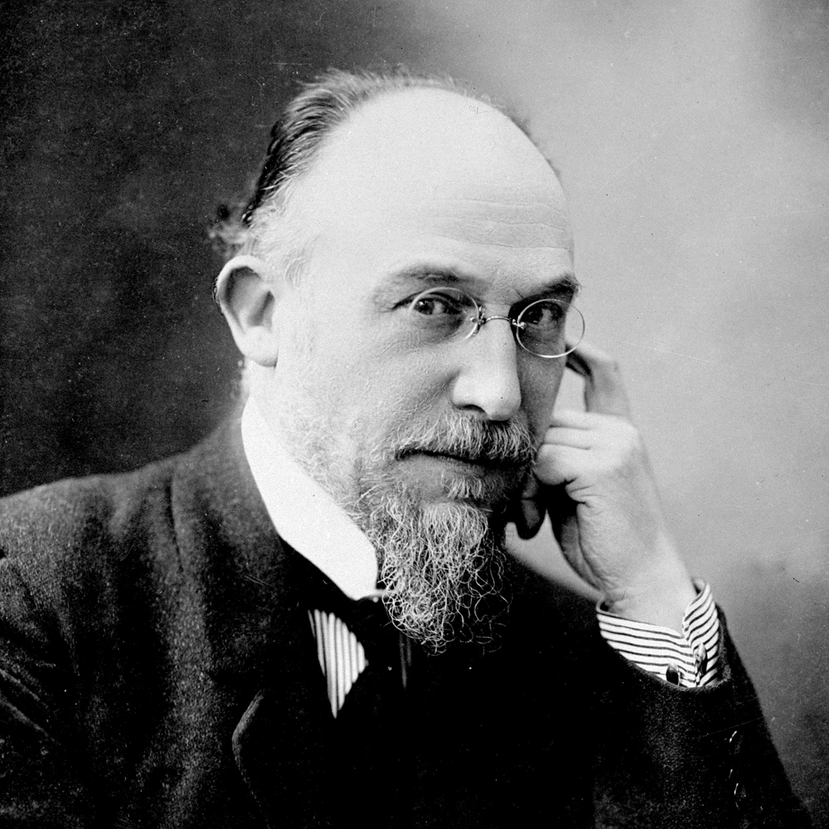
Musical Influences on Gershwin:
Erik Satie en.wikipedia.com

Slide 47
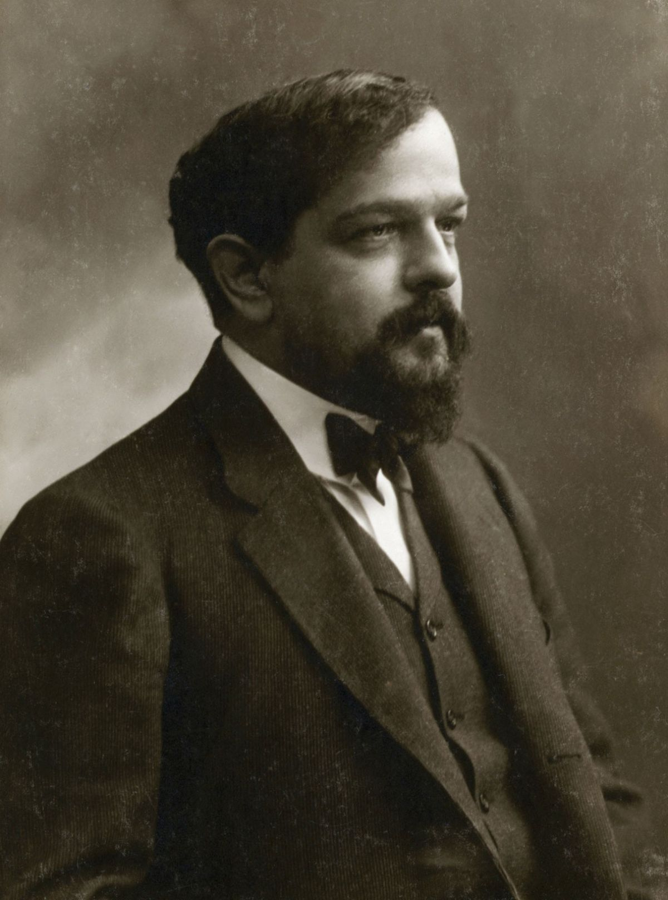
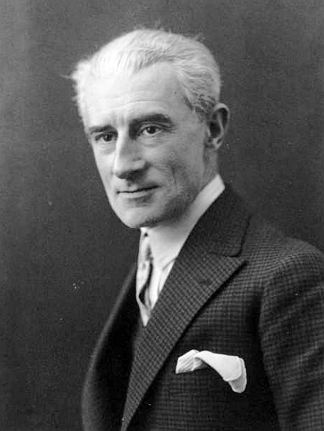
Musical Influences on Gershwin: Classical Music en.wikipedia.org
Claude Debussy
Maurice Ravel

Slide 48
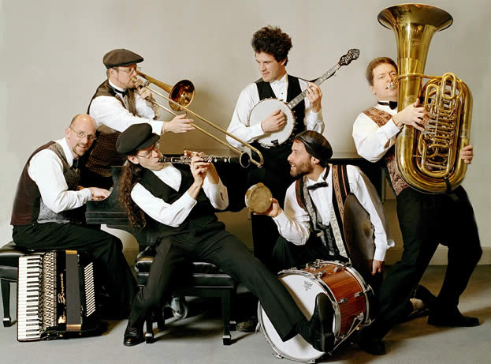
Musical Influences on Gershwin:
Klezmer Music
Musical tradition of the Ashkenazi Jews of Eastern Europe
Consists of dance tunes for weddings and other celebrations
Gershwin influenced by Yiddish music of his youth
Jazz clarinetists Benny Goodman and Artie Shaw grew up playing in klezmer groups
“Rhapsody in Blue”
http://calstate.fullerton.edu/news/2007/photos/shirimklezmer.jpg

Slide 49
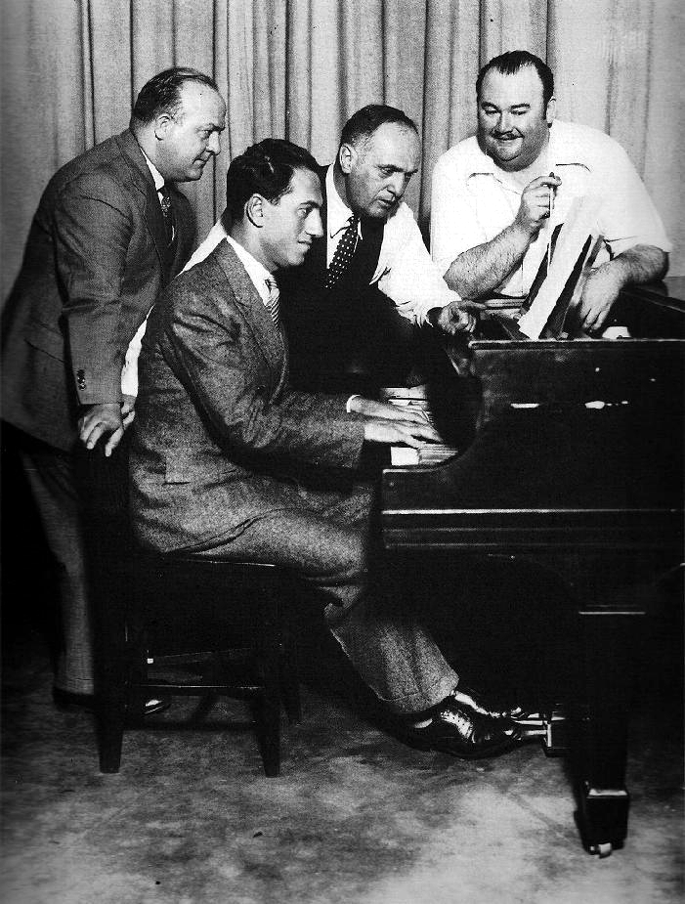
Musical Influences on Gershwin:
Ferde Grofe
Arranger for Paul Whiteman
Originally arranged “Rhapsody in Blue” for the Paul Whiteman Orchestra
Arrangement drew attention of New York Philharmonic which led to Gershwin’s commission
“Happy Feet”
“Grand Canyon Suite”
http://www.ferde-grofe.net/

Slide 50
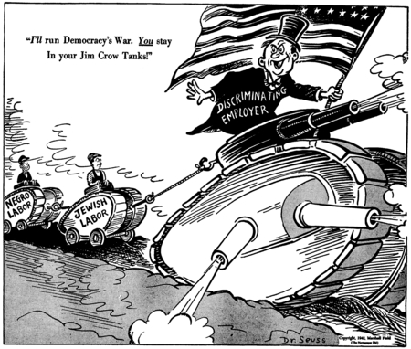
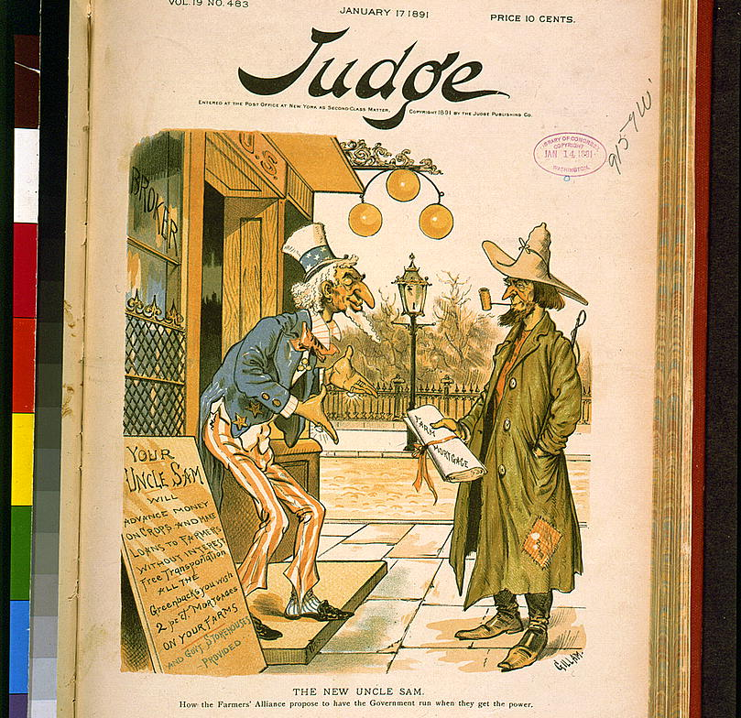
Reception/Reaction: Anti-Semitism
Analyzing Political Cartoons
http://library.ucsd.edu/speccoll/dswenttowar/index.html#q=%22racism%22&utf8=%E2%9C%93&op=AND&f[collection_sim][]=Dr.+Seuss+Political+Cartoons&sort=object_create_dtsi+asc%2C+title_ssi+asc&format=json
http://www.loc.gov/pictures/item/97504631/

Slide 51
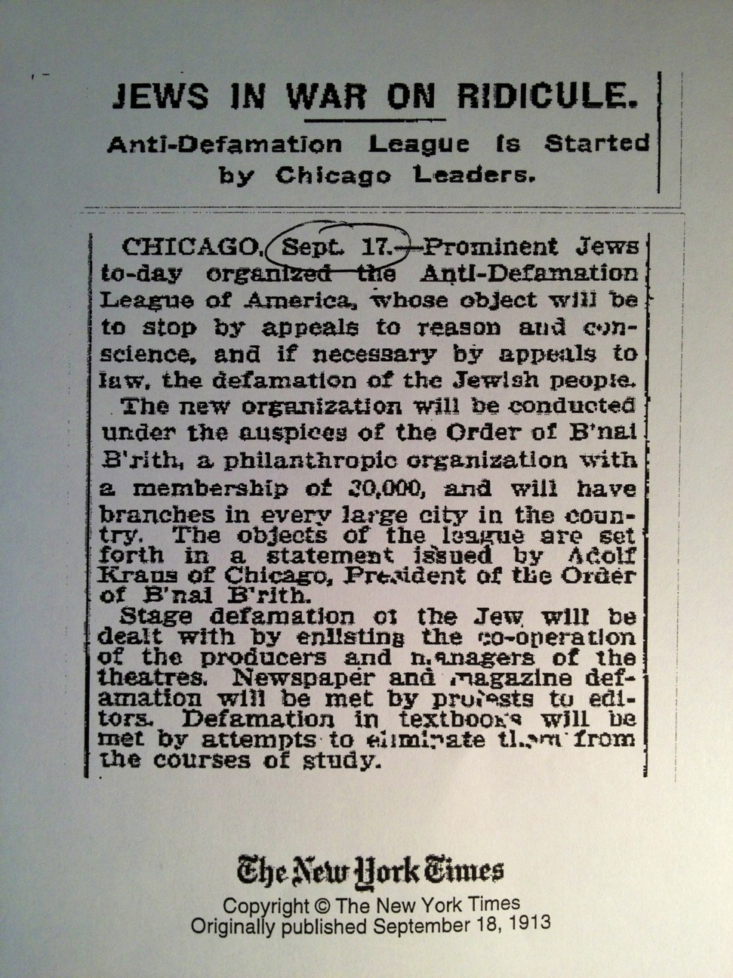
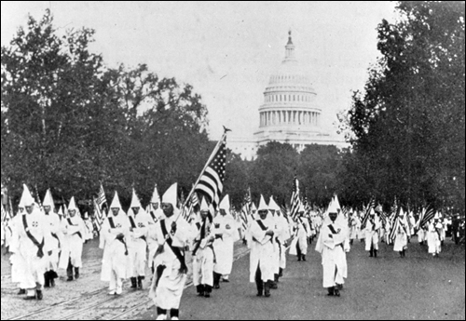
Nativism
http://www.adl.org/centennial/centennial-press-kit.html
https://www.fbi.gov/news/stories/2010/april/klan2_042910/the-fbi-versus-the-klan-part-2-trouble-in-the-1920s/

Slide 52
The Immigration Debate/Migrant Memoirs:
The Document Analysis Worksheet
James H. Patten, Testimony Before Congress (1910)
Hiram W. Evan’s “The Klan’s Fight for Americanism”
“Shut the Door,” Senator Ellison DuRant Smith (1924)
“Un-American Bill,” Rep. Robert H. Clancy (1924)
Abraham Cahan
Anzia Yezierska
Henry Roth

Slide 53
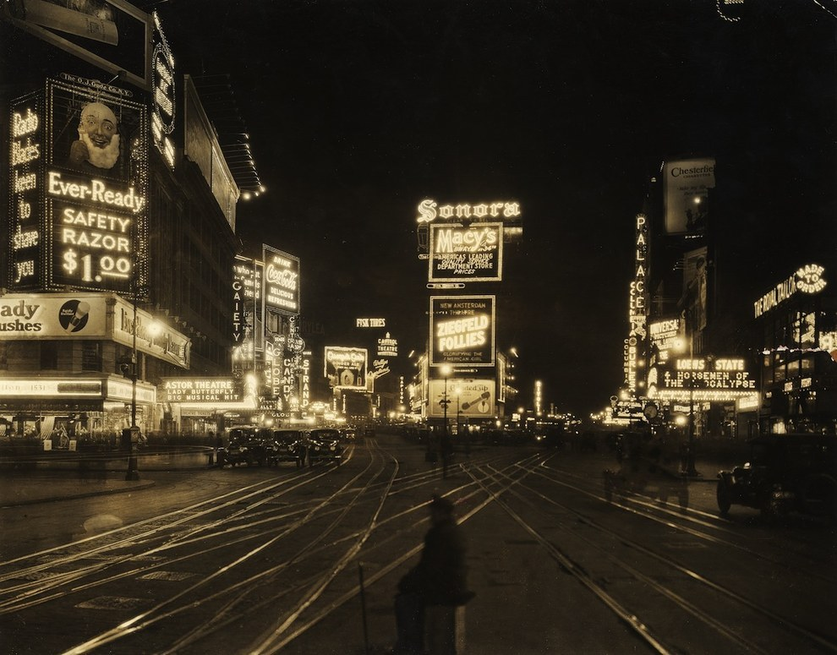
Alter Brody
“Ghetto Twilight”
“Times Square”
  (compare to McKay’s “The Tropics in New York”)
http://www.buzzfeed.com/perpetua/the-history-of-times-square-in-photos#.cq6xxNOO0

