Slide 1
Lift Every Voice
The Music of Black Women During the Civil Rights Movement

Slide 2
Women Demanding a Change:
The Protest Song as a Ticket to Ride in the
Civil Rights Movement
An interdisciplinary unit focusing on the historical and rhetorical power of black women and their protest songs.

Slide 3
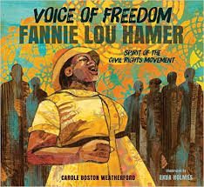
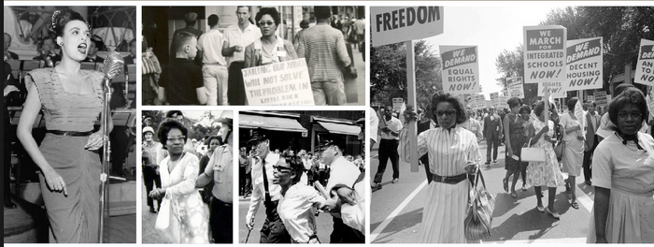
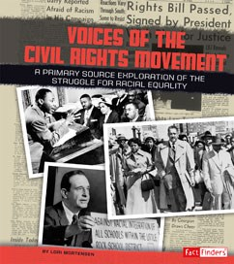
Voices of the Civil Rights Movement
Photo: Amazon.com
Photo: hbucollegian.com
Photo: Capstonepub.com

Slide 4
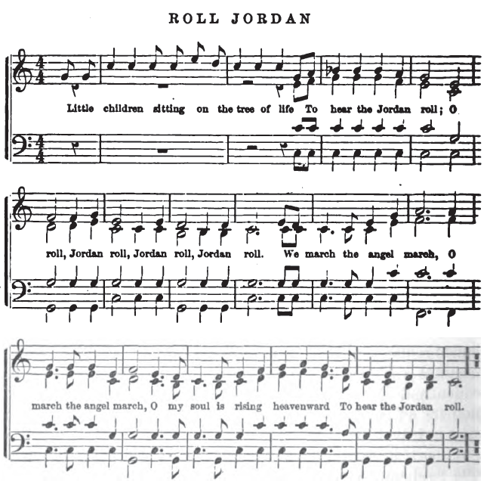
The Roots of the Protest Song
Songs begin a conversation among participants (both singer and audience members). Mimicking the call and response traditions of African American slaves in the 17th through 19th centuries, protest songs played a pivotal role in the fight for equal rights in the 20th century.
The song “Roll Jordan” contained double entendres about escaping from slavery to freedom.

Slide 5
Agency through Song...
“[Music] captures the soul in ways that few political speeches can; it has encouraged and inspired revolutions” -David Dunaway from Folk Protest and Political Music in the United States
For Black women specifically, the protest song emerged as a means to assert rhetorical power and to subvert the gendered constructs of the Civil Rights Movement.

Slide 6
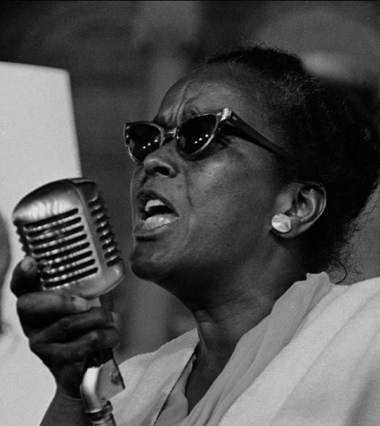
Ella Baker (1903-1986)
•NAACP staff member- 1938, President of NYC branch- 1952
•Organized SCLC’s Crusade for Citizenship in Georgia-1958
•Conflicts with male colleagues-“a determined woman”
•Emphasis on grassroots organizing- criticized top-down leadership
•Key advisor to student activists that created the student-led organization SNCC
•Helped organize Mississippi Freedom Democratic Party
•Life-long activist
Photo: http://chicagofreedomsummer.org
“The most powerful person in the struggle of the sixties was Miss Ella Baker, not Martin Luther King” -Stokley Carmichael

Slide 7
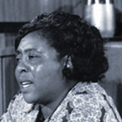
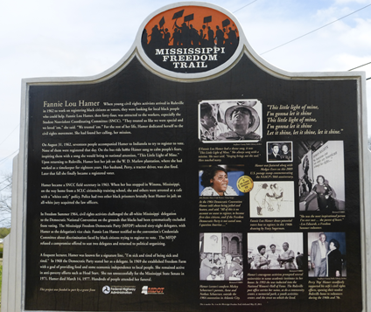
Fannie Lou Hamer (1917-1977)
Plantation sharecropper and timekeeper
1962- Inspired by SNCC activists, tried to register to vote- fired, lost home
1963- Beaten in Winona, Mississippi jail
1963- oldest SNCC employee
1964- Mississippi Freedom Democratic Party organizer
“I Question America”
Life-long civil rights activist
Photo: Black News Weekly
“I am sick and tired of being sick and tired.”
Photo: Marcie Hutchinson in Ruleville, Miss.

Slide 8
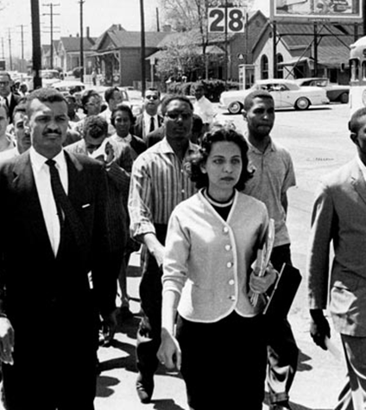
Diane Nash (1938-)
•Raised in Chicago- Fisk University (Nashville, TN)- first encounters with Jim Crow
•Attended James Lawson’s nonviolence workshops
•Student leader of Nashville sit-ins- “jail without bail”
•SNCC founding member
•Freedom Rides, Birmingham, March on Washington, Selma activist
•Chicago public school teacher
•Activist- housing, welfare
Photo: http://www.pbs.org/wgbh/americanexperience/freedomriders/assets/images/stills/81587.jpg
“First of all, Mayor West, do you feel that it’s wrong to discriminate against a person solely on the basis of his race or color?”

Slide 9
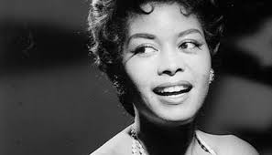
Abbey Lincoln (1930-2010)
•born Chicago, Ill.
•moved to NYC (Village Vanguard)
•married bebop drummer and composer Max Roach
•artist and activist
•fund raiser for NAACP, CORE
•NEA Jazz Masters Award
“The best thing you can do is to be a woman and stand before the world and speak your heart.”

Slide 10
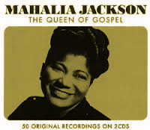
Mahalia Jackson (1911-1972)
“Queen of Gospel”
•Born in New Orleans
•Moved to Chicago 1928
•1947 solo gospel album sold 8 million copies- international fame
•Appeared with Dr. King – speeches, fundraisers
•“Voice” of the Movement- inspiration of her singing
“Tell them about the dream, Martin.”

Slide 11
Mahalia Jackson (continued)
One of the most famous events in the movement was the March on Washington and, according to Olson, “only one person seemed to care that, in the planning for what the leaders hoped would be the most glorious moment of the civil rights struggle, women had been completely ignored” (284).
<iframe width="640" heig
Rosa Parks and other important female figures were silenced; on such a monumental day in America, the only medium which allowed women to have a prominent voice, was through song.

Slide 12
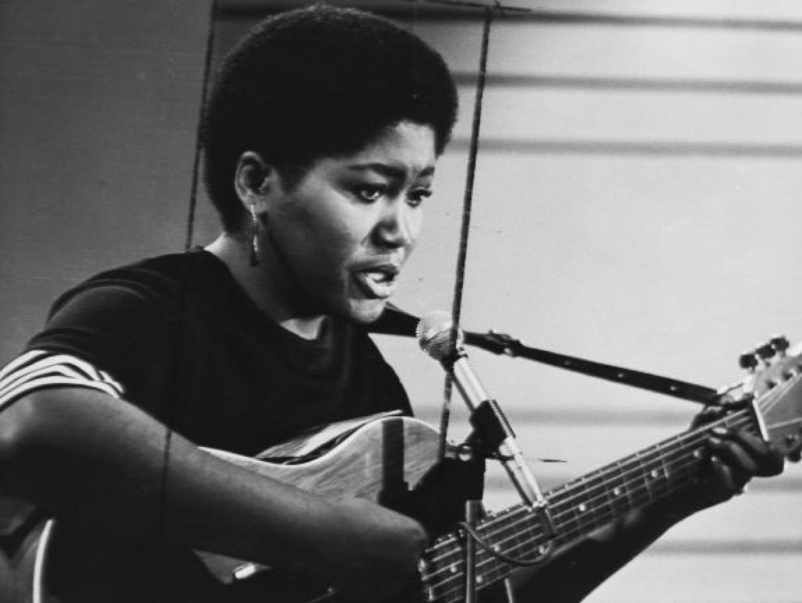
Odetta Holmes (1930-2008)
“Soundtrack of the Civil Rights Movement”
•Born in Birmingham, Alabama
•Moved to Los Angeles
•Trained as classical (opera) singer
•Influenced by folk, blues and gospel
•“Odetta Strum”
•Participant March on Washington (1963 and 1983) and Selma to Montgomery March
•NEA National Medal of the Arts
•Library of Congress Living Legend
Photo: nydailynews.com
“Through those songs, I learned things about the history of black people in this country that the historians in school had not been willing to tell us about or had lied about.” -Odetta

Slide 13
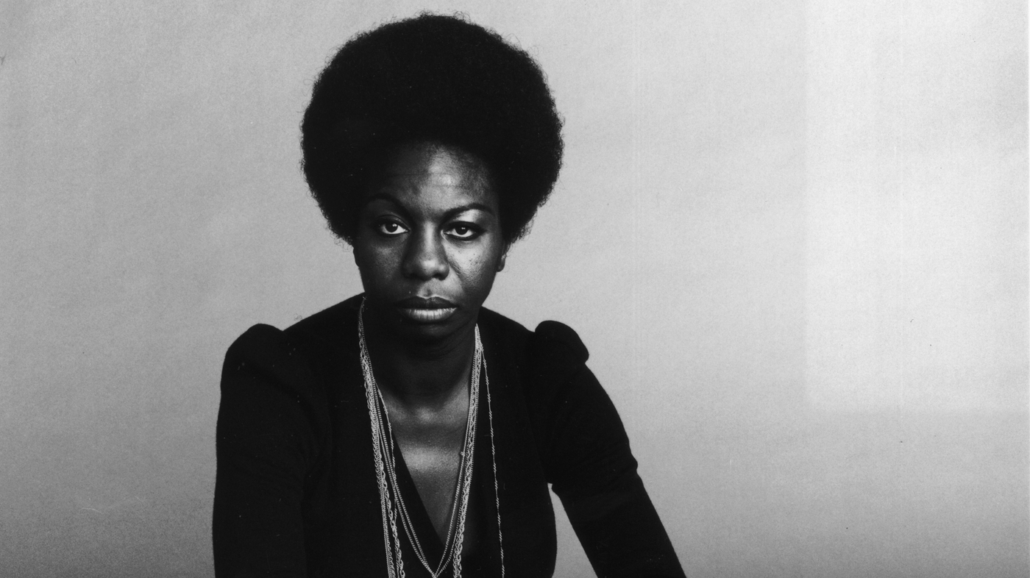
Nina Simone (1933-2003)
“High Priestess of Soul”
•Born Eunice Waymon in North Carolina
•Dreamed of becoming first black classical pianist
•Denied scholarship at Curtis Institute of Music (Philadelphia)
•Moved to New York to study classical piano at Juilliard
•Played clubs – creating name Nina Simone, so at not to offend mother, became a singer
•Fused gospel and pop with classical
•Stated, “I am not non-violent!” to Dr. King
•Civil Rights activist – performances at and compositions about events of the Movement
Photo: NPR.org

Slide 14
Nina Simone (continued)
This experience for Simone was “[l]ike switching on a light” and from that point on, she never flinched from expressing her outrage about the racism she witnessed in the movement’s twists and turns.
You don’t have to live next to me
Just give me my equality
Everybody knows about Mississippi
Everybody knows about Alabama
Everybody knows about Mississippi Goddam
More militant in her rhetoric, Simone’s song was a “war cry,” expressing her refusal to wait for equal rights.

Slide 15
Mavis Staples (1939-)
•Born 1939 in Chicago
•Began career with her family’s group,
The Staples Singers
•Immensely Popular Gospel Group
•Mahalia Jackson, family friend
•Father, Roebuck “Pops” Staples was close friend of Dr. Martin Luther King, “Voices of the Civil Rights Movement”
•Staple Singers- Gospel turned Soul
•Grammy Award Winner
“But the struggle lives on.”
-Mavis Staples

Slide 16
The Potential for Scholarship...
Hobson notes that the marginalized status of the female Black singer simultaneously subdues her voice while its status as “the quintessential American voice” affords her a gateway to influence; however, this power may be borne of her “struggle between objectification and agency” (445).
The rhetorical acts of such women as Marian Anderson, Billie Holiday, Mahalia Jackson, Nina Simone and others stand as not only a call to action for racial equality, but simultaneously an act of defiance against the constraints of the patriarchal social constructs of the time. Black women used their “voices” to defy gendered roles, to subvert racial limits on speech, and to ultimately chart a new path toward equality.

Slide 17
Essential Questions to Pursue
What are the qualities of effective leadership?
Why is activism essential to a participatory democracy?
How can songs motivate and sustain activism that seeks positive social change? How have songs given a voice to the voiceless throughout history?
What rhetorical methods allowed women to emerge as leaders of the movement?
How did the protest song afford women “a place at the table”?
What are the rhetorical elements of the protest song?
What are the rhetorical situations of women who gained leadership roles by sharing a protest song?
What female rhetorical acts of song have been understudied in the literature and what connections exist among them?

Slide 18
Protest Song Analysis and Composition Project
Arizona College and Career Ready Standards
1. Cite strong and thorough textual evidence to support analysis of what the text says explicitly as well as inferences drawn from the text. (9-10.RI.1)
2. Determine a central idea of a text and analyze its development over the course of the text, including how it emerges and is shaped and refined by specific details; provide an objective summary of the text. (9-10.RI.2)
5. Analyze in detail how an author’s ideas or claims are developed and refined by particular sentences, paragraphs, or larger portions of a text (e.g., a section or chapter). (9-10.RI.5)
1. Write arguments to support claims in an analysis of substantive topics or texts, using valid reasoning and relevant and sufficient evidence.
a. Introduce precise claim(s), distinguish the claim(s) from alternate or opposing claims, and create an organization that establishes clear relationships among claim(s), counterclaims, reasons, and evidence.
b. Develop claim(s) and counterclaims fairly, supplying evidence for each while pointing out the strengths and limitations of both in a manner that anticipates the audience’s knowledge level and concerns.
c. Use words, phrases, and clauses to link the major sections of the text, create cohesion, and clarify the relationships between claim(s) and reasons, between reasons and evidence, and between claim(s) and counterclaims.
d. Establish and maintain a formal style and objective tone while attending to the norms and conventions of the discipline in which they are writing.
e. Provide a concluding statement or section that follows from and supports the argument presented. (9-10.W.1)

Slide 19
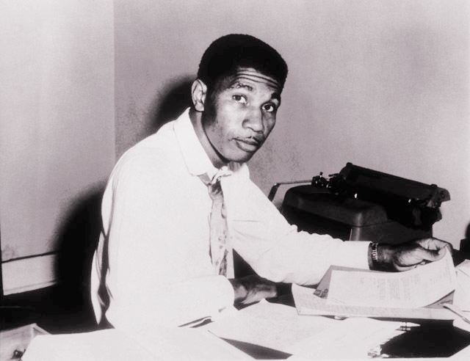
Medgar Evers Assassination
•WWII Veteran
•NAACP’s field representative in Mississippi
•Active in James Meredith’s enrollment at the University of Mississippi
•Led a large-scale campaign against segregation in Jackson, MS
•Gunned down in his driveway outside of his home by white supremacists on June 12, 1963.
•Killer convicted of murder in 1994
Photo: abcnews.go.com

Slide 20
Interview with Myrlie Evers
Video: from Visionary Project

Slide 21
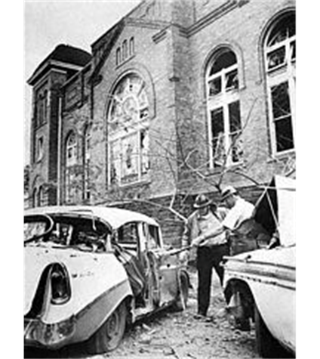
Bombing of the 16th St. Baptist Church, Birmingham, Alabama
•18 Days after March on Washington, Sunday morning, September 15, 1963
•15 people injured
•Denise McNair (11), Cynthia Wesley, Carole Robertson, Addie Mae Collins (14) killed
•First assassin convicted in 1977, two others in 2001 and 2002
Photo: Corbis.com

Slide 22
Bombing of the 16th St. Baptist Church
Video: from PBS’s Eyes on the Prize

Slide 23
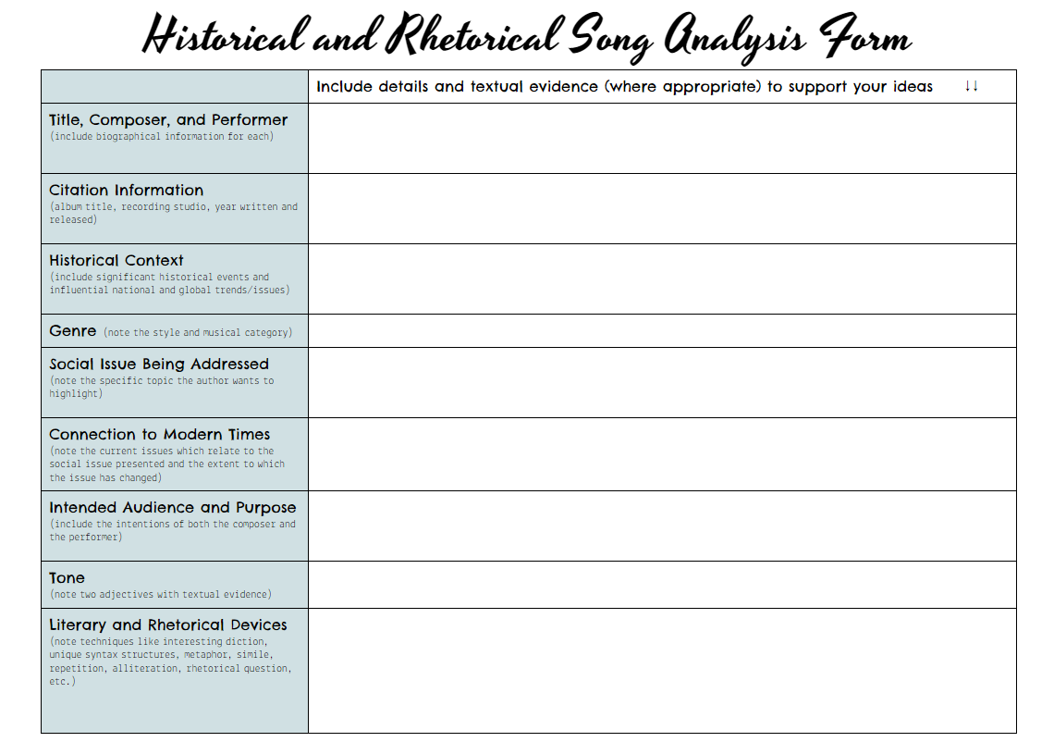
Protest Song Analysis
Students choose a song from among a selected list or choose their own (with teacher approval). Tackling the song as an argument composition, students will analyze how the songwriter presents a claim, supports it using evidence, and explains how the evidence supports the call for change.

Slide 24
“Mississippi Goddam” by Nina Simone
The name of this tune is Mississippi Goddam
And I mean every word of it
Alabama's gotten me so upset
Tennessee made me lose my rest
And everybody knows about Mississippi Goddam
Alabama's gotten me so upset
Tennessee made me lose my rest
And everybody knows about Mississippi Goddam
Can't you see it? Can't you feel it?
It's all in the air
I can't stand the pressure much longer
Somebody say a prayer
Alabama's gotten me so upset
Tennessee made me lose my rest
And everybody knows about Mississippi Goddam...
...Oh, but this whole country is full of lies
You're all gonna die and die like flies
I don't trust you any more
You keep on saying, "Go slow! Go slow!"
But that's just the trouble, do it slow
Desegregation, do it slow
Mass participation, do it slow
Reunification, do it slow
Do things gradually, do it slow
But bring more tragedy, do it slow
Why don't you see it? Why don't you feel it?
I don't know, I don't know
You don't have to live next to me
Just give me my equality
Everybody knows about Mississippi
Everybody knows about Alabama
Everybody knows about Mississippi Goddam
That's it!

Slide 25
“Mississippi Goddam” by Nina Simone

Slide 26
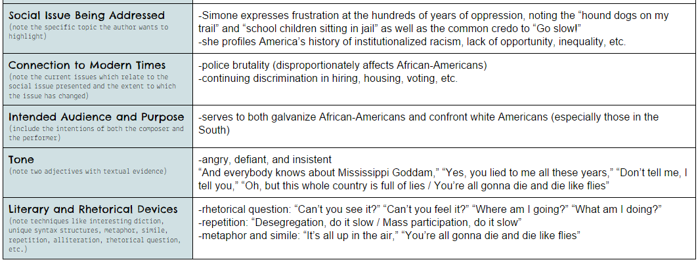
“Mississippi Goddam” by Nina Simone

Slide 27
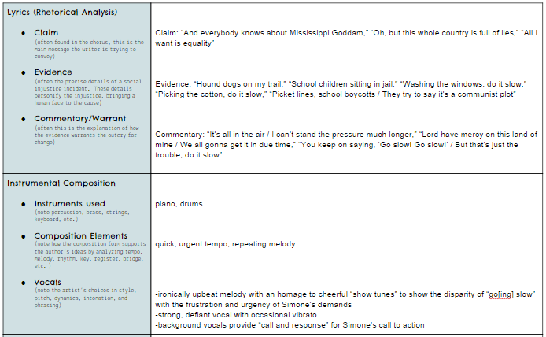
“Mississippi Goddam” by Nina Simone

Slide 28
Mavis Staples “In the Mississippi River”
written by Marshall Jones
In the Mississippi River
Lord, Lord, Lord, Lord
In the Mississippi River
Lord, Lord, Lord, Lord
In the Mississippi River
Well, you can count them one by one
It could be your son
Well, you can count them two by two
It could be me or you
Well, you can count them three by three
Do you wanna see?
Well, you can count them four by four
And you can count them eight
And they are gone because of hate
And you can count them nine by nine
In Mississippi this ain’t no crime
And you can count them ten by ten
And we wonder when the right will win
In the Mississippi River
Lord, Lord, Lord, Lord
In the Mississippi River
Lord, Lord, Lord, Lord
In the Mississippi River
We’re going stop them from going in the river We’re going stop them from going in the river With their heads cut off Tied by their hands Tied by their feet
Oh, well-a into the river they go
Oh, well-a into the river they go
Well, you can count them five by five With their hands tied
And they don’t come out alive
And their feet tied
And you can count them six by six Holes throughout the body
In Mississippi, they got it fixed
Like Goodman
And you can count them seven by seven
Like Schwerner
The Mississippi River sure ain’t heaven
And Chaney

Slide 29
“In the Mississippi River”
written by Marshall Jones

Slide 30
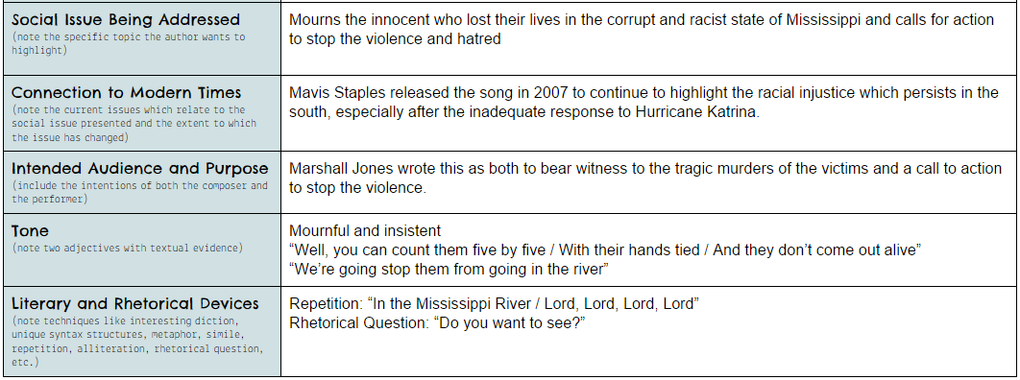
“In the Mississippi River”
written by Marshall Jones

Slide 31
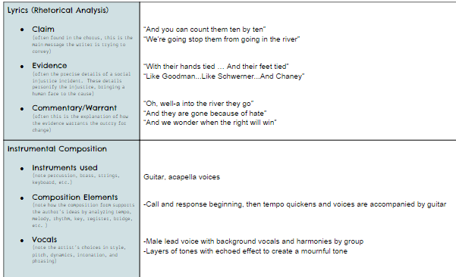
“In the Mississippi River”
written by Marshall Jones

Slide 32
Protest Song Analysis Project
Visit the PBS website, Independent Lens: Strange Fruit, and read about the works of protest from the timeline.
Decide on a songwriter and song to analyze.
Work together to analyze the lyrics and music using the Historical and Rhetorical Analysis Form
Create an e-poster to present your findings.
Rubric:
Prewriting form ____/15
Content (does it cover all aspects above and does it show thoughtful analysis?) ____/30
Clarity/Professionalism (is it clear, organized, and professional?) ____/15
Creativity (does it accomplish its purpose in a unique way?) ____/15
Total ____/75 points

Slide 33
Steps to Writing a Protest Song
Civil Rights Article Analysis
Choose a significant non-fiction article which profiles a civil rights issue or an issue of discrimination.
Once you make a choice, number the paragraphs in your article.
Preview the title, subtitles, images, and graphs/charts.
Begin reading your article, annotating for main ideas, important details, and significant explanations.
Next, skim through your annotations and think about what claim you may want to create based on your annotations (your claim is the main argument you are presenting in your song).

Slide 34
Steps to Writing a Protest Song
Song Composition
Now, using the information from your article, begin to think of a chorus or refrain which sums up the struggle (this will likely be your main claim). Refine and revise until you have a chorus which is catchy and strong.
Begin to draft your song/poem using important details from the article. Be sure to also add lines which explain your details and support your claim statement (in your chorus/refrain). If you are writing a song, you can write your own musical background or use a karaoke version of a song you like. You don’t need to be musically gifted to write a song, just be willing to have some type of beat/melody in the background (even if it is just a bongo drum, tambourine, or harmonica).

Slide 35
Steps to Writing a Protest Song
Requirements
Minimum requirements for protest song/poem:
Must be at least 20-25 lines long
Must have a title
Must have a chorus or refrain
Must include at least five examples of literary or rhetorical elements (simile, metaphor, personification, repetition, parallel structure, imagery etc.)
Must have an identifiable claim (main argument), supporting evidence (including historical detail), and commentary (explanation)
Must address a societal issue of inequity or discrimination

Slide 36
Steps to Writing a Protest Song
Revision and Rehearsal
Once you have a working draft, revise draft for syntax (flow), diction, and conventions and the smooth pairing with the music.
Type using a standard 12 point font (Don’t forget your heading!)
Prepare for performance in class by rehearsing at least 8-10 times.
Get ready for your performance!

Slide 37
Poem by Poem by Juan Felipe Herrera
Poem by Poem
— in memory of Cynthia Hurd, Susie Jackson, Ethel Lance, Rev. DePayne Middleton-Doctor, Rev. Clementa Pinckney, Tywanza Sanders, Rev. Daniel Simmons Sr., Rev. Sharonda Singleton, Myra Thompson Shot and killed while at church. Charleston, SC (6-18-2015), RIP
poem by poem we can end the violence
every day after
every other day
9 killed in Charleston, South Carolina
they are not 9 they
are each one
alive
we do not know
you have a poem to offer
it is made of action — you must
search for it run
outside and give your life to it
when you find it walk it
back — blow upon it
carry it taller than the city where you live
when the blood come down
do not ask if
it is your blood it is made of
9 drops
honor them
wash them stop them
from falling
Excerpt from Notes on the Assemblage, copyright 2015 by Juan Felipe Herrera. Reprinted by permission of City Lights Books.

